Slide 1
Understanding Dropout from Treatment for Problem and Disordered Gambling
Rory A. Pfund, PhD
Research Director, Tennessee Institute for Gambling Education and Research (TIGER)
Research Assistant Professor, Department of Psychology, University of Memphis
Desert Diamond Casino Presentation
December 10, 2024

Slide 2


Funding

Slide 3



TIGER

Slide 4

www.thegamblingclinic.com

Slide 5


Slide 6
Available Treatments
Psychotherapy
Self-guided treatments (online, self-help workbook)
Personalized feedback
Mutual help groups
**no FDA approved medications for gambling disorder

Slide 7
Available Treatments
Psychotherapy
Self-guided treatments (online, self-help workbook)
Personalized feedback
Mutual help groups
**no FDA approved medications for gambling disorder

Slide 8
Outcomes at Posttreatment
Dowling et al. (2023) Cochrane Database of Systematic Reviews
Forman et al. (2024) manuscript under review
Goslar et al. (2017) Journal of Behavioral Addictions
Pfund et al. (2023) Clinical Psychology Review
Smith et al. (2024) manuscript under review

Slide 9
Cognitive-Behavioral Treatment (CBT) on Gambling Outcomes
Pfund et al. (2023) Addiction

Slide 10
CBT on Co-Occurring Outcomes
Pfund et al. (2023) Psychology of Addictive Behaviors

Slide 11
CBT Response Rates
Pfund et al. (2023) Addiction

Slide 12
Various CBT Components
Relapse prevention
Cognitive restructuring
Behavioral substitution
Stimulus control
Problem solving
Self-monitoring
Imaginal desensitization
Exposure
Financial management
Social comparison
Social skills training
Goal setting
Rodda et al. (2018) Journal of Behavioral Addictions

Slide 13
Association between Attendance and Outcomes
Pfund et al. (2020) Psychology of Addictive Behaviors
Notes:
Outcomes include gambling behavior (FID) and symptoms

Slide 14
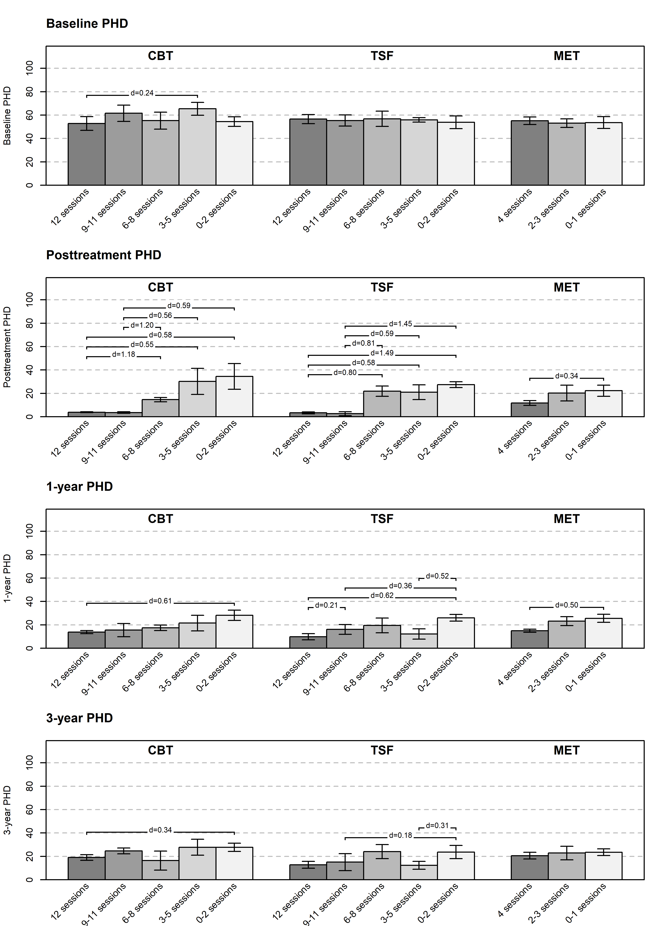
How Many Sessions are Needed?
Pfund et al. (2021) Journal of Consulting and Clinical Psychology

Slide 15
How Many Sessions are Needed?
Pfund et al. (2021) Journal of Consulting and Clinical Psychology

Slide 16
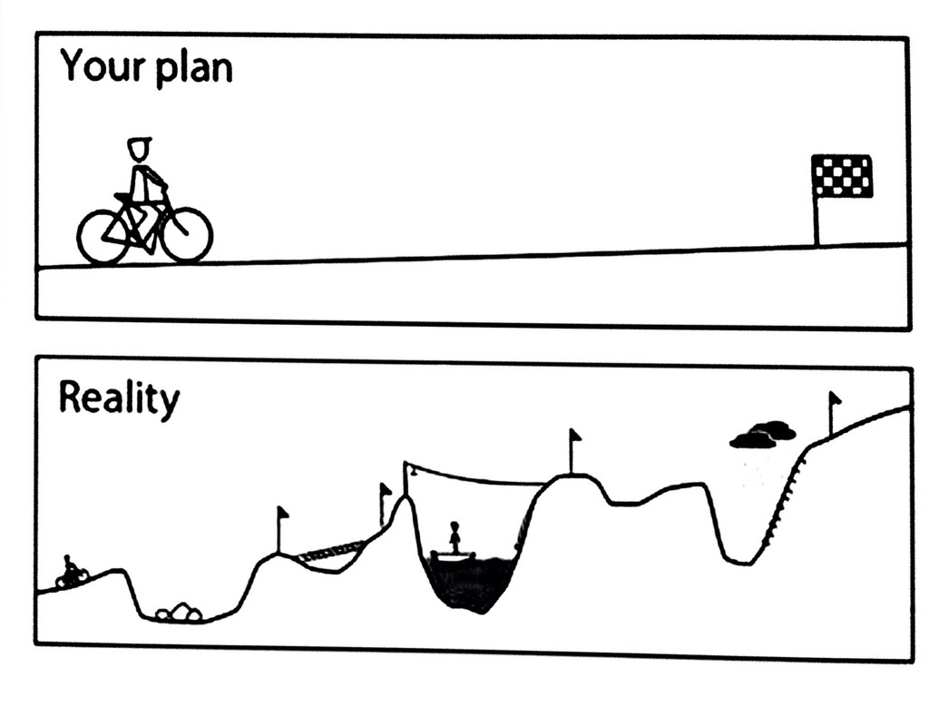
First point of contact
Termination

Slide 17
First point of contact
Termination

Slide 18

The Treatment Gap
About 39% of individuals drop out of treatment
Pfund et al. (2021) Psychology of Addictive Behaviors

Slide 19
What is “Dropout?”
When an individual initiates treatment and then leaves it before completion
Different from not seeking treatment
Notes:
It is assumed in research and clinical settings that discontinuation is an undesirable outcome but there is little empirical evidence on this.

Slide 20
Implicit Assumptions
People do not want to change
Treatment is always necessary
We know what is best for people
Pfund et al. (2022) Journal of Addiction Medicine

Slide 21
Problems with Assumptions
People do want to change
Treatment is not always necessary
People often have preferences for what is best for them
Pfund et al. (2022) Journal of Addiction Medicine

Slide 22
Definitions
Common definitions:
  Attending a portion of a treatment
  Attending all sessions of a treatment
  Therapist judgment
  **each definition universally applied to all people in treatment**
Pfund et al. (2021) Psychology of Addictive Behaviors

Slide 23
Dropout Rates by Definitions
 | Dropout Rate | 95% Confidence Interval | Q-value | p-value
Dropout definition (# of studies) |  |  | 51.08 | < .001
Attending some sessions (9) | 33.2% | 25.5%, 41.9%
Attending all sessions (10) | 64.1% | 57.0%, 70.6%
Therapist judgment (12) | 27.2% | 20.7%, 35.0%
Pfund et al. (2021) Psychology of Addictive Behaviors
Notes:
Difficult to guide clinicians toward identifying individuals who might be at high risk for leaving treatment without getting the help they need.

Slide 24
Preferred Terms
Say This | Not That
Discontinuation/attendance | Dropout
Pfund et al. (2022) Journal of Addiction Medicine

Slide 25

Discontinuation at Initial Contact
In our clinic, 50% of clients who schedule an initial appointment for face-to-face outpatient treatment do not show

Slide 26
Discontinuation throughout Treatment
Pfund et al. (2018) Journal of Gambling Studies

Slide 27
Advancing A New Definition
Discontinuation relative to session-to-session changes in outcome
  Those who do not respond during treatment or even worsen (discontinuation)
  Those who respond and sustain throughout treatment (treatment completion)

Slide 28
Discontinuation (No response)
Pfund et al. (2018) Journal of Gambling Studies

Slide 29
Completion (Responded and sustained)
Pfund et al. (2018) Journal of Gambling Studies

Slide 30
Overlap with Other Definitions
70% of sample classified correctly
30% of the sample classified incorrectly (i.e., classified as dropout in one definition and completer in the other)
 | Dropout Classified as Not Responding
Dropout Classified as Attending <3 Sessions | Yes | No
Yes | 30%
No |  | 40%
Pfund et al. (2018) Journal of Gambling Studies

Slide 31
Overlap with Other Definitions (continued)
11% of individuals who responded were classified as “dropouts” according to other definition
 | Dropout Classified as Not Responding
Dropout Classified as Attending <3 Sessions | Yes | No
Yes | 30% | 11%
No |  | 40%
Pfund et al. (2018) Journal of Gambling Studies

Slide 32
Overlap with Other Definitions (continued)
19% of individuals who did not respond were classified as “treatment completers” according to the other definition
 | Dropout Classified as Not Responding
Dropout Classified as Attending <3 Sessions | Yes | No
Yes | 30% | 11%
No | 19% | 40%
Pfund et al. (2018) Journal of Gambling Studies

Slide 33
In Other Words…
**Discontinuation based solely on session attendance may discredit the meaningful progress that some individuals make during treatment**
**Discontinuation based solely on session attendance may prevent us from identifying individuals who need more sessions**

Slide 34
Monitoring Progress
Assess individuals’ progress at the beginning of each session
Reflect on individuals’ reactions to treatment progress
What to monitor?
Gambling behavior (e.g., money wagered)
Symptoms (e.g., Gambling Symptom Assessment Scale)
Self-efficacy (e.g., Gamblers’ Self-Efficacy Questionnaire)
Treatment goals (e.g., abstinence, sticking to money or time limits)
Notes:
Difficult to guide clinicians toward identifying individuals who might be at high risk for leaving treatment without getting the help they need.

Slide 35
Take Home Points
Use the terms “discontinuation” and “attendance” rather than “dropout”
Most people will discontinue treatment after scheduling the initial session or after attending the first session
Monitor behaviors throughout treatment to determine when to terminate

Slide 36
Thank you!
Questions?
Email: rapfund@memphis.edu
Website: www.thegamblingclinic.com
Office: 901-678-8720

