Slide 1
Treating Gambling Harms valuable strategies to engage & retain our clients
James P Whelan, PhD
The Gambling Clinic
Tennessee Institute for Gambling Education and Research
The University of Memphis
2.27.23

Slide 2
Where are we going
A bit of background
What are they waiting for?
    Client engagement & treatment hesitancy
Please don’t leave!
    Decreasing premature treatment termination

Slide 3


In 1998…

Slide 4













Problems/Disorder
Not gambling Recreational Problem Gambling &
Gambling disorder
Notes:
!% to 2% = disordered gamblers 3-4% some symptoms
Rare event
Diagnosis – 4 of possible 9 symptoms; diagnosis requires interview;
Handy view: 1. Gambles 2. Gambling = problems 3. Still Gambles

Slide 5
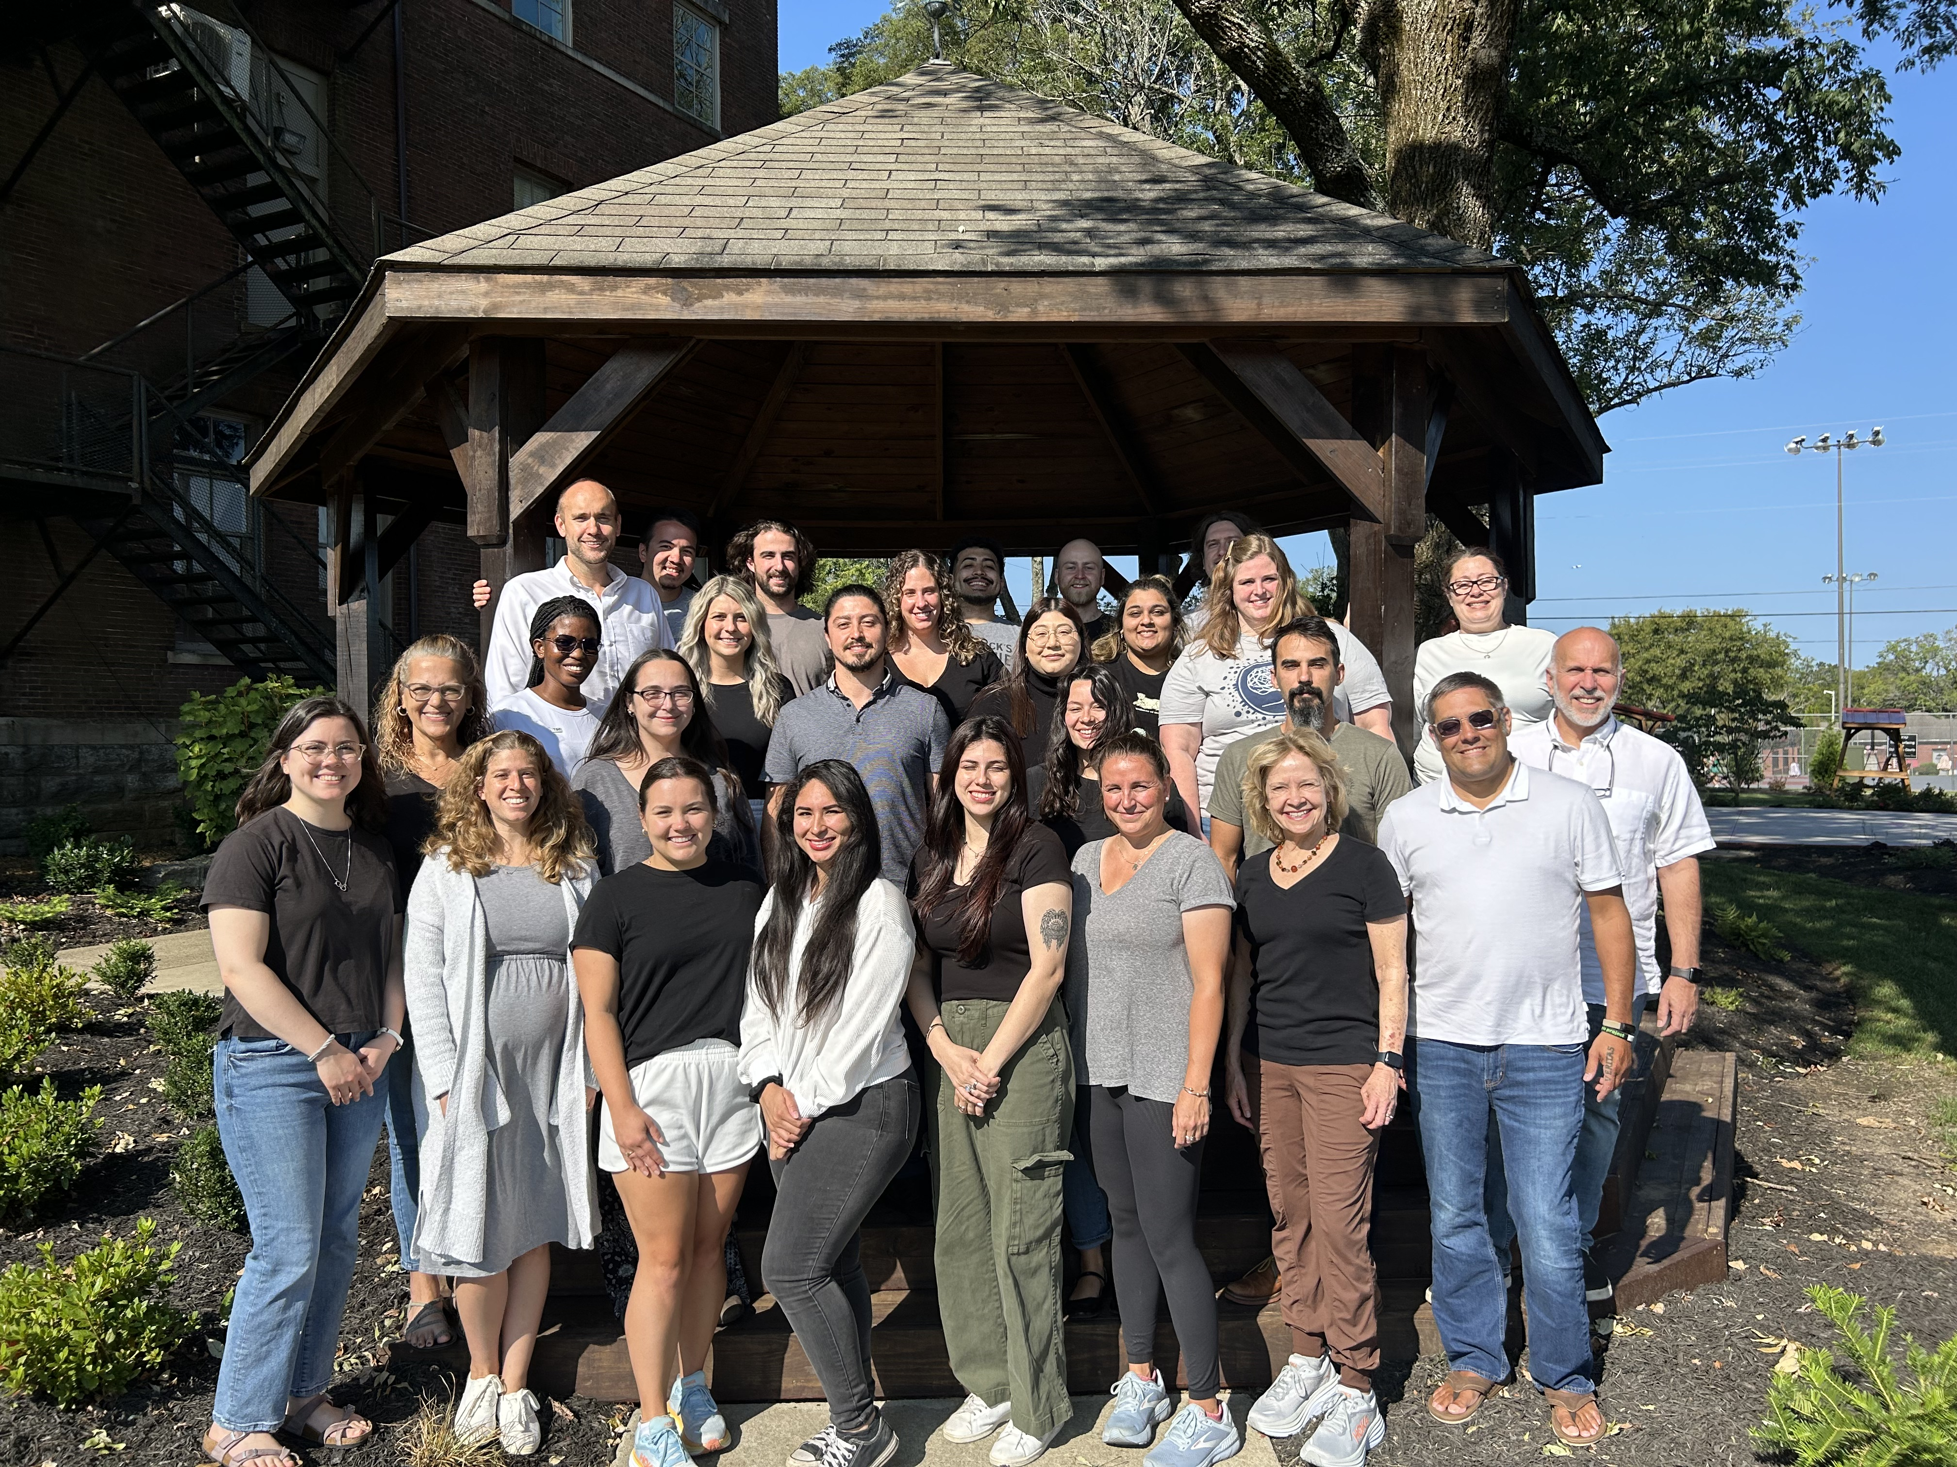




Slide 6
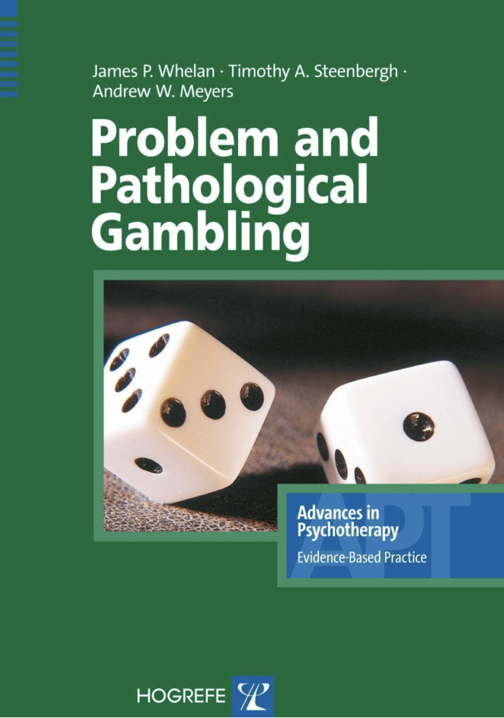
the research lab
the therapy room

Slide 7
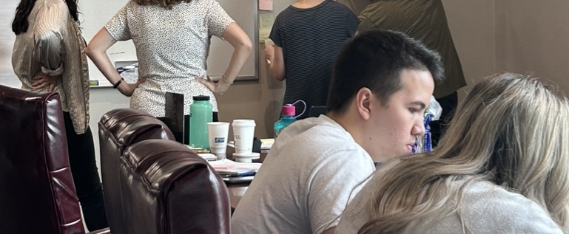
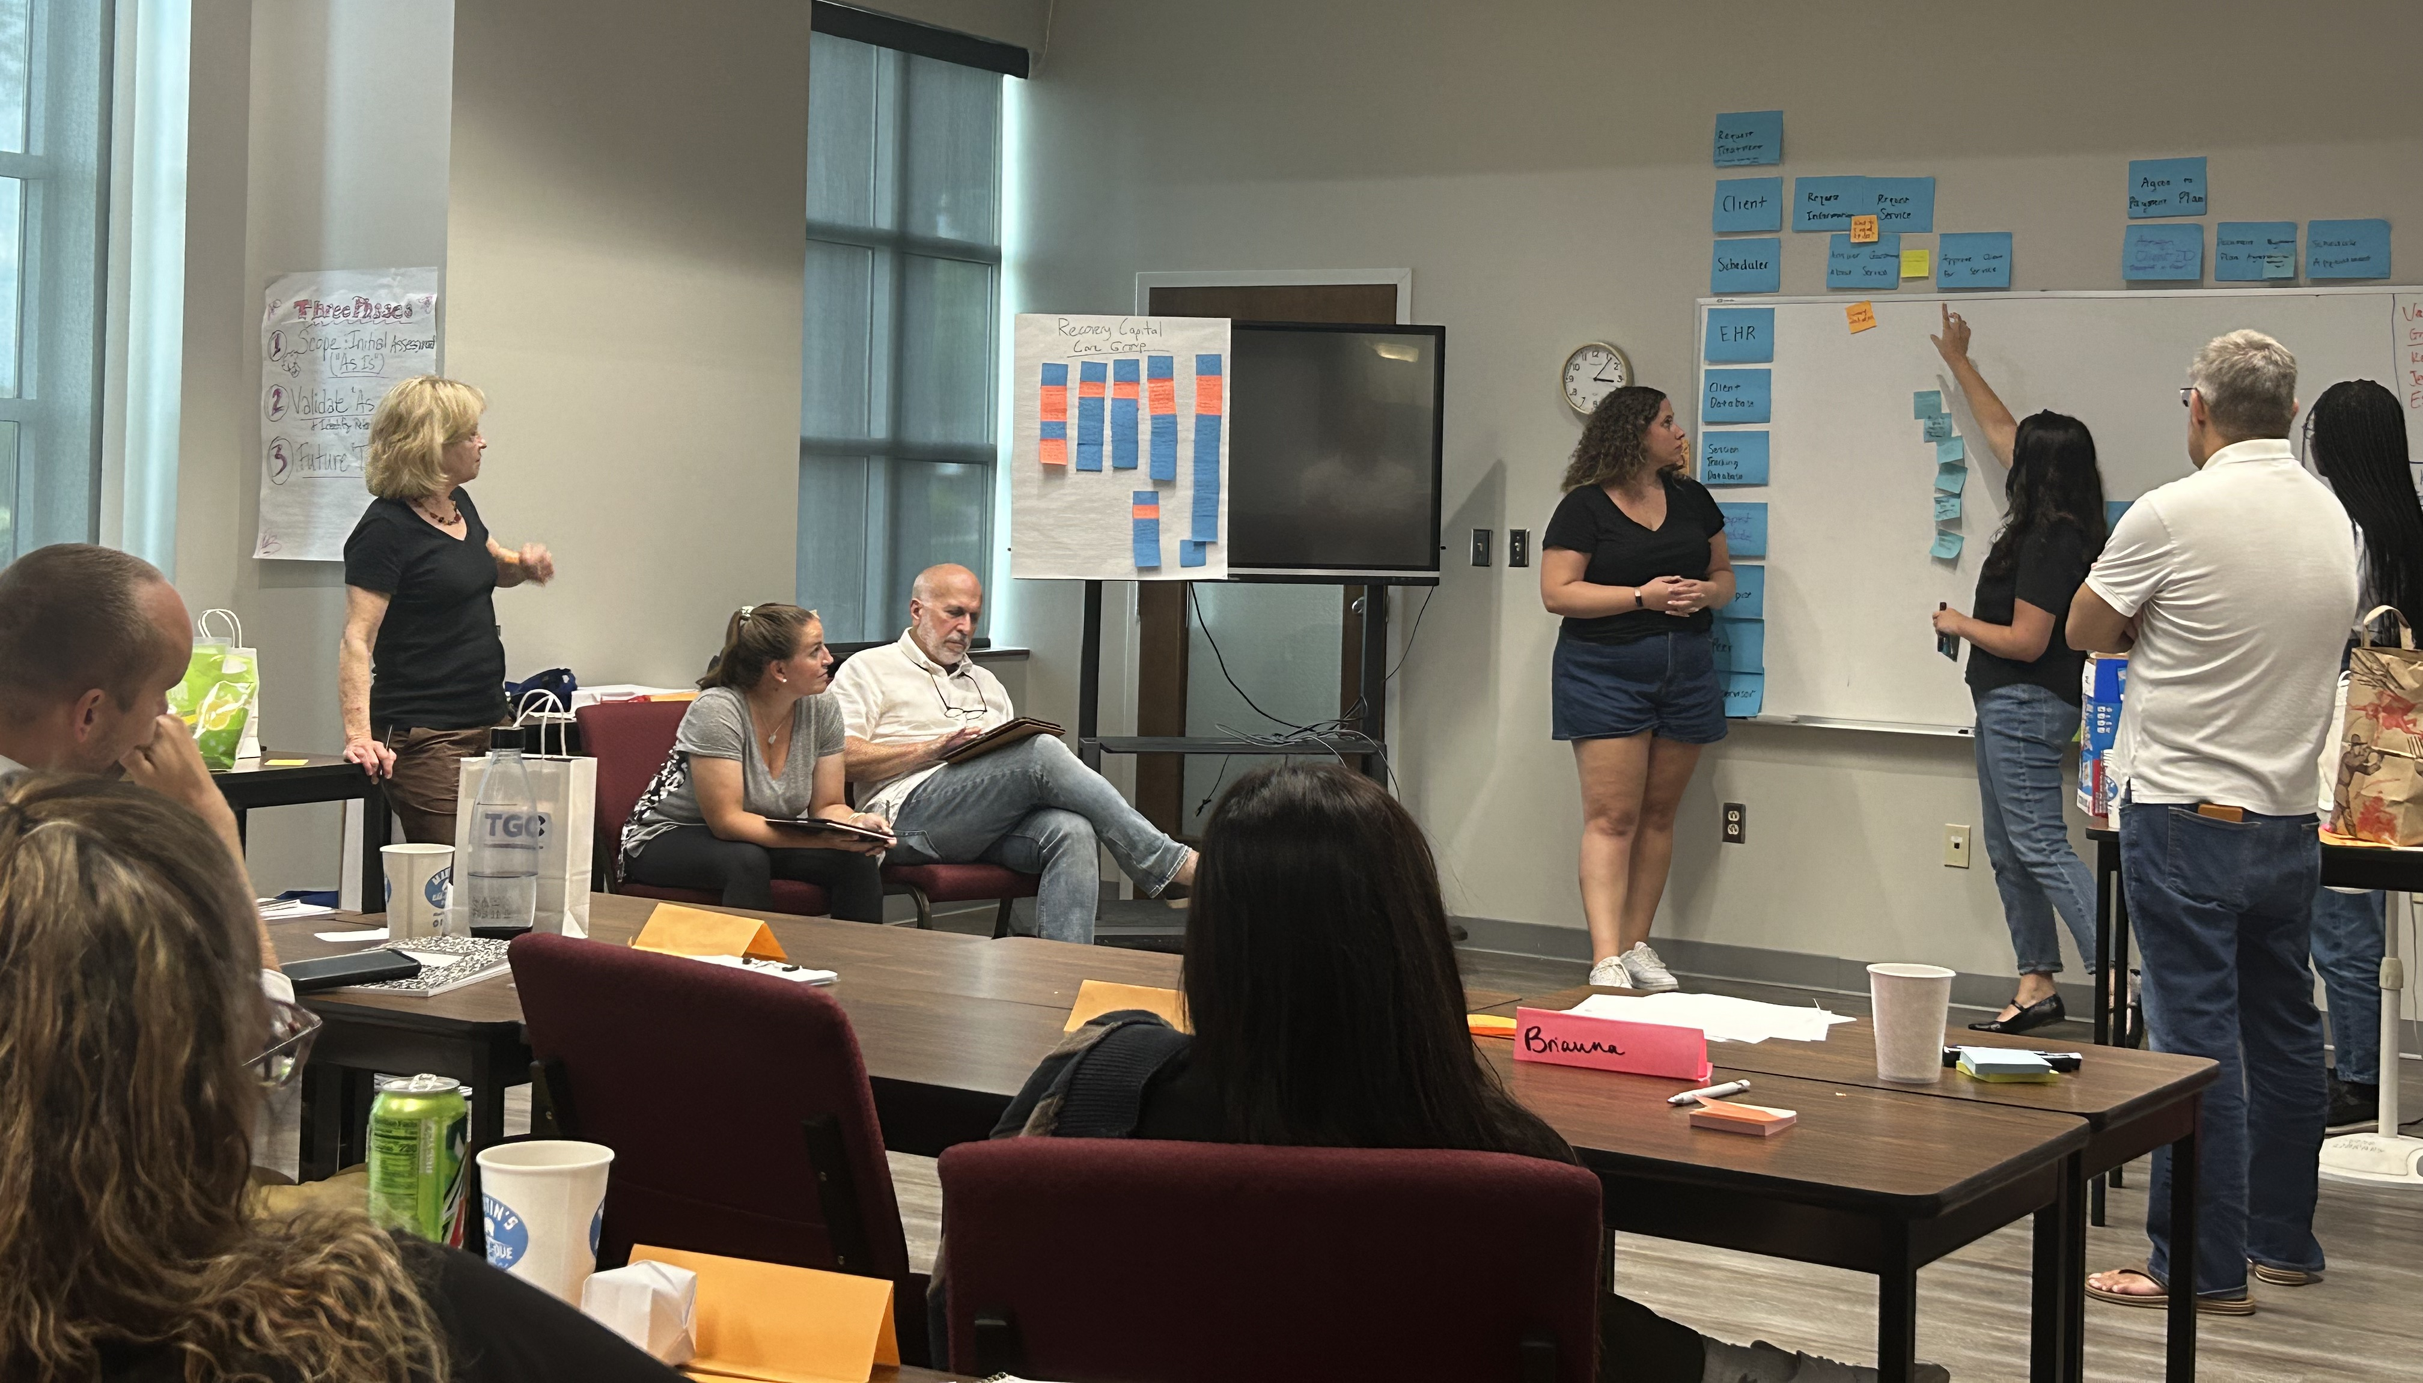
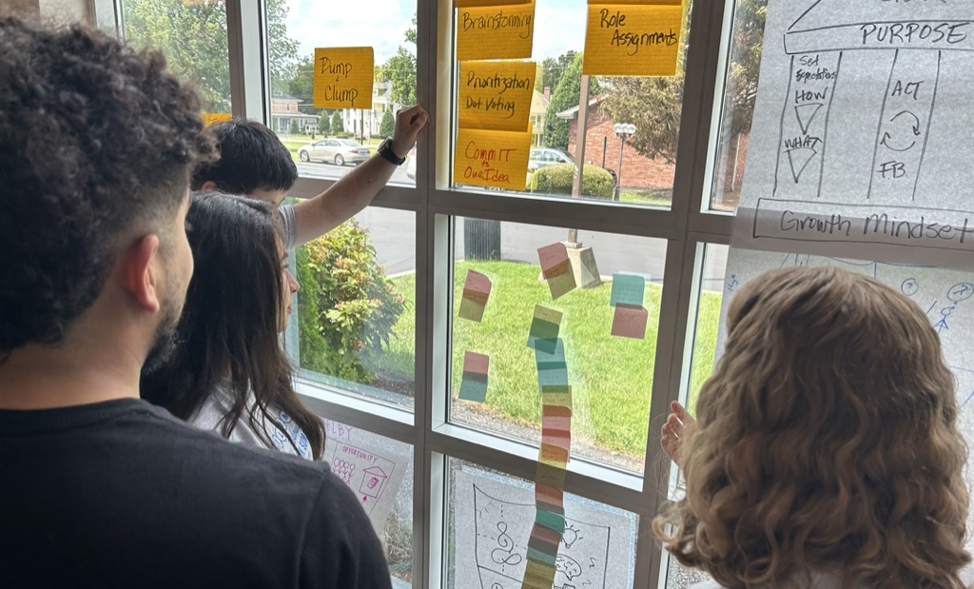
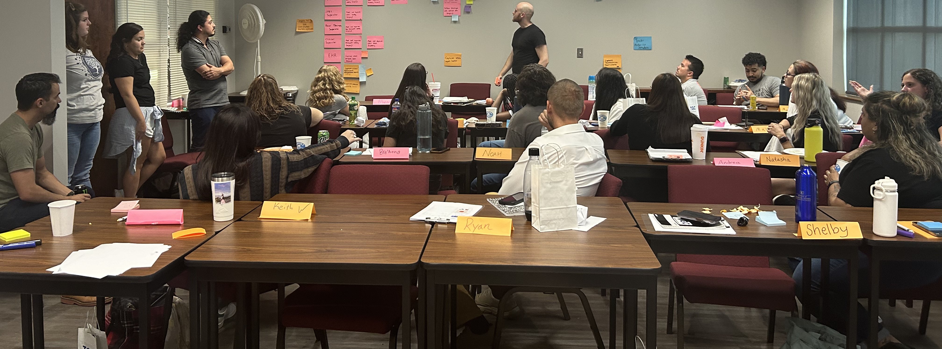

Slide 8
What are you waiting for?

Slide 9
Help Seeking
% of those with gambling
problems seeking help
% of those with gambling
problems seeking treatment

Slide 10
Treatment Hesitance

Slide 11
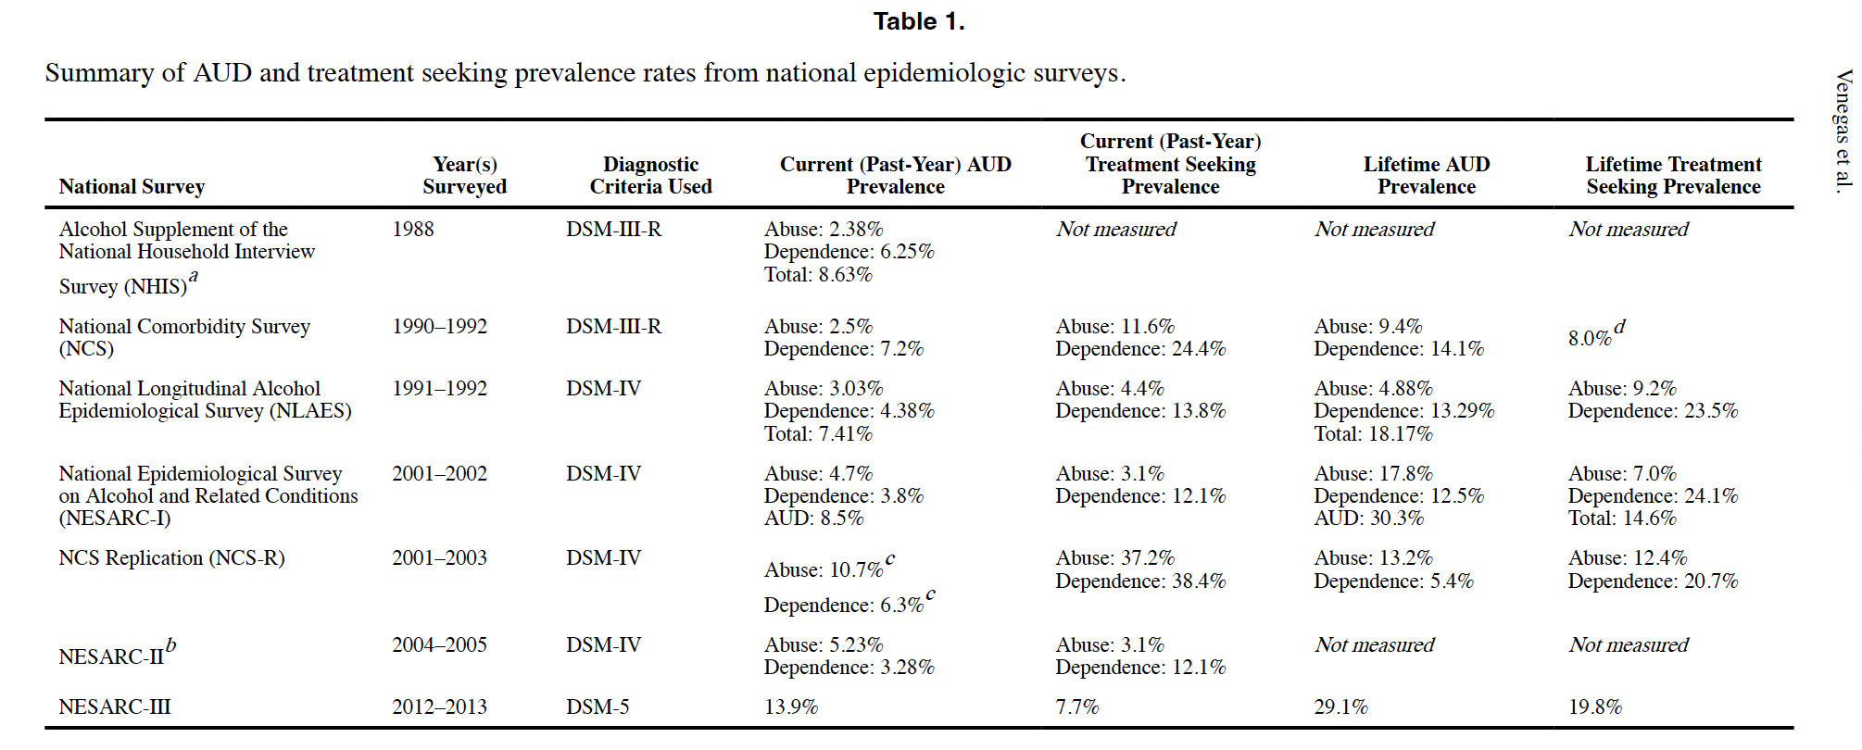
What about engagement in alcohol treatment?
Venegas et al., (2021) Understanding low treatment seeking rates for alcohol use disorder: a narrative review of the literature and opportunities for improvement. The American Journal of Drug and Alcohol Abuse, 47(6), 664-679.

Slide 12

Perhaps a change in how we think
Traditional View
  Barrier = the client
  Needs to want to change
  has not hit bottom

Slide 13
Systemic View
  Change perspective
  Understanding contextual barriers
  Make people intrigued by the idea to pursue treatment

Slide 14
Treatment Hesitancy
Reasons for not seeking gambling treatment
  Low awareness of problems/harms
  Stigma - Public and Self
  Low awareness of services & service effectiveness
  Never being able to win back their losses

Slide 15
Awareness
Boughter, J. R., McPhail, A, & Whelan, J. P. (2022, October). Exploring frequent gamblers' insight into their own gambling problems. Presented at the annual conference of International Center for Responsible Gaming in Las Vegas, NV.

Slide 16
Awareness
PGSI: How often have you felt you had a gambling problem?
During the last year did you think your gambling was a problem?

Slide 17
What % screen & follow-up for serious health problems?
Notes:
Note: Health care disparities – poor, insurance, access etc.

Slide 18
Perhaps it is how we screen
Successful screenings tend to be convincing biological tests with definitive outcomes.
These outcomes are connected to treatment consultations
Very different from how we screen…

Slide 19
Brief Biosocial Gambling Screen
During the past 12 months, have you become restless, irritable or anxious when trying to stop/cut down on gambling?
During the past 12 months, have you tried to keep your family or friends from knowing how much you gambled?
During the past 12 months did you have such financial trouble as a result of your gambling that you had to get help with living expenses from family, friends or welfare?

Slide 20
Problem Gambling Severity Index
Have you bet more than you could really afford to lose?
Have you needed to gamble with larger amounts of money to get the same feeling of excitement?
When you gambled, did you go back another day to try to win back the money you lost?
Have you borrowed money or sold anything to get money to gamble?
Have you felt that you might have a problem with gambling?
Has gambling caused you any health problems, including stress or anxiety?
Have people criticized your betting or told you that you had a gambling problem, regardless of whether you thought it was true?
Has your gambling caused any financial problems for you or your household?
Have you felt guilty about the way you gamble or what happens when you gamble?
Peter, C.S.*, Whelan, J.P., & Pfund, R.A. (2022). Text comprehension analyses to improve assessment Accuracy demonstration using gambling disorder screening. Journal of Gambling Studies 38(4), 1269-1287. doi: 10.1007/s10899-022-10110-0

Slide 21
AQ-27 Subscale | Casino Gambler | eSports Gambler | Internet Gamer | Financial Crisis | F(3, 393) | Partial η2 | p-value
Blame | 19.26 (5.26)ª | 18.76 (5.43)ª | 18.81 (5.92)ª | 11.43 (5.51)^{b} | 62.79 | .28 | < .001
Anger | 17.49 (6.70)ª | 16.38 (6.98)ª | 15.94 (7.14)ª | 6.87 (5.36)^{b} | 75.77 | .32 | < .001
Pity | 17.59 (6.23)ª | 17.57 (4.86)ª | 17.11 (5.76)ª | 20.40 (5.13)^{b} | 10.34 | .07 | < .001
Helping | 11.91 (5.66)ª | 11.51 (4.88)^{ab} | 11.64 (5.92)^{ab} | 9.95 (5.10)^{b} | 3.83 | .03 | .02
Danger | 9.44 (5.39)ª | 8.42 (5.42)ª | 6.05 (4.42)^{b} | 5.57 (4.33)^{b} | 18.51 | .11 | < .001
Fear | 7.62 (5.01)ª | 7.22 (5.10)^{ab} | 5.45 (3.91)^{bc} | 5.42 (4.73)^{c} | 7.75 | .05 | < .001
Avoidance | 18.88 (5.24)ª | 17.58 (5.28)ª | 17.42 (6.10)ª | 10.06 (4.91)^{b} | 73.56 | .31 | < .001
Segregation | 6.27 (4.40)^{ab} | 6.54 (4.99)ª | 5.62 (4.13)^{ab} | 5.09 (3.89)^{b} | 3.08 | .02 | .04
Coercion | 12.00 (4.81)ª | 12.30 (5.20)ª | 10.79 (5.55)ª | 7.24 (4.58)^{b} | 29.36 | .15 | < .001
Stigma

Slide 22
Treatment Hesitancy
Reasons for seeking treatment
  Financial distress
  Conflict with others
  Negative Emotions
  Work or Legal problems
  Health & Well-being
Reasons not related to seeking treatment
  Lifestyle change
  New understanding about gambling
  Loss of interest in gambling

Slide 23
Watching our language
    How can you engage in more person first language?
    What mental health terms do you use and what do you avoid?
    What is the best way to talk about harms and symptoms?
    What language should be use with significant others?
    What language would make change more desirable (i.e., promote self-efficacy)?
Notes:
Let’s dive a little deeper into a few of these

Slide 24

Carl’s search for help
Promoting awareness of services
Was his struggles a real problem?
Will treatment help?
How do I find a therapists?
How do I know if that person is any good?

Slide 25
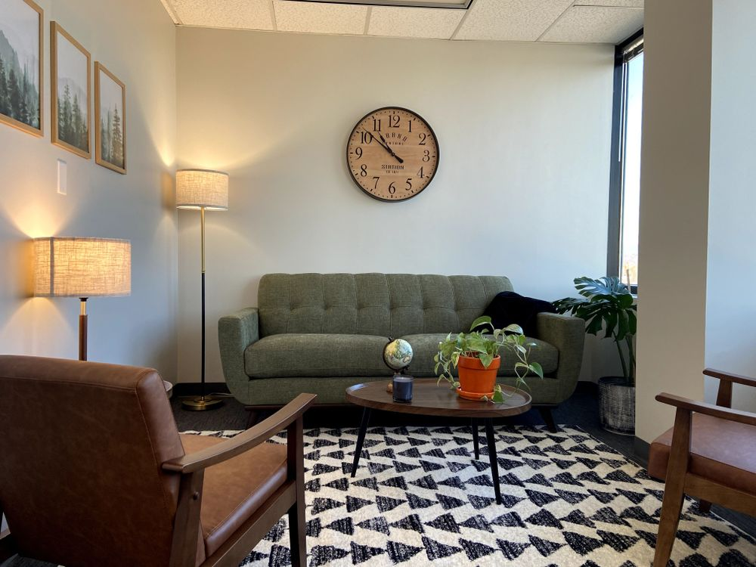
Does this online information provide Carl with answers?
I believe meaningful connection changes people — this is what the therapeutic process is about. I am passionate about encouraging growth and restoration for those questioning their purpose and searching for meaning. I works with those facing questions, concerns, self-evaluation, personal development, and more.
I believe that your story is vital to understanding who you are. How you view the world, relate to people, your emotions and body responses all hold clues to where you may need heal. Raising your insight may be the clue to unlocking more of your story and creating the environment you need to live the flourishing life you desire.

Slide 26
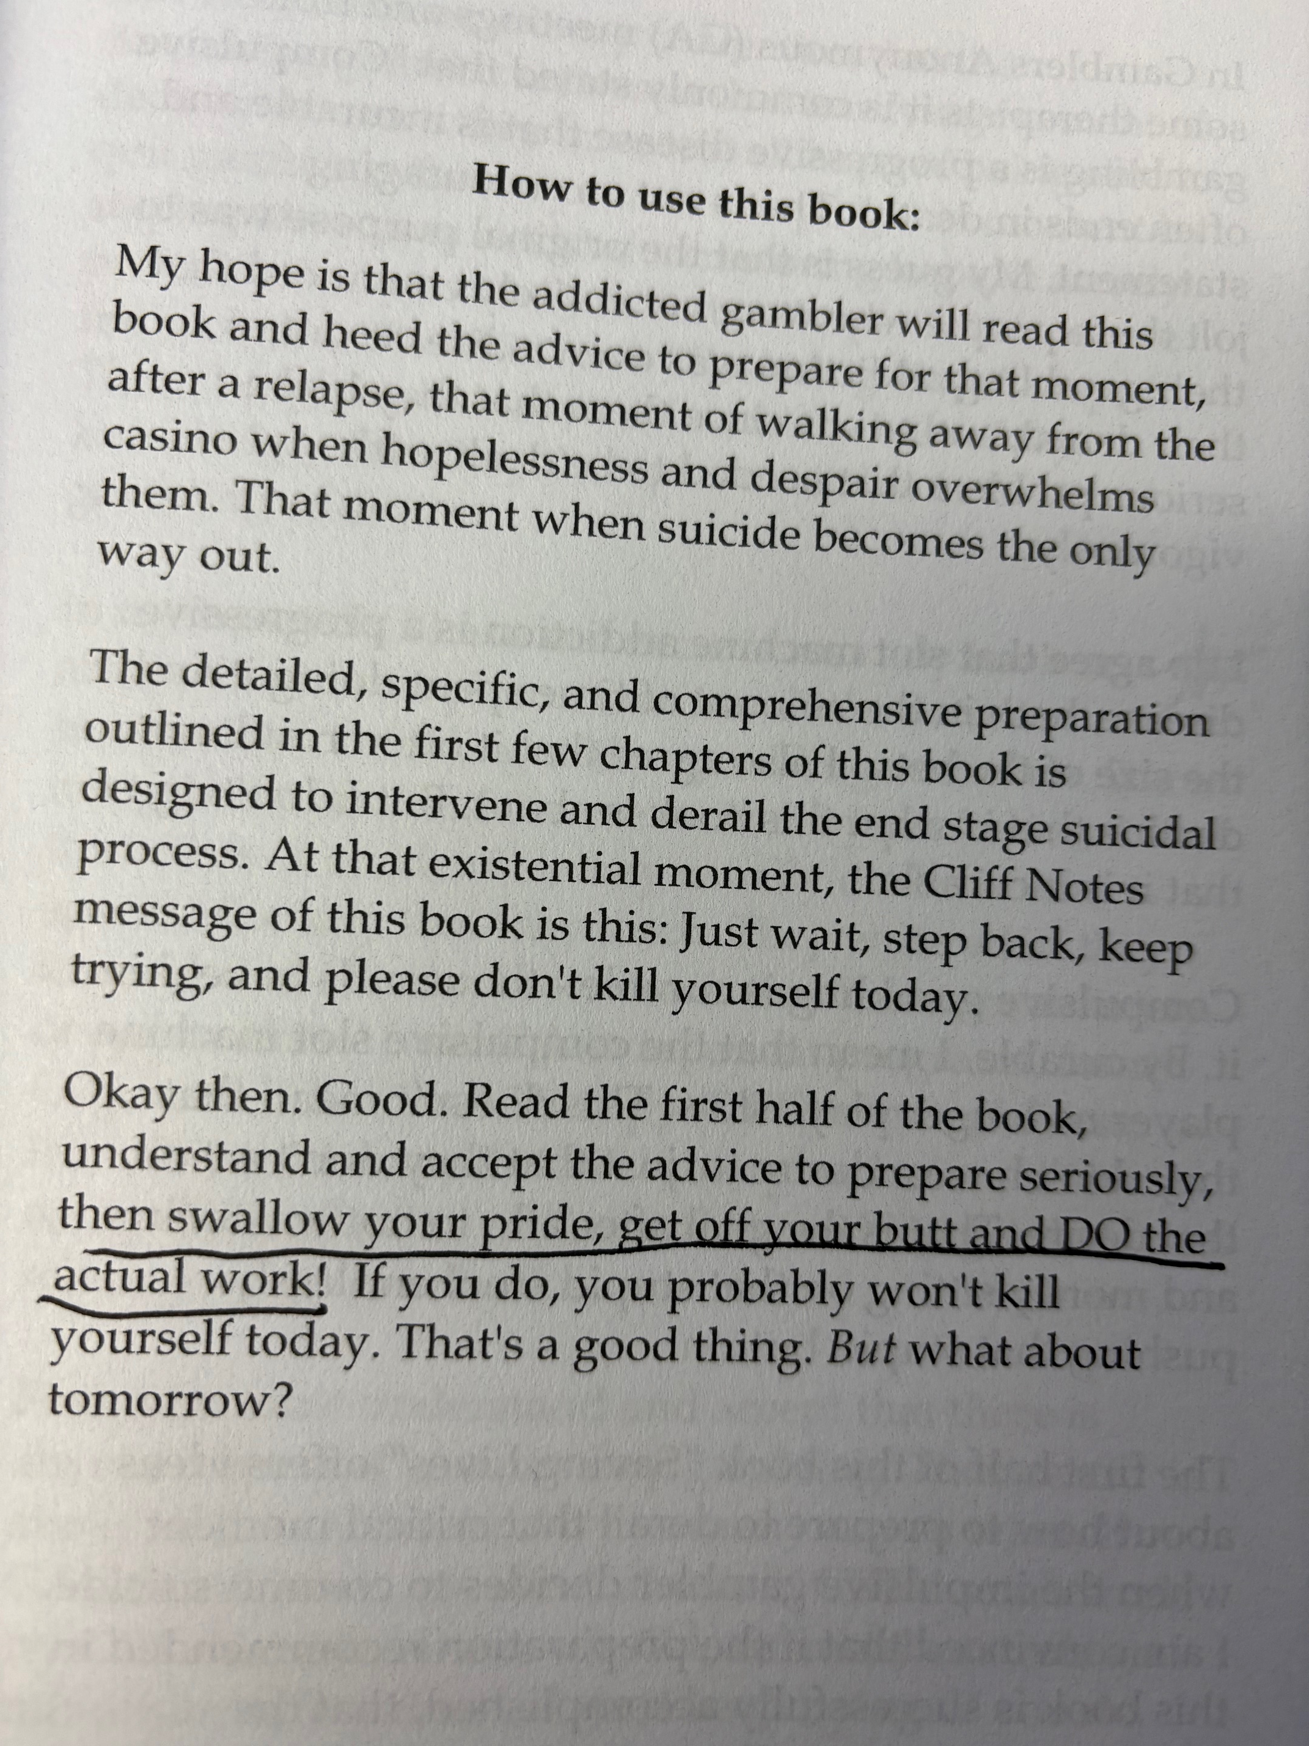
Does this self-help guidance provide answers?

Slide 27
Your message to clients
  What message you can send to those with gambling problems to clearly communicate why the person should seek treatment?
Notes:
Let’s dive a little deeper into a few of these

Slide 28
“The Letter Project”
50% do not show for 1st appointments
Solution – Address hesitancy with mailed personal letter
    Use motivational elements
    Inform treatment expectations

Slide 29
Para #1: Central Components of the MI Spirit
Partnership
  Message about being a companion who collaborates with the other person’s own expertise
Acceptance
  Communicates nonjudgmental understanding of people as they are
Compassion
  Benevolent intention toward the person’s well-being
Evocation
  Eliciting the other person’s own motivation for a particular change

Slide 30
We are glad you called. Calling for an appointment can be hard to do. It means you are thinking about how gambling has caused you problems. It might help to think about how your recent gambling may conflict with the way you want to live your life and you may be unsure about what to do. We want work with you to explore the costs and benefits of what you have been doing. Doing this often helps people to decide if they want to make changes. While you need to decide about your gambling, we look forward to learning more about you. We are here to help and support you in any changes you might want to make.
partnership acceptance compassion evocation

Slide 31
We are glad you called. Calling for an appointment can be hard to do. It means you are thinking about how gambling has caused you problems. It might help to think about how your recent gambling may conflict with the way you want to live your life and you may be unsure about what to do. We want work with you to explore the costs and benefits of what you have been doing. Doing this often helps people to decide if they want to make changes. While you need to decide about your gambling, we look forward to learning more about you. We are here to help and support you in any changes you might want to make.
partnership acceptance compassion evocation

Slide 32
In advance of your appointment, we would like to tell you about us. The Gambling Clinic started in 1999. We had learned that many struggle due to their gambling. Since opening the clinic, we have worked with over 1,000 individuals. We also have done a great deal of research on how to help people make changes. As a result of our work, we have become known as a national leader in helping people with their gambling.
Some people wonder about how our treatment works. There are several likely causes of your gambling problems. We know that understanding a person’s gambling history is essential. Together we find skills that can create new ways of thinking and behaving. Once a person starts to change, it is important to be in control of your gambling and get on a path of better financial health. We believe that change happens if we work together to find different choices. We have learned that most people can create and maintain change in less than 10 one-on-one meetings with a member of our staff.
Credibility
Treatment rationale
Treatment experience

Slide 33
Results
 | regular reminders | motivational letter
% attending | 51% | 76%

Slide 34

Then COVID
Email | Telehealth | In-Person
Telehealth | 82% | 88%
“caretaker” “navigator”

Slide 35
Please don’t leave!

Slide 36
Treatment Discontinuation 39%
Pfund, R. A.*, Peter, S. C.*, Ginley, M. K.*, Whelan, J. P., & Meyers, A. W. (2021). Dropout from face-to-face, multi-session psychological treatments for problem and disordered gambling: A systematic review and meta-analysis. Psychology of Addictive Behaviors, 35(8), 901-913.

Slide 37
Notes:
Therapeutic Alliance – not just the most potent element of treatment – it is also necessary for treatment effects

Slide 38
Leveraging the Relationship
    Actively manage expectations
      review what’s next & why important
    Be collaborative
      setting treatment goals
      indications of treatment success
    Engage in periodic outcome assessment
      provide feedback that informs planning

Slide 39

Treatment Discontinuation
Talk about it!
Process
  Near end of 1st session
  Describe the probably of not continuing
  Ask about what likely factors for client
    Why return
    Why not return
  Estimate probably
  Discuss how to increase chance of returning

Slide 40
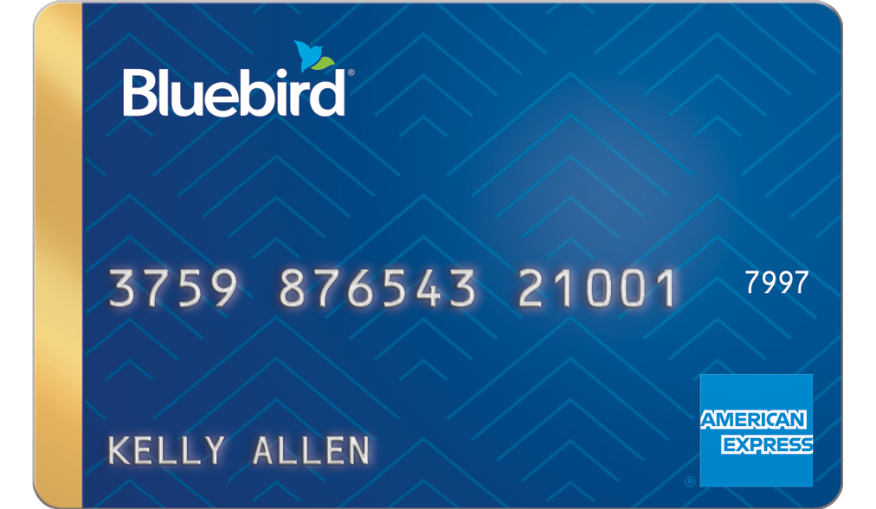


Contingency Management
Contingency Management
Operant reinforcement strategy
  Tangible reward (money on gift card) for
  behavior adherence/change
Empirically support – substance use treatment
  Escalating payments for treatment attendance

Slide 41
What are they waiting for?
  Let’s thinking differently
  Be a concierge
Please don’t leave
  New thinking again
  Develop an active plan

Slide 42


TN Institute for Gambling Education & Research
University of Memphis
400 Fogelman Drive
Memphis, TN 38152
@GamblingClinic (901) 678-STOP (7867)
www.thegamblingclinic.com gambling@memphis.edu

