Slide 1


Panoramic Views:
Self and Gambler in Helping Relationships
Cindy Anderson, MSW, LCSW, ICGC-I
Poker Face

Slide 2
Panoramic Views:
Self and Gambler in Helping Relationships
Cindy Anderson, MSW, LCSW, ICGC-I

Slide 3



Panorama of Self as Helper
“Knowing your own darkness is the best method for dealing with the darknesses of others.” – Jung

Slide 4

Key approaches: “Assume you know nothing about the client.” Dr. George Dee
First supervisor, Jane Wayland Center, Phoenix Arizona
____________________________
“You have to open yourself up and let the pain move through you. It’s not yours to hold.” “My attempts at taking away (patient’s) heartache were just a way of trying to protect myself from suffering.” Frank Ostaseski, MD in The Five Invitations

Slide 5
WHAT ARE YOUR REACTIONS?
Harry is a 58-year-old man who has $42,000 worth of debt from gambling. He goes to the casino several times a week. His wife has left him, and his adult children have also distanced from him. He manages to continue working, though in a dead-end job. He has considered illegal ways to fund his gambling, such as selling his mother’s oxycodone on the streets. (Fictional character)
AQ = Attribution Questions
AQ-9 Questions modified, Mental Health Toolkit, Rating 1-9 from none to very much.
I would feel pity for Harry.
How dangerous would you feel Harry is?
How scared of Harry would you feel?
I would think it is Harry’s own fault that he is in his present condition.
I think it would be best for Harry’s community if he would be placed in mandatory residential treatment.
How angry would you feel about Harry?
How likely is it that you would help Harry?
I would try to stay away from Harry.
How much do you agree that Harry should be forced into treatment, even if he doesn’t want to be?
Notes:
Improv

Slide 6
STIGMA ABOUT GAMBLING/Gamblers
Societal
Gambler Self Stigma
Helper
Gamblers are dangerous
Gamblers are immoral
Responsible for, or able to control the gambling behavior
NM Insurance code – excludes SA & PG treatment. NMSA 59A-23E-18F
More bias against women gamblers
Can’t address the mental illness until gambling or other addiction under control.
May be unaware of the biopsychosocial factors – brain chemistry changes for eg – which make sobriety difficult.
Adopting societal stigma or not countering it.
*Sense of hopelessness about helping.*
Sense of shame
Problem concealment
Don’t seek treatment
Aware of others’ stigma toward them and afraid of it

Slide 7
EXPANDING OUR VIEW OF GAMBLING
The betting or staking of something of value, with consciousness of risk and hope of gain, on the outcome of a game, a contest, or an uncertain event whose result may be determined by chance or accident or have an unexpected result by reason of the bettor's miscalculation.
We immediately think of gambling as gambling in casinos, or purchasing lottery tickets, but we are placing bets on many of life aspects. Many of these activities may still have some reassurances of payoff, but many remain risky!
Video games
Coupons/sales
Bingo
Raffles
Agriculture
Stock Market
Business ventures
Real estate
Jewelry, Art
Love relationships
College
Children
Notes:
Ask audience for examples
Father
Marrying my husband – Marriage as crapshoot

Slide 8
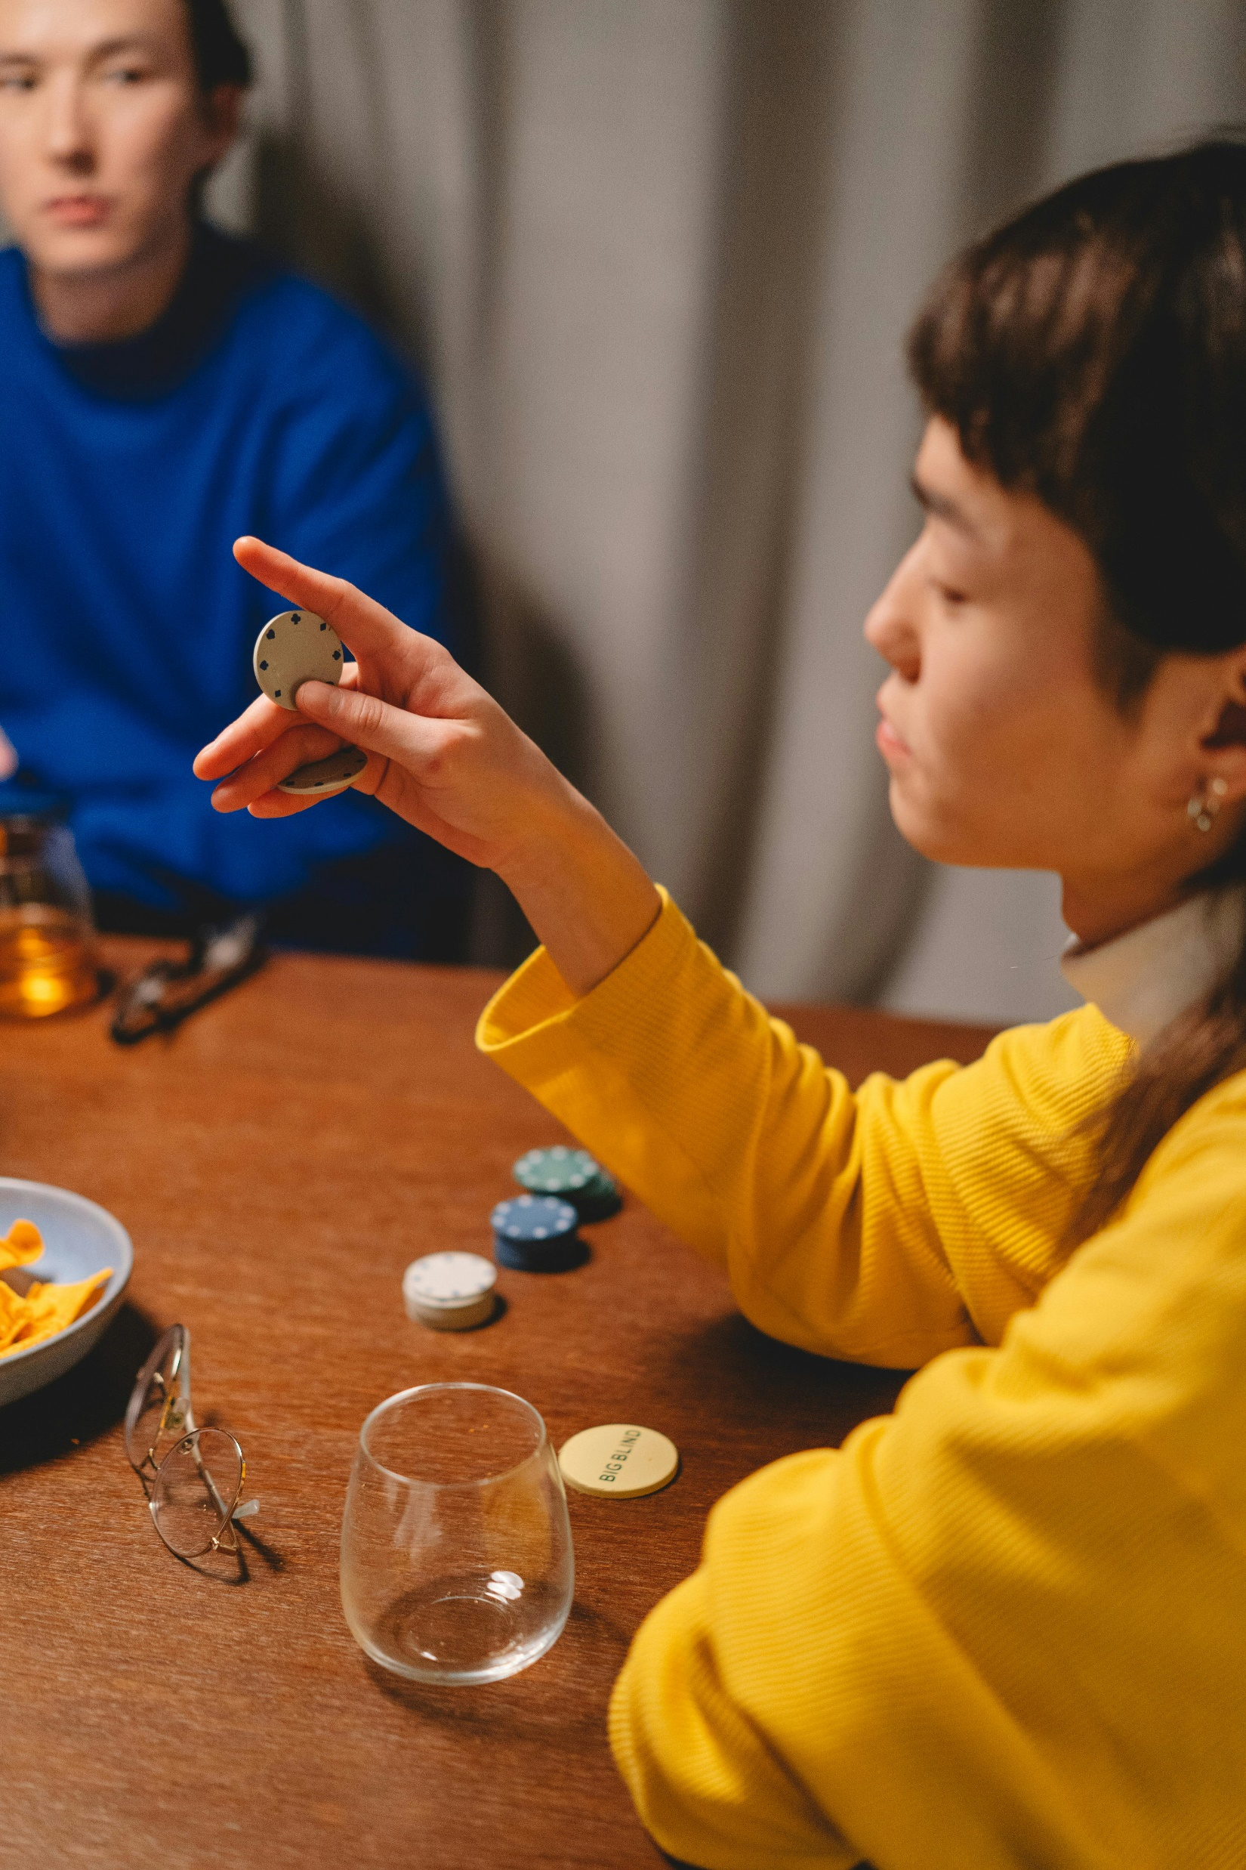
RISK FACTORS FOR PROBLEM GAMBLING
Close proximity to a gambling venue
A big win, early in gambling onset
Adverse childhood events
Losses, Trauma
Cultural or familial support for gambling
ADHD – impulsivity and need for activity
Family history of gambling problems
Bipolar disorder or psychotic disorders
Personality disordered
Use of substances
Parkinson’s medication
Being member of a disenfranchised or low income group
Active military or vets
College students (6% problem gamblers)

Slide 9
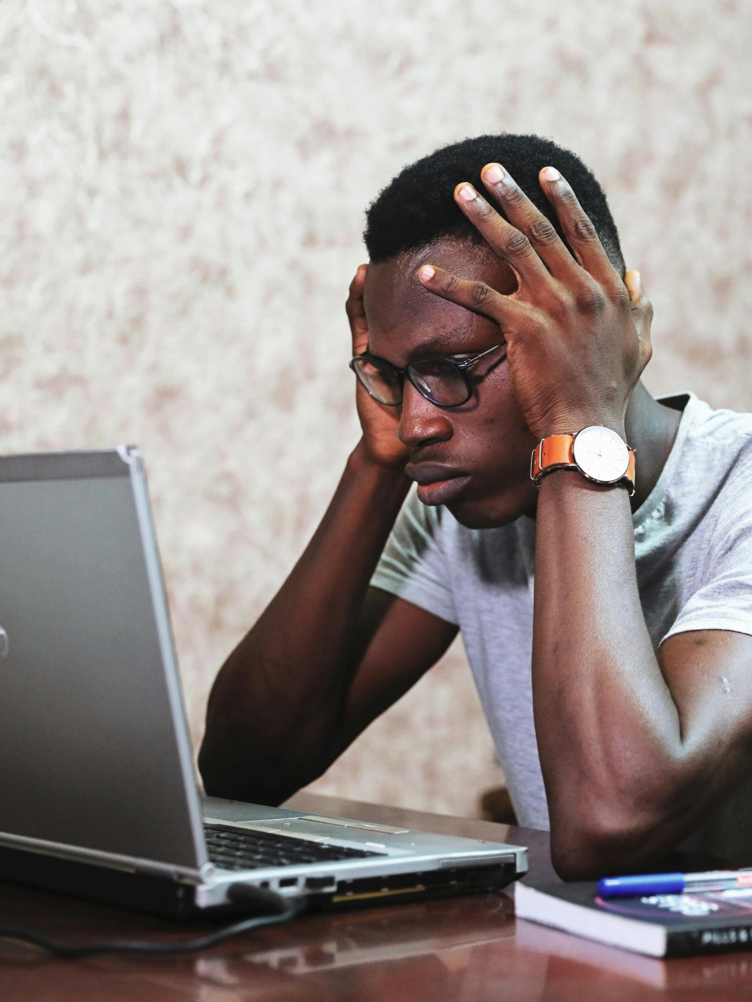
A Day in the Life of Gambler
Wakes up, thinks about last night’s loss.
Feels very upset, even angry about the loss
Gets ready for work, is running late.
While driving starts to think about how he can recover the loss (chasing the loss)
Gets to work and starts in on a task. Feels tired.
His thoughts go back to the casino.
His thoughts go back to chasing the loss.
He realizes he needs to get back to work.
Again, thoughts of the casino
When asked by coworker if he went gambling again, he says no.
Gets a call from a bill collector. Ignores the call.
Thoughts again about how we can win back the money.
When he gets home from work he tries to convince himself not to go to the casino.
He goes to the bar instead.
He finds himself mindlessly at the casino, after drinking.
Cycle repeats!

Slide 10
USUALLY SOME FORM OF SHAME EXPERIENCED IN ADDICTIONS
Toxic shame is feeling flawed and defective as a human being. (John Bradshaw, Brene Brown)
Healthy shame is experiencing the manifestation of our limitations. (morally, physically, socially, etc.)Bradshaw
Notes:
Ask audience for eg. of healthy shame

Slide 11
Guilt as opposed to Shame
Guilt involves our perception that we have fallen short of our values, either by doing something wrong or not doing something we should have.
We have to have a sense of morality in order to feel guilt.
Guilt is an energizing emotion – it leads us to correct our actions.
GUILT IS ABOUT AN ACTION OR LACK OF ACTION;
SHAME IS ABOUT OURSELVES AS A PERSON

Slide 12

SOURCES OF SHAME
Trauma
Excessive criticism
Loss
Family system
Secrets
Religions
Abandonment
Sex Abuse
Physical Abuse
Mental Illness
Society
Work
Money
SHAME CYCLE
TOXIC SHAME
ADDICTION or Misuse
Negative Experience

Slide 13
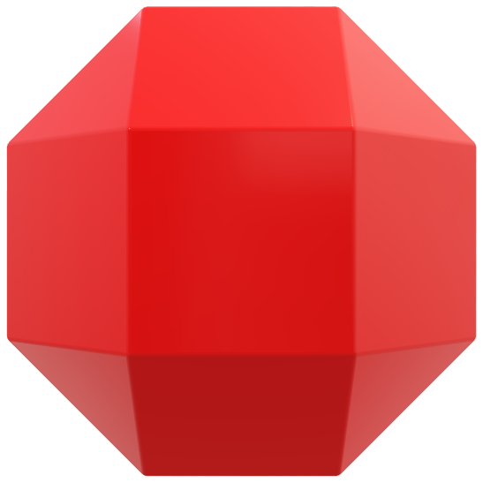
Meds Substances
Recreation
Spirituality
Brain &
Thinking
UNDERLYING
Secrets
Talents
Shame
Trauma
Loss
Guilt
Aspirations
Personality
Significant
Relationship
Friends
Finances
Work/
Volunteer
Culture
Health
Family of Origin
People are multifaceted!

Slide 14
Comorbidities and Associated Conditions
75% of Problem Gamblers have primary mental illness (Kessler 2008)
Mental Illness
Substances
Other addictions
Post Traumatic Stress Disorder – as high as 34%
Depression/Bipolar (Mood disorders)– 50%
Anxiety – 40%
ADHD – up to 43% (childhood ADHD)
Personality Disorders 60%
Obsessive-Compulsive Disorder – not well studied
Eating Disorders
Alcohol 73%
Marijuana – assoc w/ MH issues and PD
Stimulants – higher correlation
Parkinson’s Drugs
Tobacco
Total illicit drugs – 38%
Shopping
Porn/Sex addiction
Video gaming
Day trading
Internet
Religious practices
Exercise
Food

Slide 15
Role of Trauma, Loss and Shame
Trauma and PTSD are linked to Gambling Disorder or Problem Gambling. (Moore & Grubbs 2021)
Severity of PTSD also linked to severity of gambling.
People with trauma may use gambling to cope with the negative symptoms they experience. (escape gambling)
People who experienced losses in life may not only try to escape the negative emotions but also metaphorically attempt to recoup what has been lost.
UNDERLYING NEED OR MOTIVATION:
Pleasure
Desire to feel like a winner
Desire to feel control over circumstances
Desire to feel valued, worthwhile
Desire to avoid pain, physical or emotional

Slide 16

NAVIGATING THE MAZE for Treatment or Support
ASSESSMENT PHASE
Get to know your gambler & create atmosphere of hope/positive regard. Expect distrust of you as helper
At first, and frequently assess for suicidal ideation
Assess for severity. Screening tools are helpful:
Brief Biosocial Screen; Lie-Bet; NODs; Problem Gambling Severity Index, DSM 5, SOGS
If severity, may discuss self-ban or immediate harm reduction strategies.
Look for comorbidities – substances, trauma, mental health issues, other behavioral addictions. Address/refer.
Assess for stages of change (may differ for each problem)

Slide 17
Domains for Assessment and Intervention (Slide 1)
Financial
Relational
Spiritual
KEY domain to address. Wait for some trust to build in the relationship.
Is the gambler still able to work?
What bills are being unpaid?
Has the gambler borrowed money from others? Obtained money illegally?
Get a list of debts. Look for unexpected debts – such as a credit card in their child’s name, withdrawing money from someone’s savings account, home equity loans.
Look for numerous accounts.
Who are the supportive persons to the gambler?
Who has exited their life due to the gambling?
How has gambling impacted the gambler’s sexuality?
Does the gambler have friends or a partner who also participate in gambling?
As in any addiction, or illness, the gambler may have disconnected themselves from meaning in life.
What is the gambler’s spiritual history?
How is the shame they feel keeping them from seeking spiritual guidance?

Slide 18
More domains for assessment & intervention – Slide 2
Cultural
Health
Suicide
Some cultures accept or even endorse gambling.
Asian cultures accept/endorse gambling and have beliefs about being lucky.
Native American cultures have had gambling games as a communal activity. Also have mystical beliefs. Native Americans have among the highest rates of disordered gambling.
Black cultures have high rates of disordered gambling and due to income disparity are more highly affected.
Problem gambler’s health suffers, due to the preoccupation with gambling, long hours of sitting, even being in smoky environments.
Parkinson’s Disease is associated with disordered gambling. The dopamine drugs given will generate the excitement and highly associated with gambling.
Some people with health problems gamble to escape the stress or pain of their condition.
50% of problem gamblers have had suicidal ideation and 17% of attempted it.
Problem gamblers have the highest suicide rate of any of persons with addictive disorders.
Judicial
Is the gambler in trouble legally? May need legal representation, support.

Slide 19
More Domains for assessment and intervention – Slide 3
Recreation
Find or reconnect to enjoyable activities. (Form of behavioral economics)
Remember that nothing will compare to the high of the gambling. But ask them to try for activities that come close.
Make sure recreational activities don’t involve persons who will encourage the gambler to drink, drug or gamble.
Society
Advocate for gamblers, educate others about the disease
Advocate for insurance coverage/treatment
Watch your own language about gambling – instead of “addict”, use “person with a gambling problem”.
Look for ways to influence policymakers

Slide 20
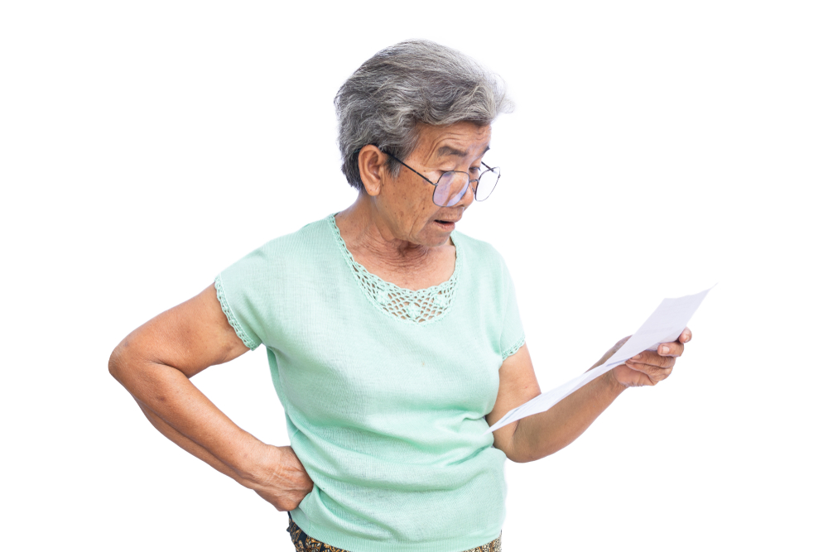
Treatment tasks – Slide 1
Look for support person – involve if appropriate. GA, Facebook groups or podcasts too. Can get sponsor at GA.
Encourage positive health behaviors: see MD, take meds, exercise.
Encourage substitute recreation (behavioral economics) Encourage sense of meaning
Educate on gambling effects on the brain
Assess level of debt (few sessions later)
Put together debt management plan
???
HELP!!

Slide 21
More treatment tasks
Look at cognitive distortions about gambling
Substitute cognitive processes
Use imagery to imagine coping or to imagine the negative effects of gambling
Teach techniques to manage urges
Educate on and help gambler set up barriers to gambling
Mindfulness very helpful
Do deeper work, after more stability (need to assess readiness) Look at life factors, family of origin which may have led to gambling
Couples work or family work is encouraged
Expect difficulty in reducing or stopping gambling

Slide 22
Collaborations
Medical
Mental Health/SA Treatment
Peer Support/Tech
Contact with Medical Provider – PCP and/or Specialist
Pharmacist
Gambler’s Anonymous
RGANM texting available
1-800-Gambler (Text, Talk)
Gam-Anon for families
Gamban
Facebook/Youtube/Instagram
Podcasts (Hello My Name is Craig)
May have adjunct treatment provider
Prescriber
Intensive Outpatient

Slide 23
Conclusions
Be open as a practitioner to understand yourself, and to understand the gambler.
Have empathy! (“Empathy is the ladder out of the shame hole” – Brene Brown) Information given to you is in sacred trust.
Take the panoramic view of the gambler’s life and look for many domains from which to intervene.
Expect a bumpy, uneven ride. Who of us has a straight line to our goal?
Enlist help from other professionals or members of the community.
Keep hopeful and positive. Don’t buy into the gambler’s desperation.

Slide 24
Thank you for coming!
Enjoy AZ Panoramas, The Panoramas of your life and THE Panoramas OF THE PEople WHOM you serve.

Slide 25
We are the World (Channel Aid 2018)
There comes a time
When we heed a certain call
When the world must come together as one
There are people dying
Oh, and it's time to lend a hand to life
The greatest gift of all
We can't go on
Pretending day-by-day
That someone, somewhere soon make a change
We're all a part of God's great big family
And the truth, you know, love is all we need
We are the world
We are the children
We are the ones who make a brighter day, so let's start giving
There's a choice we're making
We're saving our own lives
It's true we'll make a better day, just you and me

