Slide 1


Sports Gambling in the U.S.
Joshua B. Grubbs, Ph.D.

Slide 2
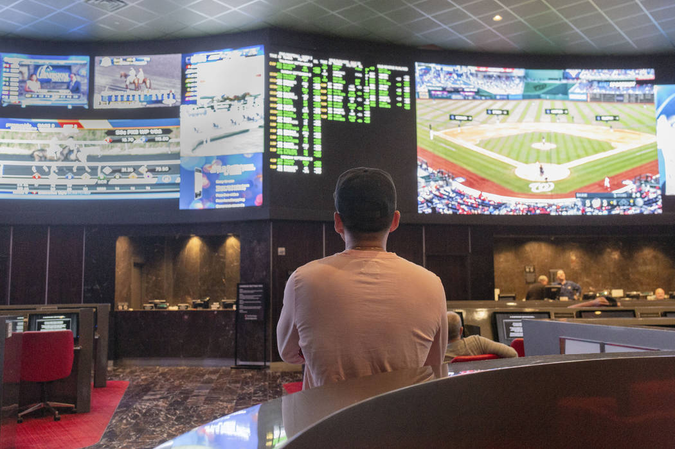
Sports betting is not inherently more risky than other forms of gambling… but sports gamblers are.

Slide 3
A little bit of research investment goes a very, very long way in improving our understanding of gambling behavior

Slide 4



Support
Kindbridge
Research Institute
Problem Gambling
Network Of Ohio
International Center
for Responsible Gaming

Slide 5


Notes:
Dave Fernandez, Nottingham Trent and Help University, Kuala Lumpur, Malaysia

Slide 6
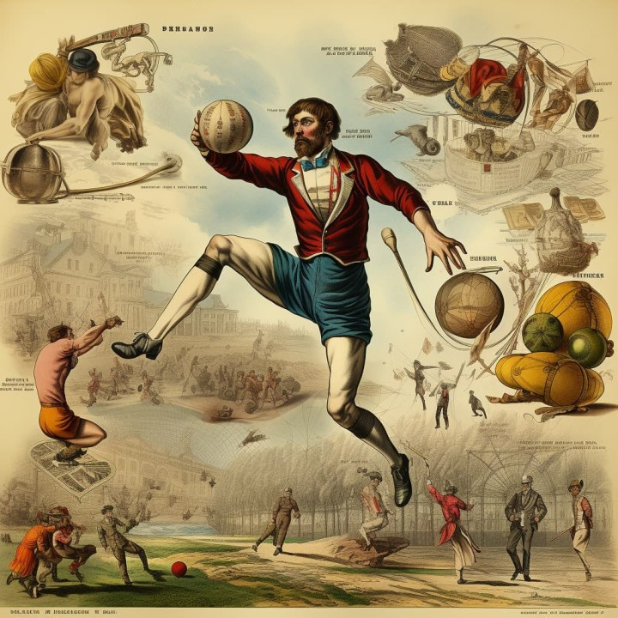
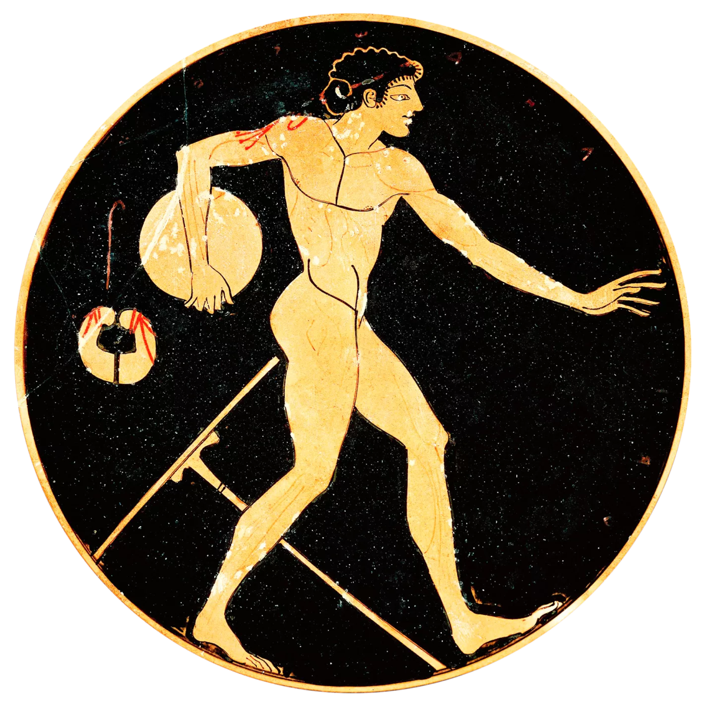

Slide 7
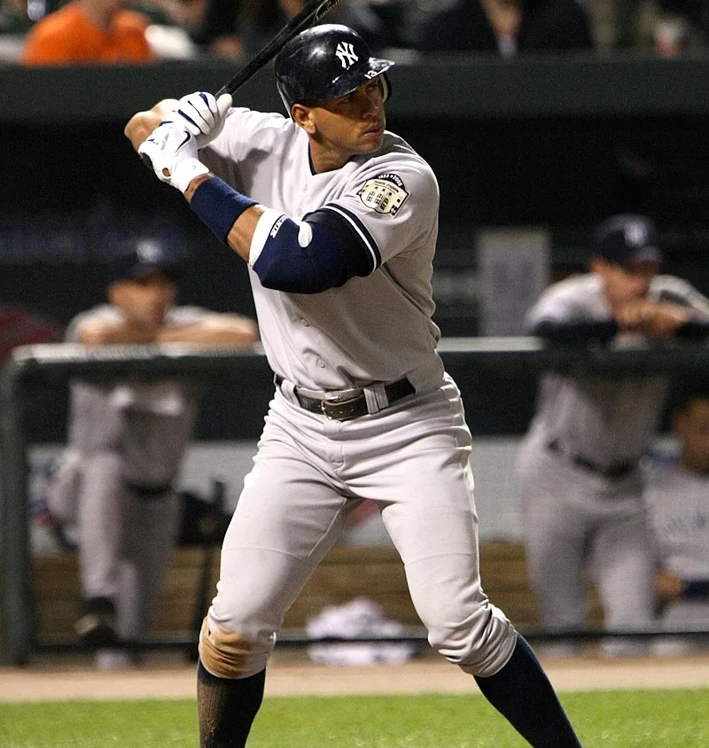
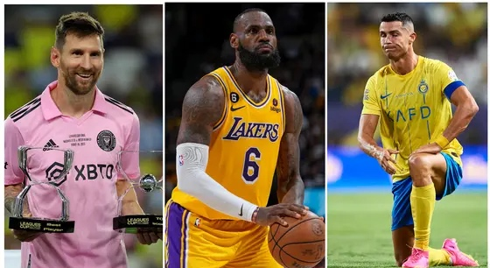
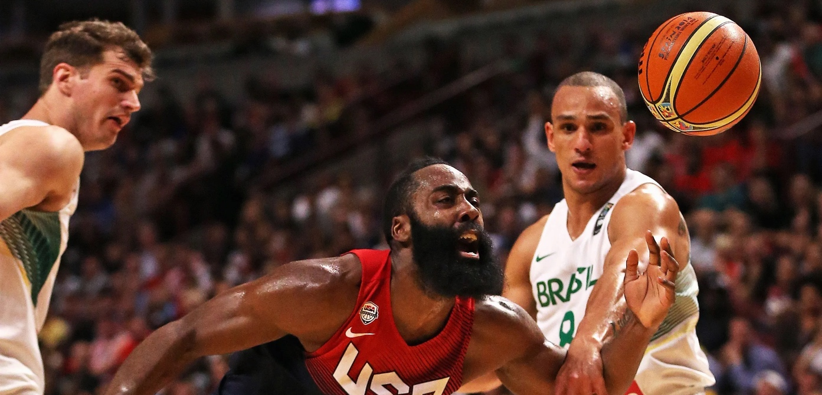

Slide 8
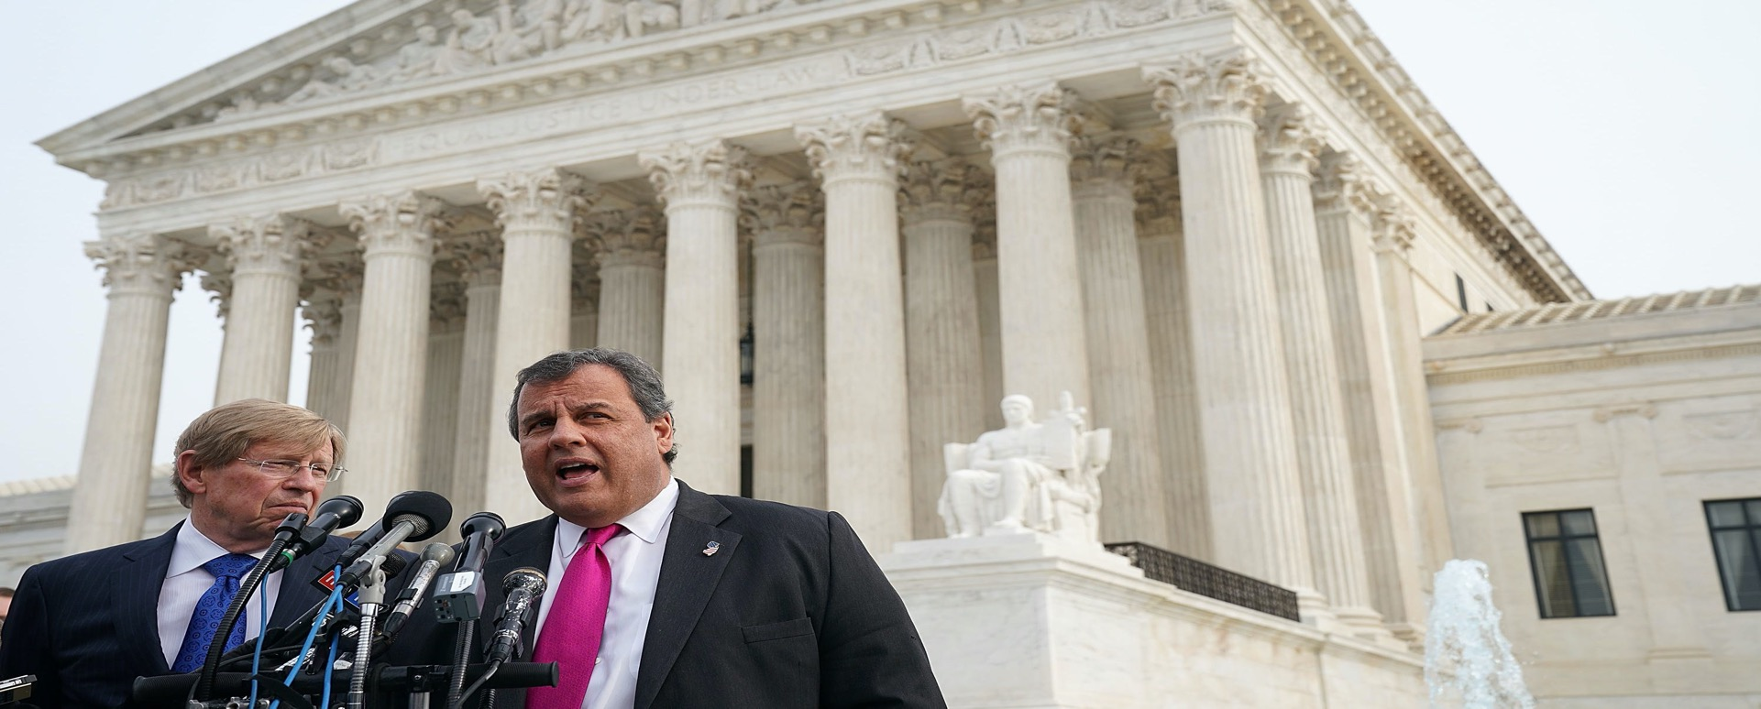
Murphy vs. NCAA (2018)

Slide 9
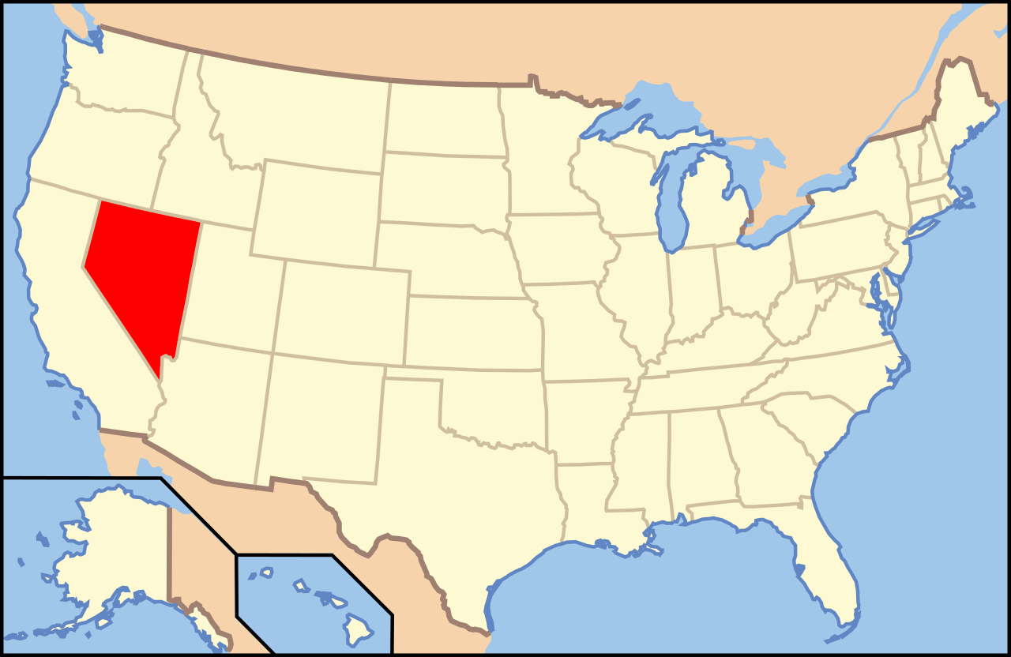
From 1992 to 2018

Slide 10
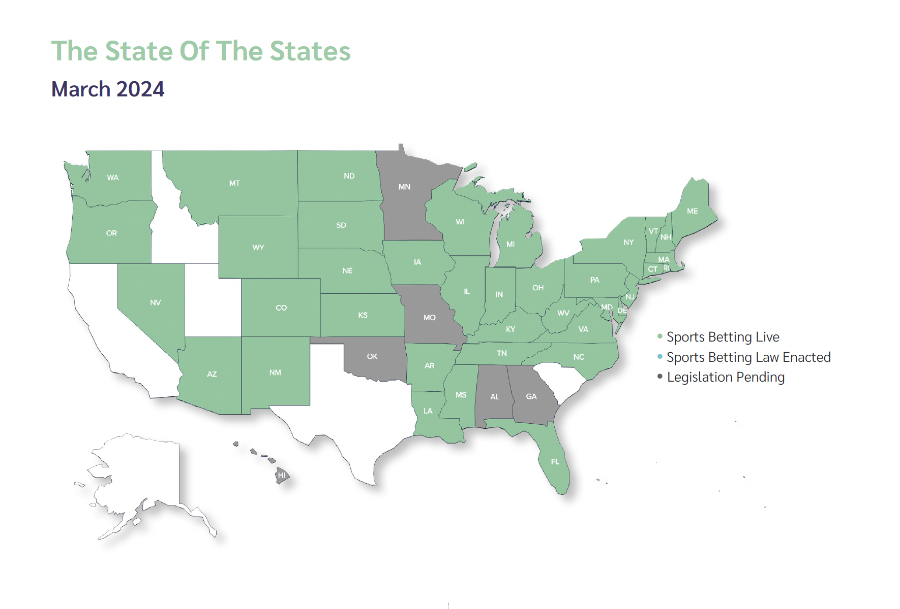
As of March, 2024
Notes:
US$21.6 billion in 2020.
All US sportsbooks generated $4.29 billion in combined revenue in 2021 on $57.2 billion in handle, excluding tribal-run sportsbooks).
2022-- $93.4 billion in handle
$16 billion in 2023; compared to $8billion in 2022
$250 billion in handle thus far; $21billion in Revenue; over 3.7 billion in taxes…
around $67 billion in 2023 so far… august 2023; over $6b in revenue; 1.2$ ibillion in taxes
About 90 million people in Florida, Texas, California

Slide 11
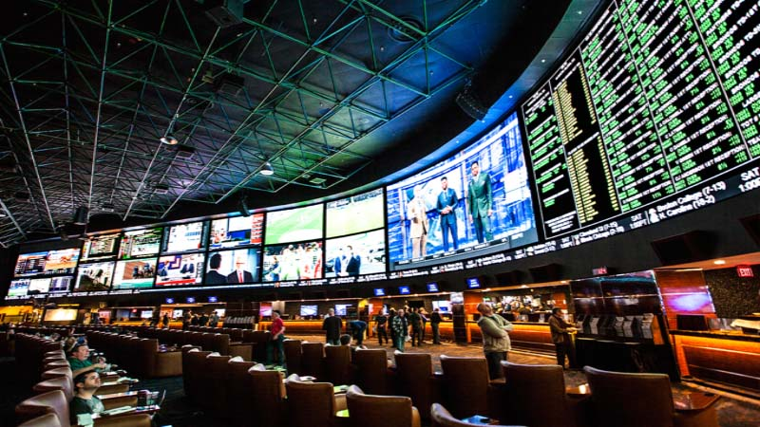
Sports Books

Slide 12
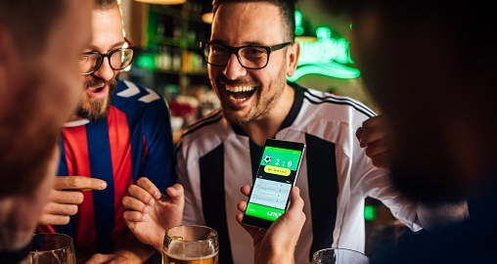
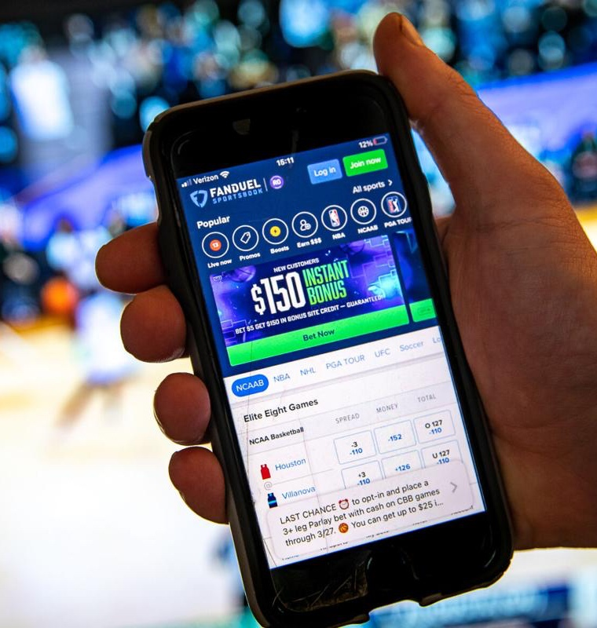
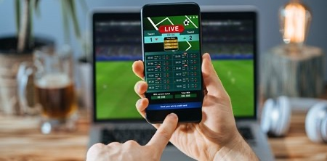

Slide 13
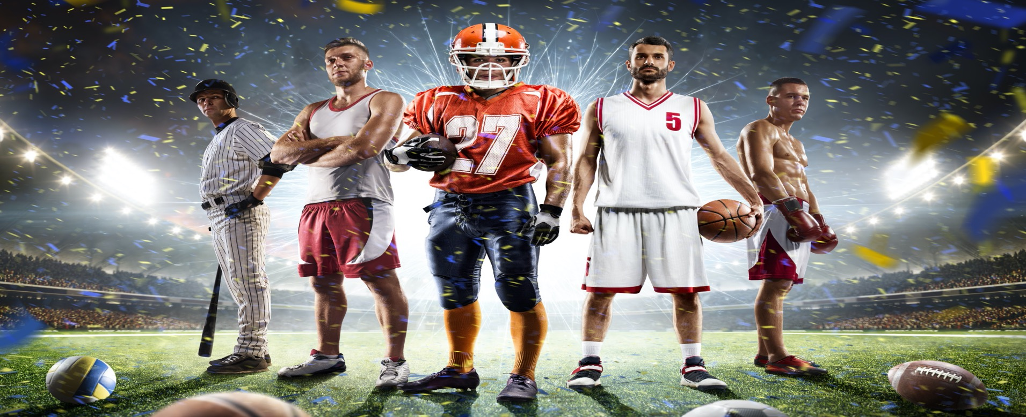
Fantasy Sports

Slide 14

Daily Fantasy Sports
Notes:
About 45 states

Slide 15
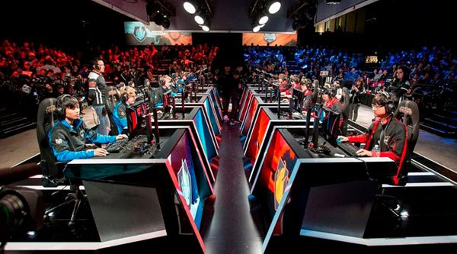
e-sports

Slide 16


Slide 19
ICRG Sports Wagering Fund
Initially Announced for Applications due in 2020
Applications Resumed in 2021
Funding Began in Fall of 2021.
$402,000.00

Slide 20

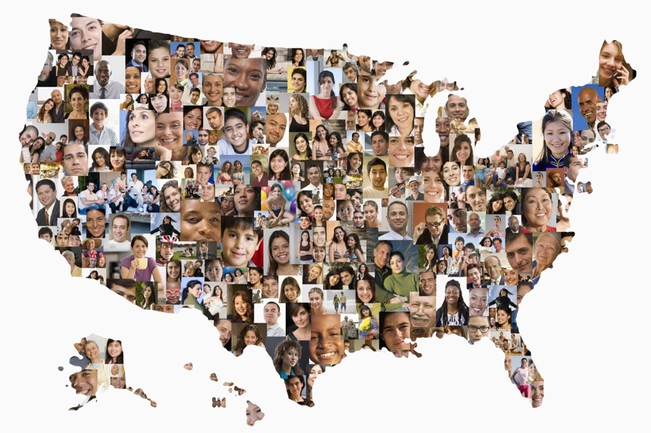
Present Study
Notes:
Describe yougov
Sturgis and Kuha
More problem gambling… more frequent gamblers… more online gambling

Slide 21
Present Study
Total N = 4,359
  n = 2,806(U.S. Nationally Representative)
  n = 1,553 (Oversample of Sports Bettors)
Measures
  17 gambling behaviors
  Problem Gambling Severity Index
  Substance Use Behaviors
  Gambling cognitions

Slide 22
Baseline (March/April, 2022)
First Follow-up (September/October, 2022)
Second Follow-up (March/April 2023)
Third Follow-up (September/October 2023)
Final Follow-Up (March/April 2024

Slide 23
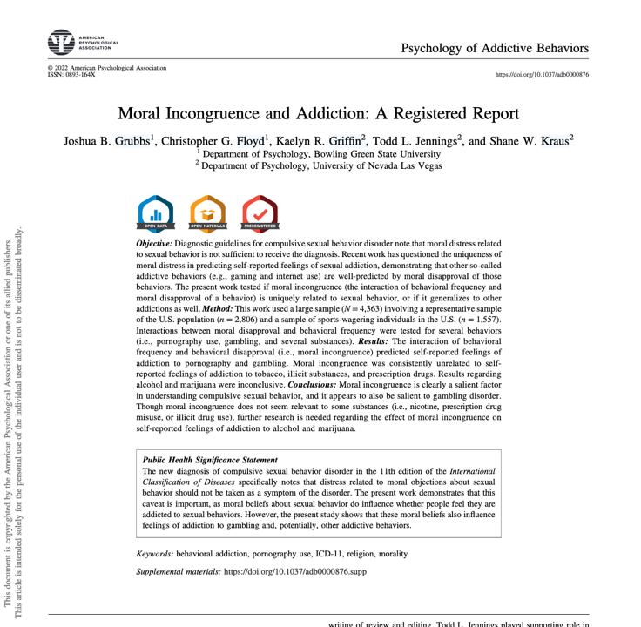
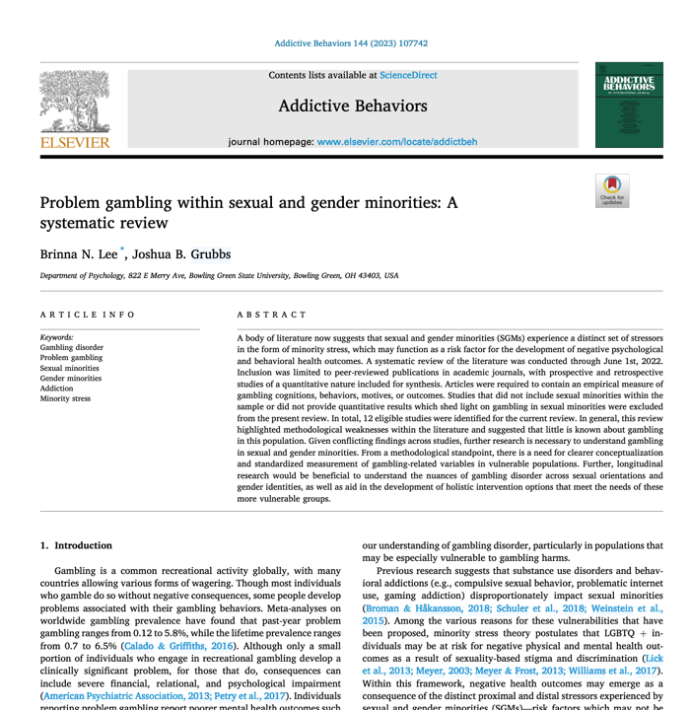
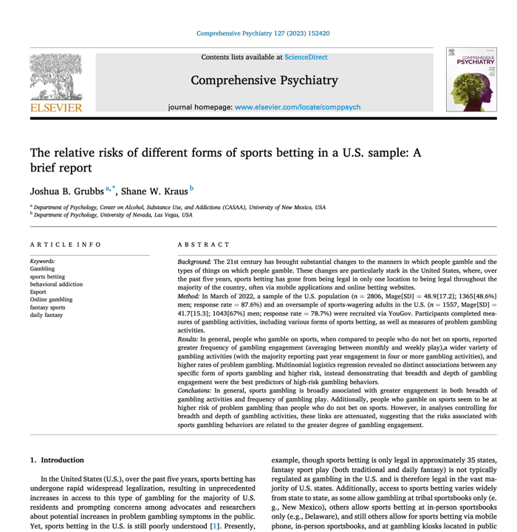
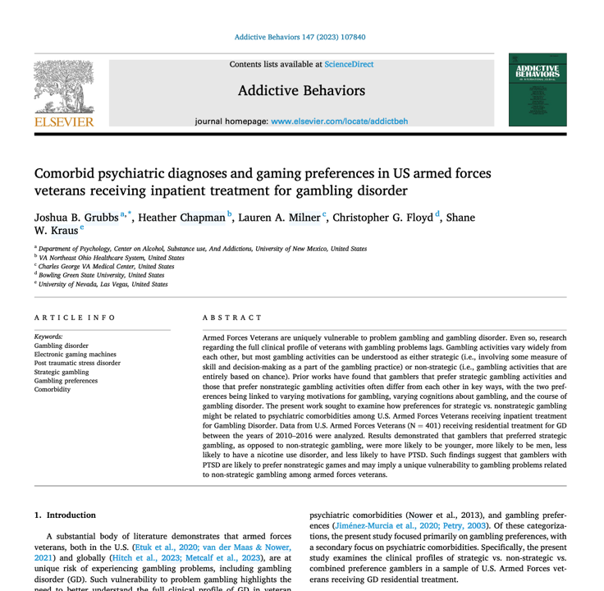
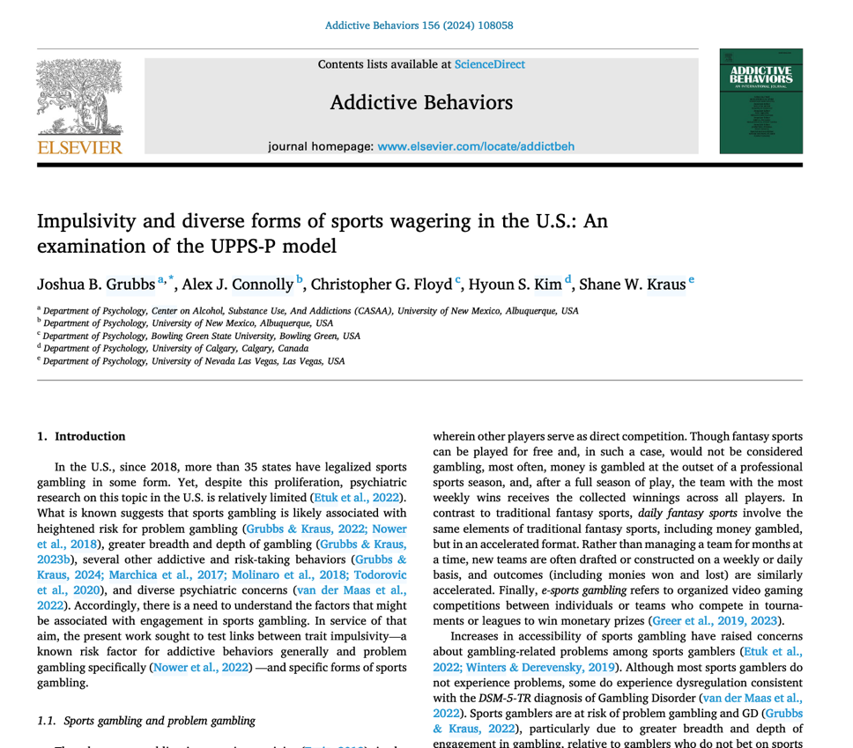
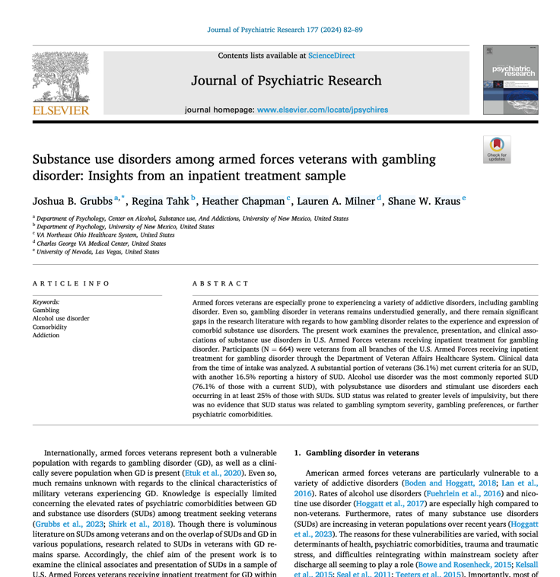
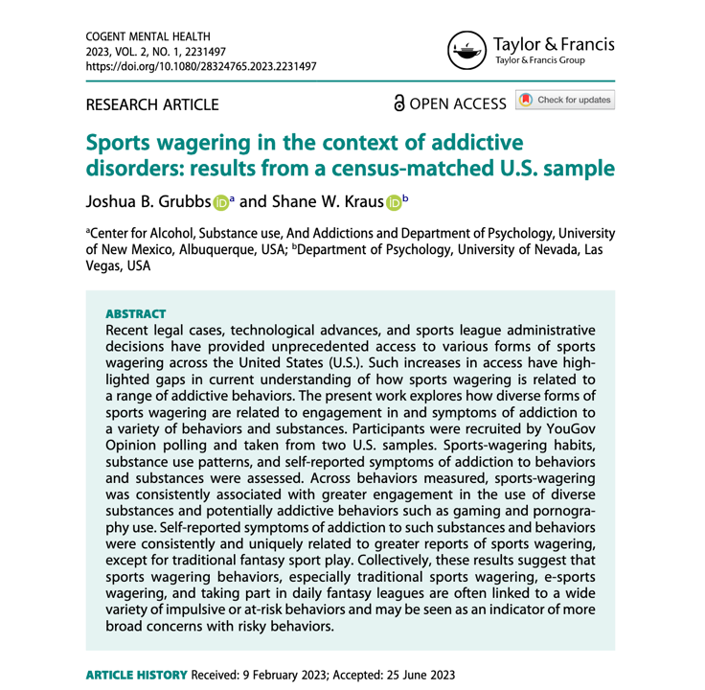
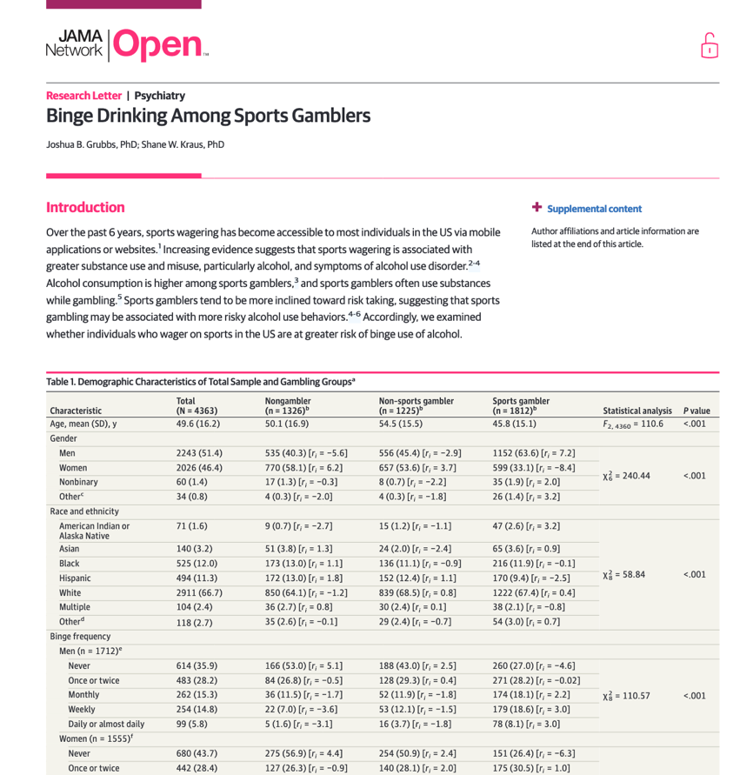
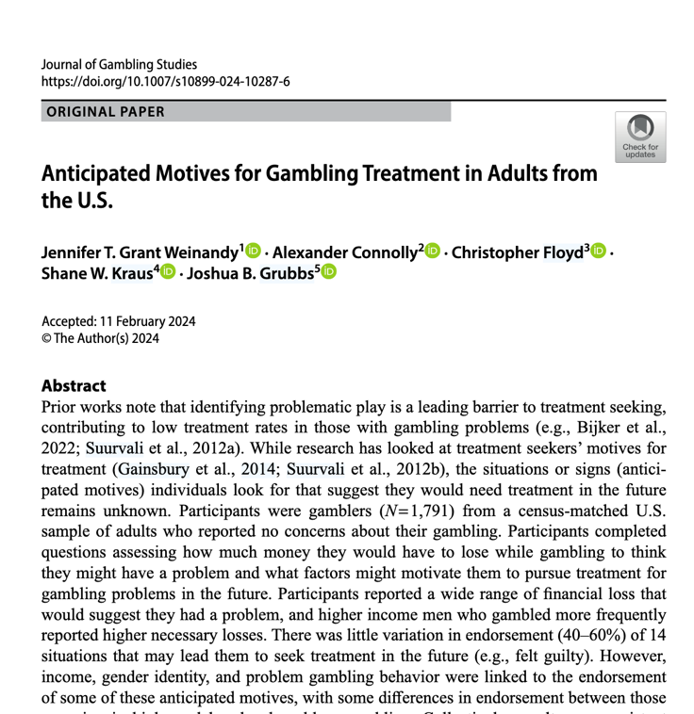
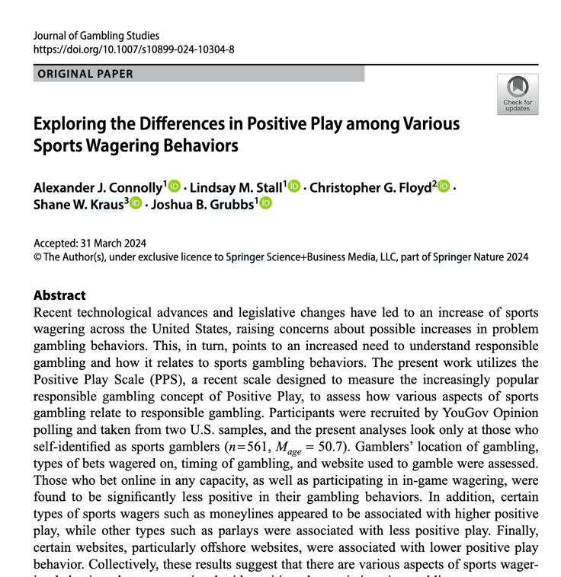
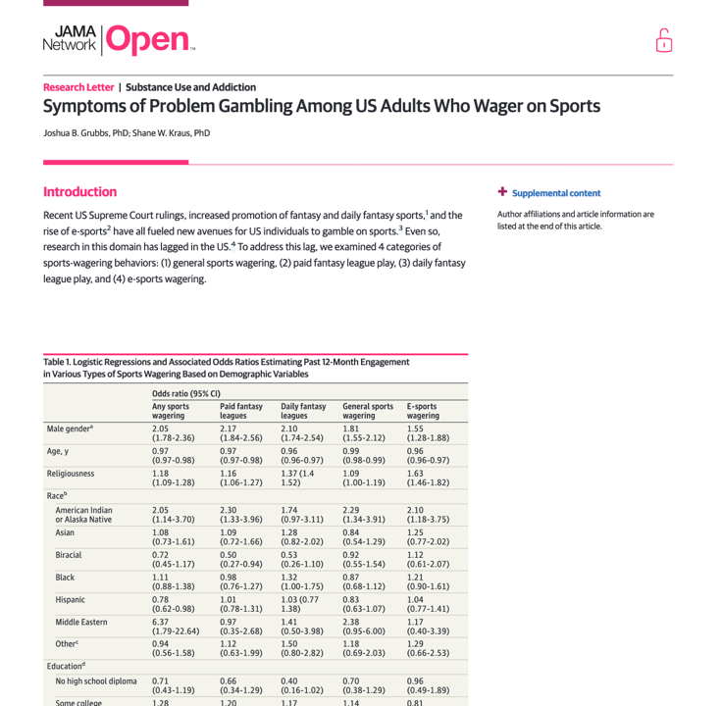
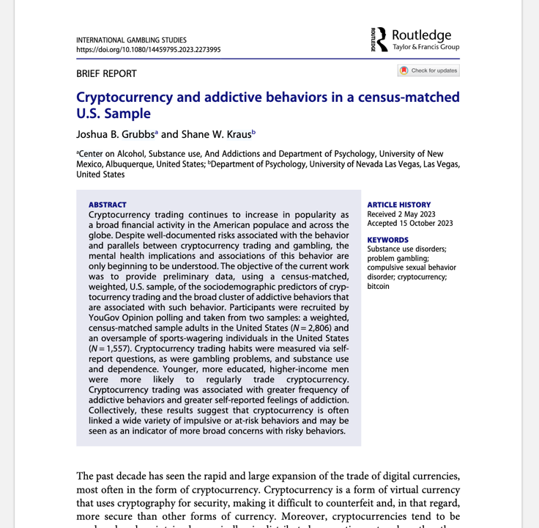
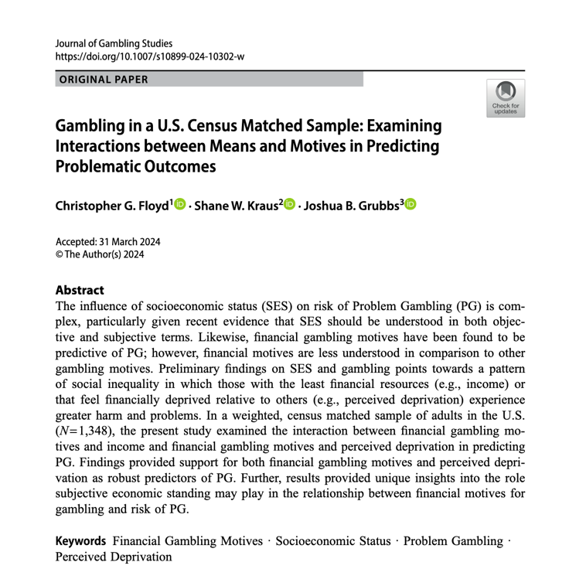

Slide 24
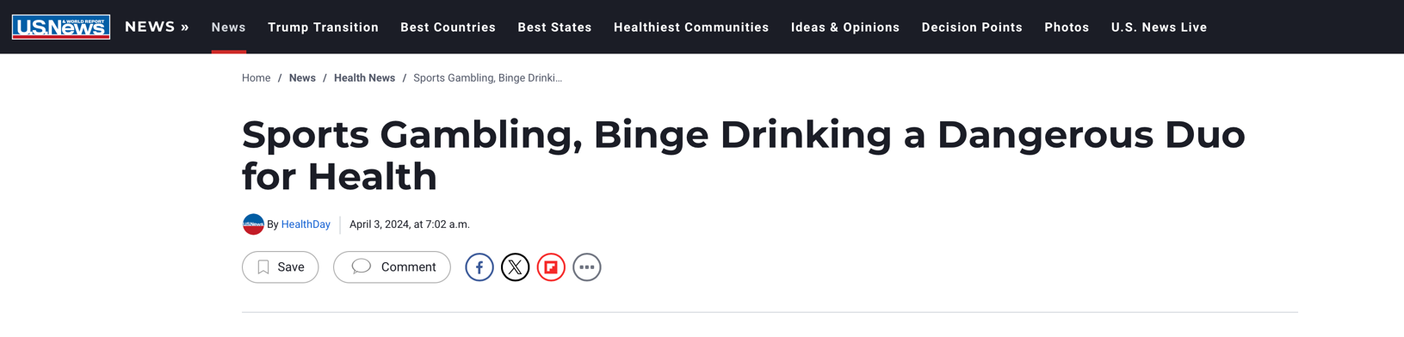
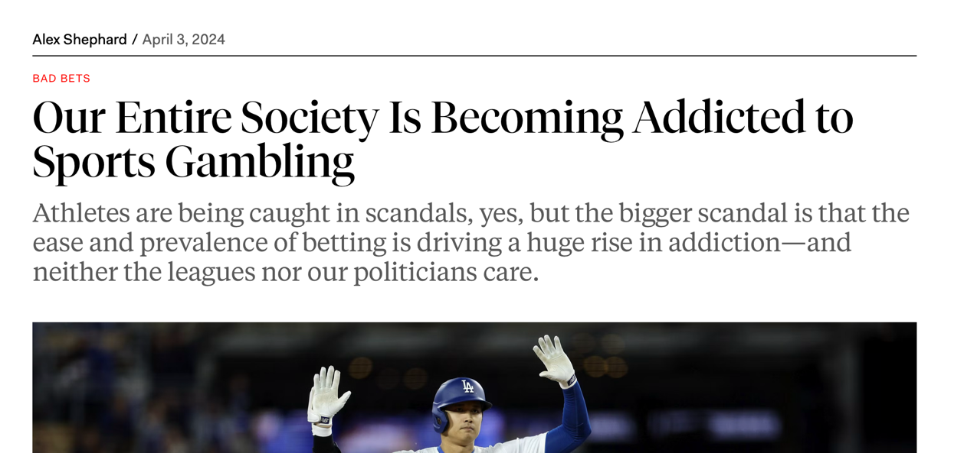
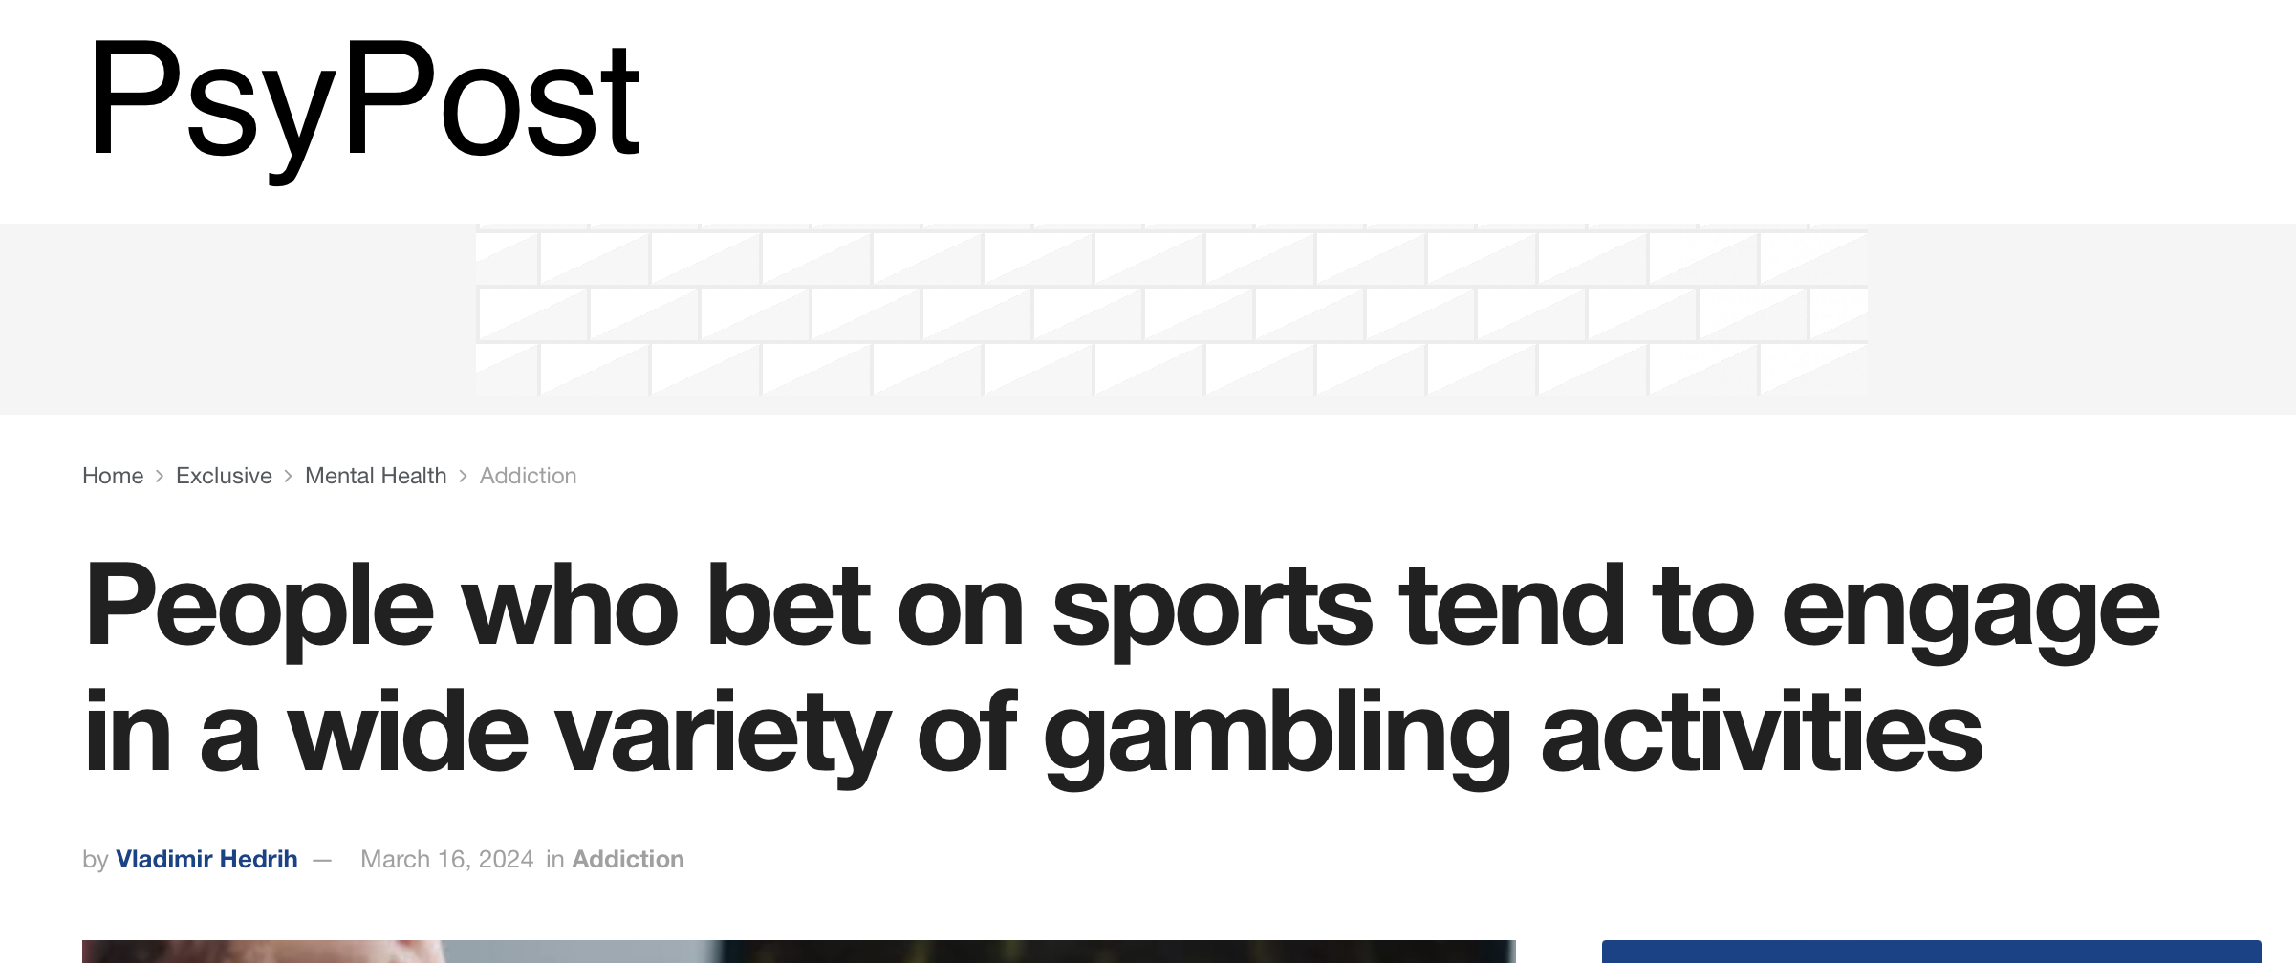
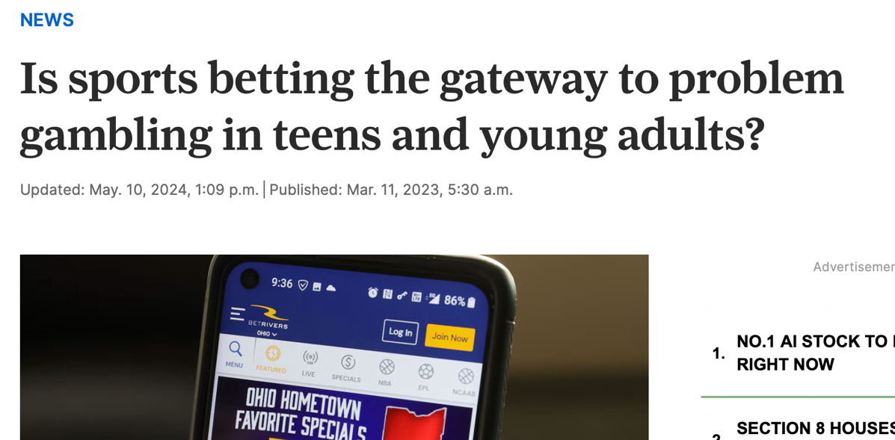
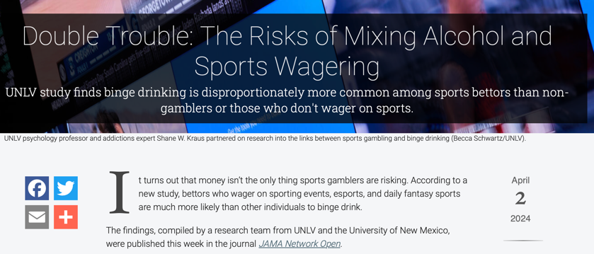
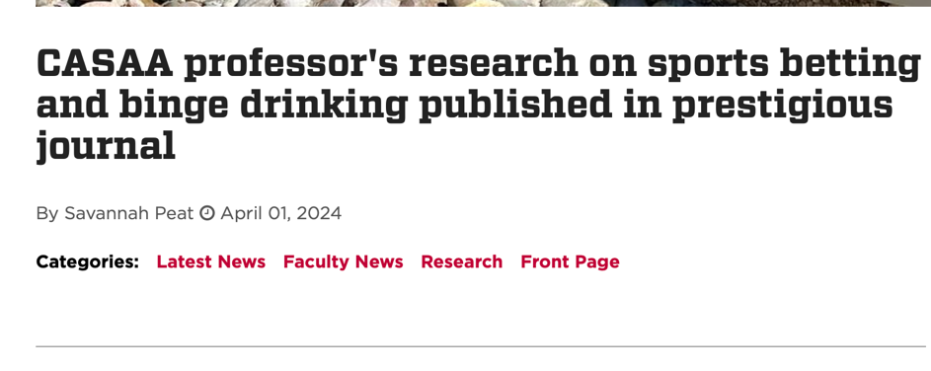
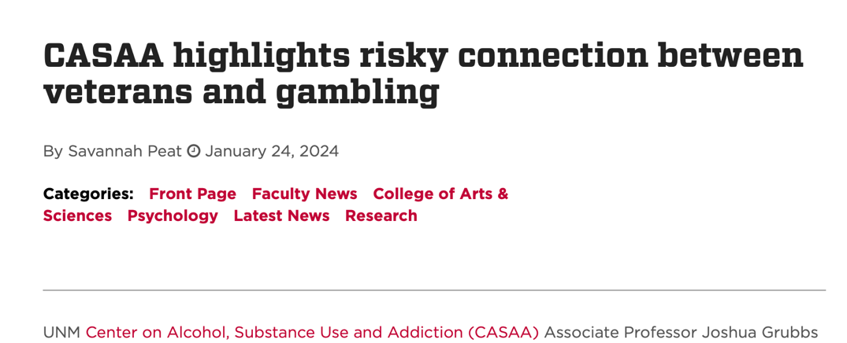

Slide 25
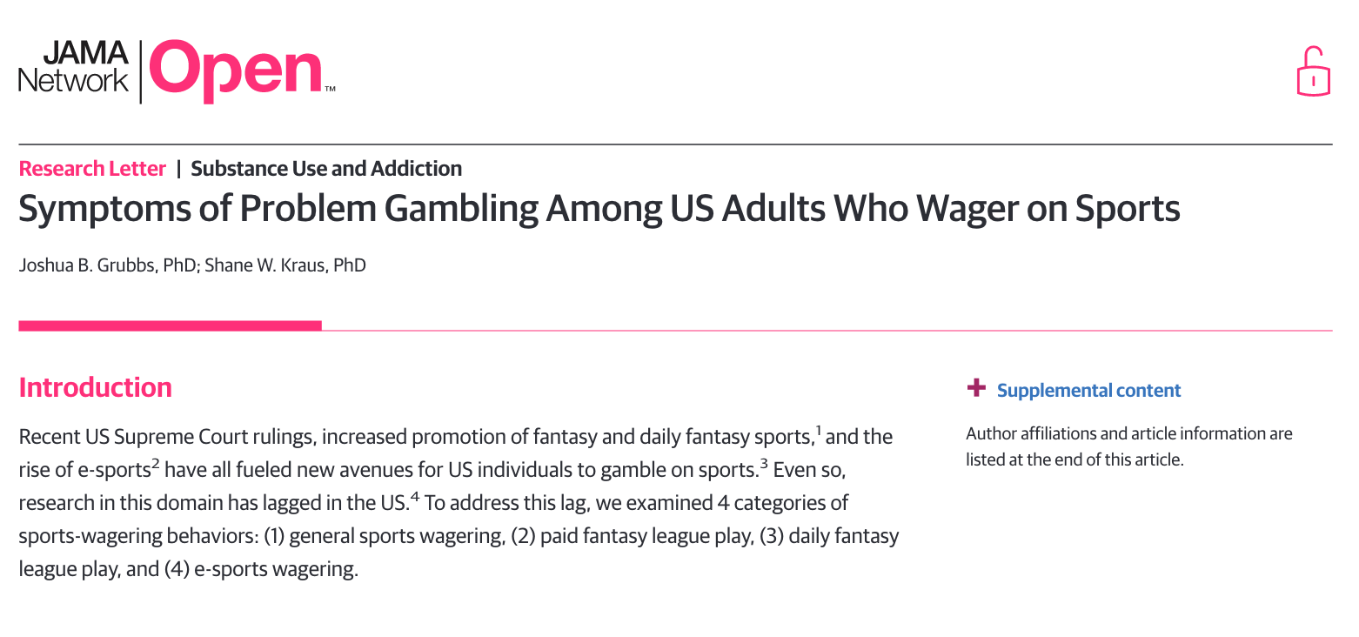

Slide 26
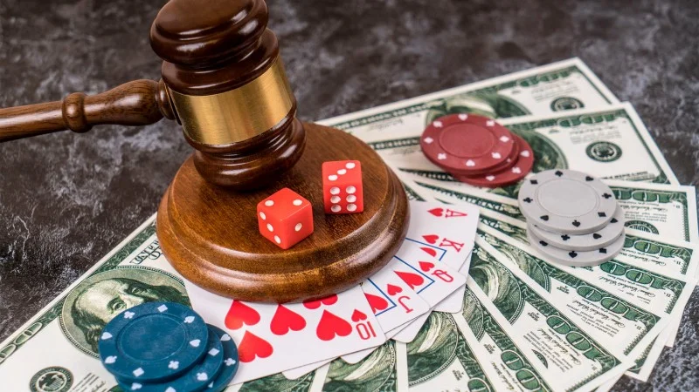

Slide 27

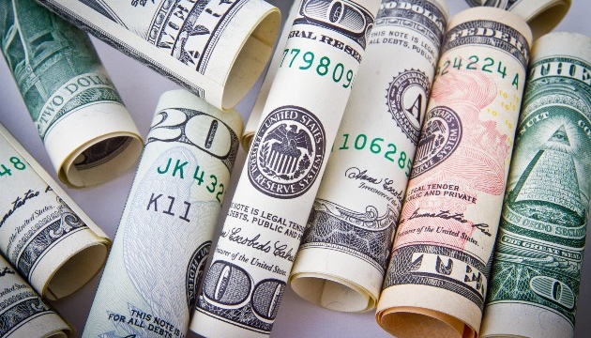

Notes:
Men, Younger men, men with college degrees, and income
As well as legality

Slide 28
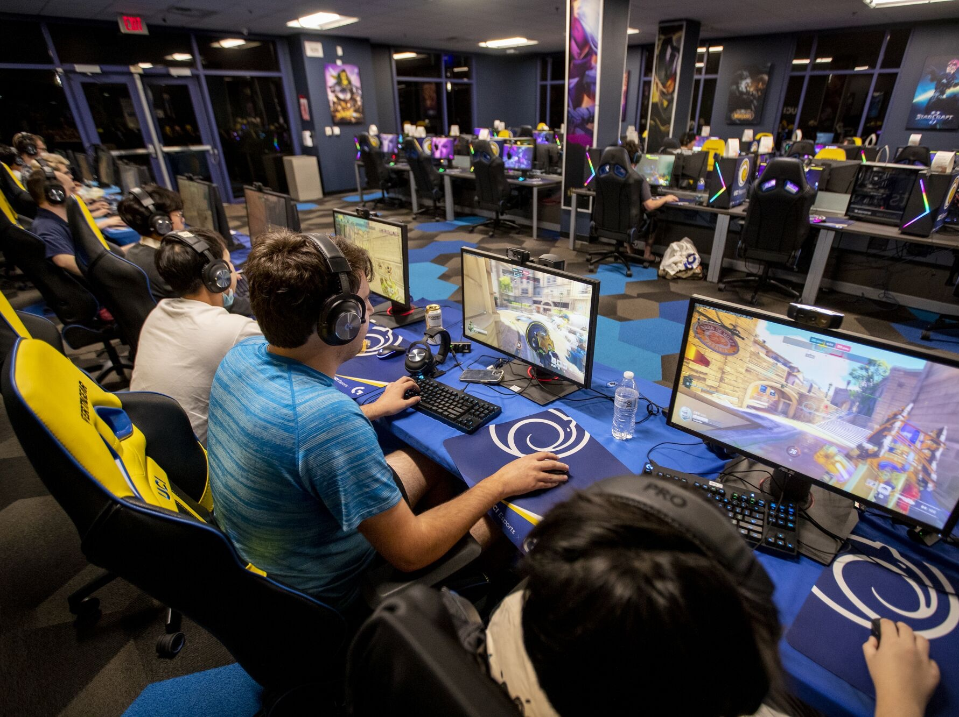
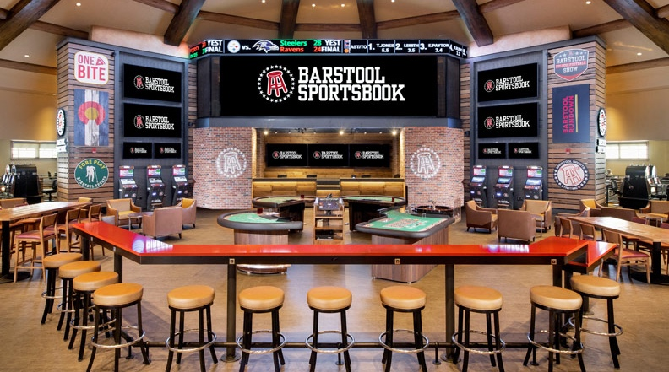


Slide 29
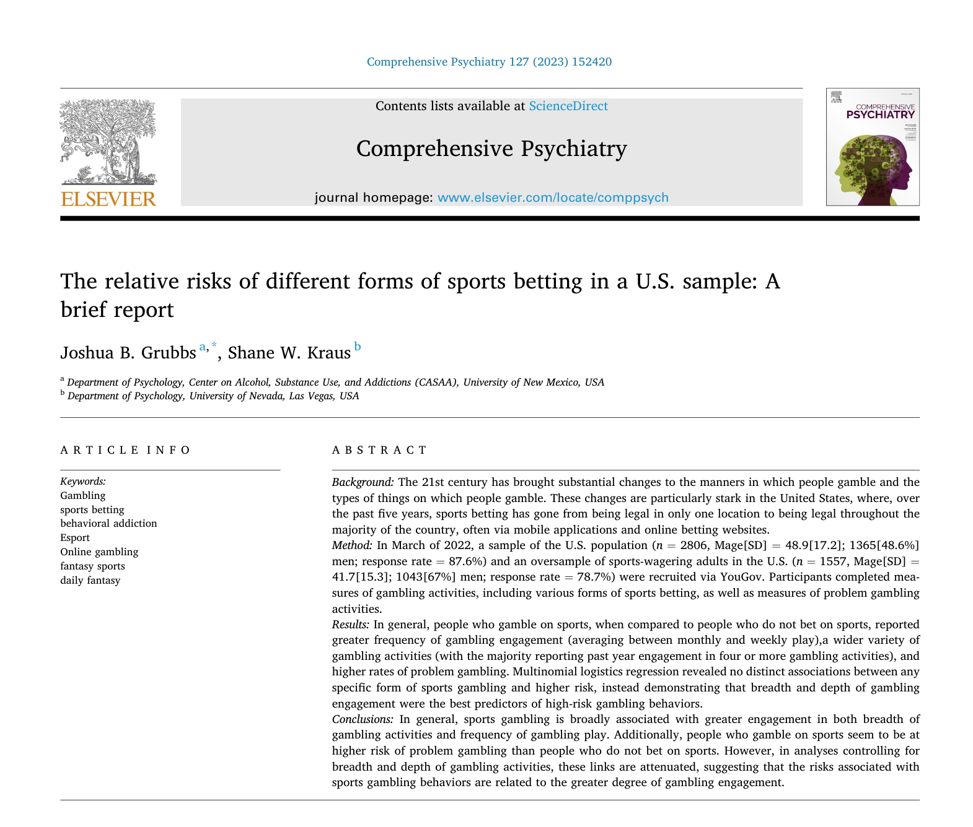

Slide 30
Not at All/Never

Slide 33
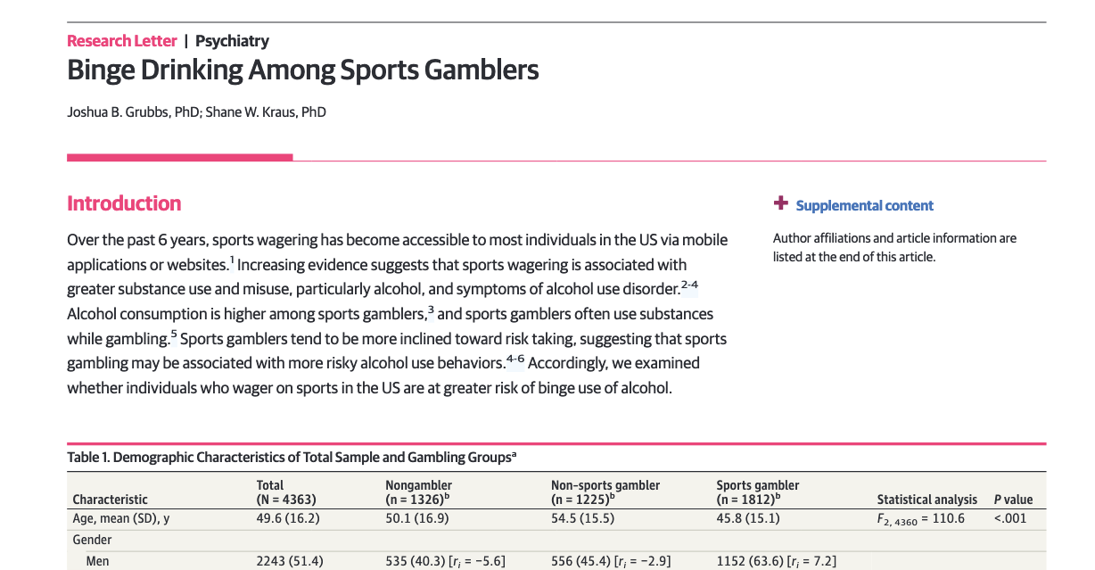

Slide 36

Drinking While Gambling

Slide 37
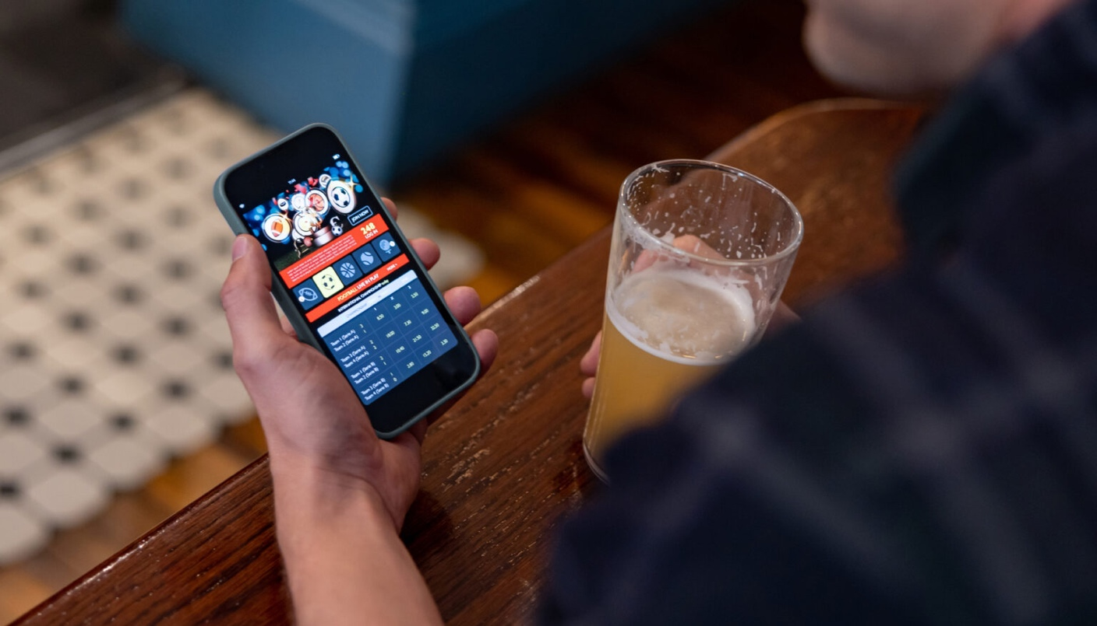
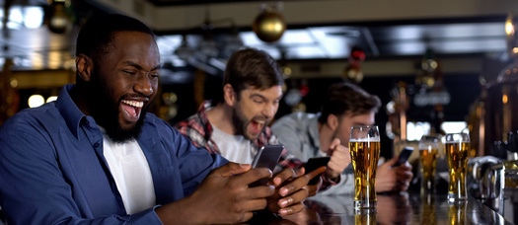
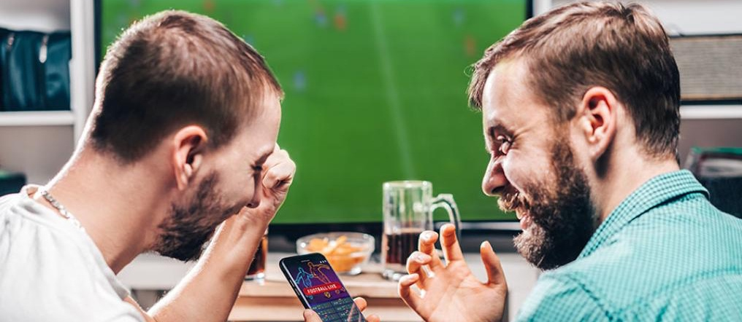
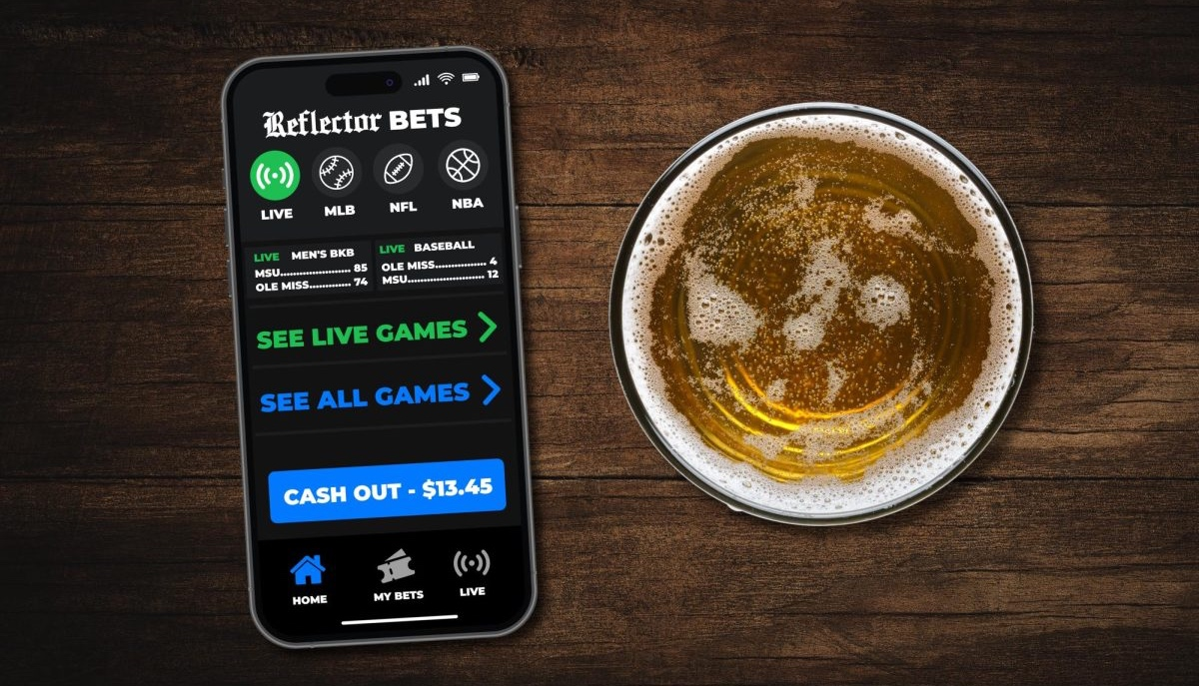

Slide 39
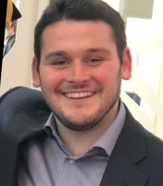
Gambling Motives

Slide 40
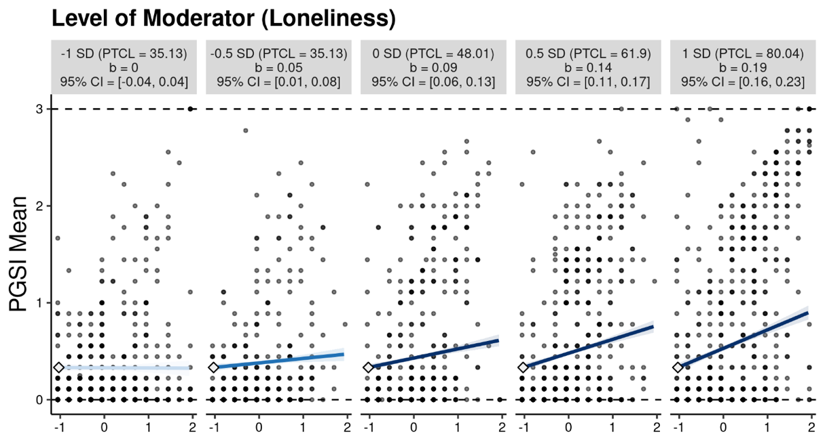
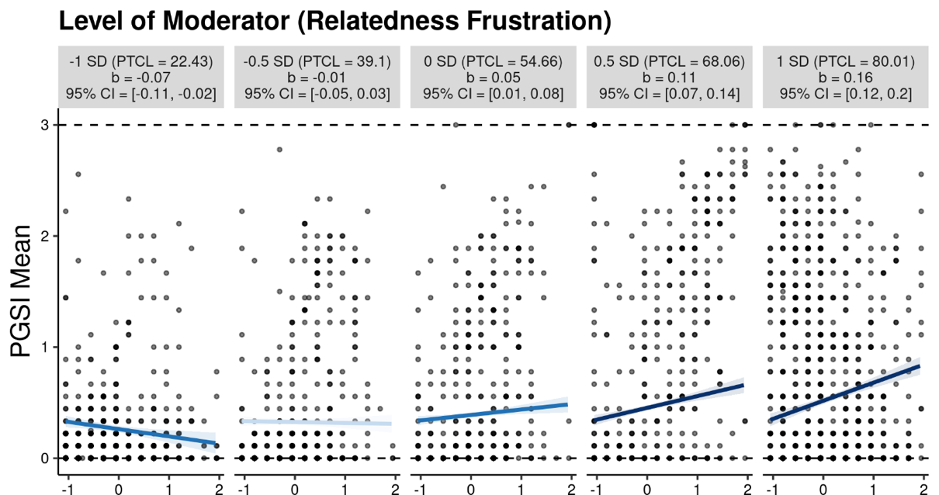
GMQ-S Interaction plots
Conditioned on levels of Loneliness
Negative effect at low frustration
Positive effect at High frustration
Notes:
Explanation Loneliness: for participants low in loneliness (i.e., -1 SD), social motives were not significantly associated with an increase in PGSI scores. However, social motives are significantly positively associated with an increase in PGSI scores at mean levels of loneliness (i.e., 0 SD). Further, for participants high in loneliness (i.e., +1 SD), a one unit increase in social motives was associated with a 0.19 increase in PGSI mean scores. Specifically, findings demonstrated that a positive effect of social motives on problem gambling is conditioned on levels of loneliness.
Explanation Relatedness Frustration: for participants low in relatedness frustration (i.e., -1 SD), social motives are significantly negatively associated with a decrease in PGSI scores (b = -0.07, p = 95%, CI = [-0.11, -0.02]. However, at relatedness frustration levels -0.5 SD below the mean, the effect is no longer significant. Further, for participants high in relatedness frustration (i.e., +1 SD), a one unit increase in social gambling motives was associated with a 0.16 increase in PGSI mean scores.
LOW Frustration = Protective Factors (negative relationship)
HIGH Frustration = Deficits/Vulnerabilities (positive relationship)

Slide 41



Sports Gamblers
Notes:
Findings remained the same among sports gambler subsample
Also, examined coping given less research on this with sports gamblers

Slide 42
Baseline (March/April, 2022)
First Follow-up (September/October, 2022)
Second Follow-up (March/April 2023)
Third Follow-up (September/October 2023)
Final Follow-Up (March/April 2024

Slide 43
Notes:
{1, Never}...
2, once or twice
3, monthly
4, weekly

Slide 45
Notes:
0 = No risk
1-4 Low risk
5-7 Mid risk
8+ high risk

Slide 46
 | Mean | SE |  | p-value | Variance |  | SE | p-value
Sports frequency Intercept | 2.397 | 0.032 |  | <.001 | 1.333 |  | 0.055 | <.001
Sports frequency Slope | -0.007 | 0.006 |  | .249 | 0.017 |  | 0.004 | <.001
PGSI Intercept | 2.269 | 0.125 |  | <.001 | 20.972 |  | 1.677 | <.001
PGSI Slope | -0.096 | 0.020 |  | <.001 | 0.113 |  | 0.067 | .098
Slope/Intercept Correlations
 | Sports Frequency Intercept |  | Sports Frequency Slope |  |  | PGSI Intercept
Sports Frequency Intercept | 1
Sports Frequency Slope | r=.030, p=.652 |  | 1
PGSI Intercept | r=.569, p<.001 |  | r=-.096, p=.106 |  |  | 1
PGSI Slope | r=-.481, p<.001 |  | r=.504, p<.001 |  |  | r=-.613, p<.001
Model Fit: CFI= .999, TLI=1.00, RMSEA= .013, SRMR= .020

Slide 47
Sports Gambling and Substance Use Over Time

Slide 51


Slide 52


Slide 53
Project 5: Gambling Related Cognitions Over Time

Slide 54
Notes:
Ted hartwell

Slide 59
Conclusions
Sports betting is related to problem gambling outcomes via:
  Greater depth of play
  Greater breadth of play
  Greater proportion of problematic players
Sports wagerers persist in their gambling behavior over time
  Greater Depth
  Greater Breadth
Sports wagerers also demonstrate higher levels of a range of other addictive behaviors

Slide 60
Sports betting is not inherently more risky than other forms of gambling… but sports gamblers are.

