Slide 1
Cognitive-Behavioral Therapy (CBT) for Addictions
Conference at Sandia Resort and Casino
Wednesday, March 5, 2025
Bruce S. Liese, PhD, ABPP
Professor of Family Medicine, Community Health, and Psychiatry
Clinical Director, Cofrin Logan Center for Addiction Research and Treatment
University of Kansas Medical Center
bliese@kumc.edu

Slide 2
Disclosure
Dr. Liese has co-authored three textbooks with Dr. Aaron T. Beck (published by Guilford Press), including the most recent Cognitive-Behavioral Therapy of Addictive Disorders (2022). He receives royalties for the sale of these books.

Slide 3
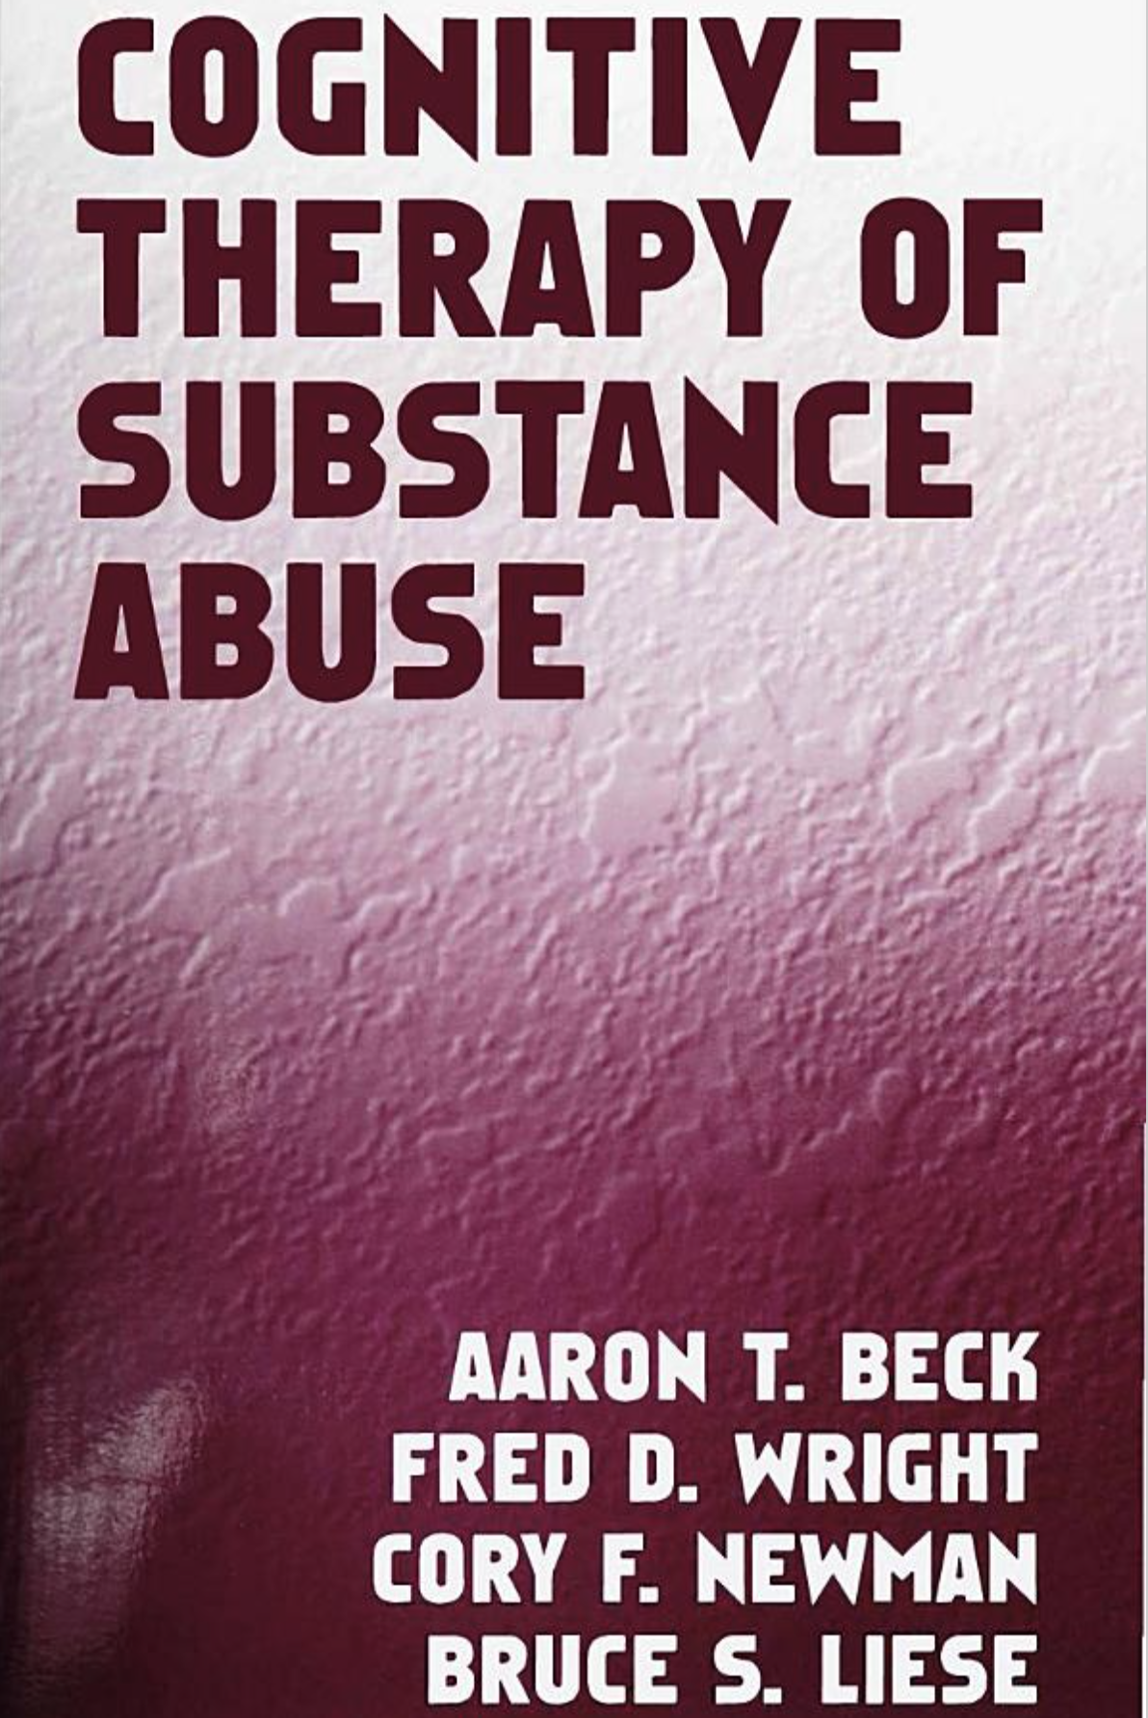
Back in 1993…

Slide 4
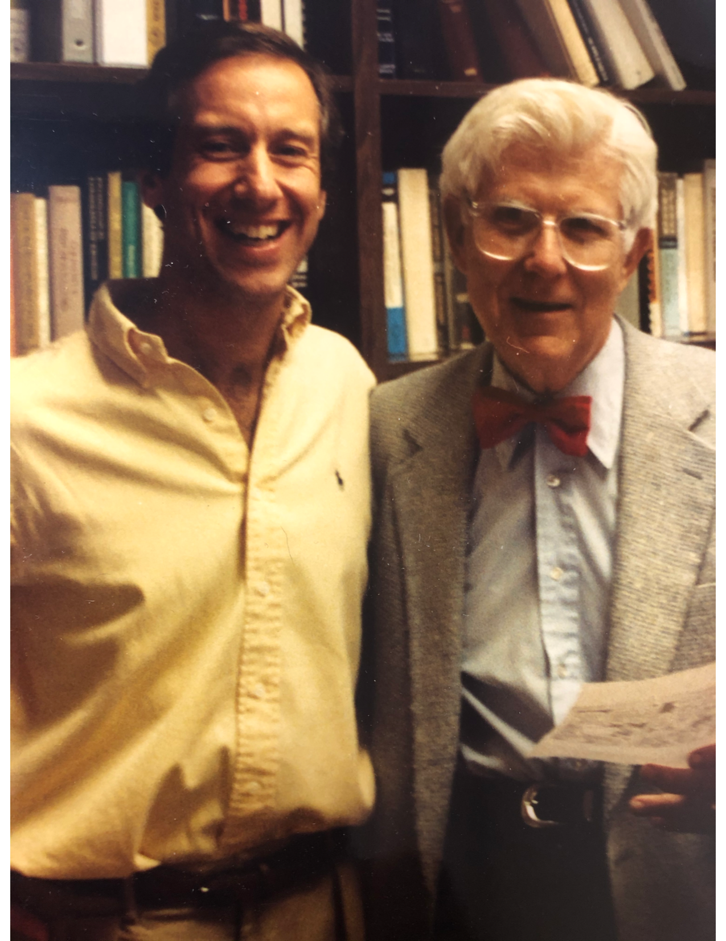
Back in 1993…

Slide 5
Addictions back in 1993…
Cocaine epidemic (crack) “Greatest threat to the United States”
Patients labeled “drug addicts” and “alcoholics”
Stereotypes ubiquitous (addiction associated with race, class, etc.)
DSM-IV - Substance abuse and dependence (dichotomous, legal)
Each addiction (e.g., alcohol, nicotine, heroin) considered unique, different, and often stereotyped
The sole aim of treatment was abstinence
Focused on relapse prevention
Please do not copy or distribute without permission from Bruce S. Liese, PhD (bliese@kumc.edu)

Slide 6
CBT back in 1993…
Misconceptions:
CBT is superficial and mechanistic
CBT focuses on symptoms, ignores personality
CBT ignores importance of early life experiences
CBT ignores interpersonal relationship factors
CBT minimizes the therapeutic relationship
CBT ignores motivational issues
CBT disregards emotion
One size fits all
Gluhoski (1994). Misconceptions of cognitive therapy. Psychotherapy, 31(4), 594-600.

Slide 7
Addictions today: Changes and Advances
Opioid epidemic; alcohol and nicotine use continue to cause high morbidity and mortality rates; cannabis increasingly accessible
We are more aware of stigmatizing behaviors and language
There is extensive data to refute stereotypes
DSM-5 – craving added, legal problems removed, behavioral addiction recognized, diagnoses on a continuous scale (mild, moderate, severe)
We realize there’s more to treatment than preventing relapse
It’s understood that patients should determine their own goals
MI has contributed to emphasis on collaborative therapy process
Please do not copy or distribute without permission
from Bruce S. Liese, PhD (bliese@kumc.edu)

Slide 8
DSM-5 Substance-Related and Addictive Disorders
DSM-IV (1994-2013) addictions were categorized as Substance Abuse and Dependence. No mention of behavioral addictions
DSM-5: Substance-Related and Addictive Disorders
Continuous scale introduced: mild (2-3 criteria), moderate (4-5 criteria), and severe (6 or more criteria)
Term addictive disorders added; abuse and dependence removed
Craving was added; Legal problems removed
Gambling added as first behavioral addiction
Internet gaming disorder added to Section III

Slide 9
Diagnostic criteria (DSM-5) for chemical addictions
Problematic pattern of use leading to impairment or distress in following areas:
Larger amounts consumed – or taken over a longer period than intended
Persistent desire or unsuccessful efforts to reduce or control use
Great deal of time spent obtaining, using, or recovering from use
Craving or a strong desire to use
Failure to fulfill role obligations (work, school, home, etc.)
Continued use despite persistent social/interpersonal problems caused or exacerbated by use
Important social, occupational, recreational activities given up
Use when physically hazardous
Continued use despite problems
Tolerance
Withdrawal
American Psychiatric Association (2022). Diagnostic and statistical manual of mental disorders (5th ed., text rev.).

Slide 10
Ten Classes of Drugs
Alcohol
Caffeine
Cannabis
Hallucinogens
Inhalants
Opioids
Sedatives, anxiolytics
Stimulants
Tobacco
Other

Slide 11
Diagnostic criteria (DSM-5) for gambling
Problematic pattern leading to impairment or distress in following areas (4+):
Needs to gamble with increasing amounts of money to achieve same level of excitement
Restless, irritable when trying to cut down or stop gambling
Repeated unsuccessful attempts to control, cut down, or stop gambling
Preoccupied with gambling (e.g., persistent thoughts, planning next venture, reliving gambling experiences)
Gambles when distressed
Returns after loss (chasing the high)
Lies to conceal extent of gambling
Has jeopardized or lost significant relationship, job, educational, or career opportunity due to gambling
Relies on other to provide money to relieve desperate financial situations caused by gambling
American Psychiatric Association (2022). Diagnostic and statistical manual of mental disorders (5th ed., text rev.).

Slide 12
DSM-5 (Section III) – Internet Gaming Disorder
Problematic pattern leading to impairment or distress in following areas (4+):
Preoccupation with Internet games.
Withdrawal symptoms when taken away.
Tolerance—need for increasing amounts of time engaged in Internet games.
Unsuccessful attempts to control the participation in Internet games.
Loss of interests in previous hobbies, etc
Continued use despite known problems.
Has deceived family, therapists, or others regarding amount of gaming.
Internet games to escape or relieve a negative mood (eg, loneliness, anxiety).
Has jeopardized or lost a significant relationship, job, or educational or career related in Internet Gaming.
American Psychiatric Association (2022). Diagnostic and statistical manual of mental disorders (5th ed., text rev.).

Slide 13
Six Core Components of Addiction
Salience – Importance; dominates thoughts, feelings, behaviors
Mood modification – Addictive behavior induces a desired state
Tolerance – Increase needed for same effect
Withdrawal symptoms – Unpleasant feelings and physical effects when activity is stopped or reduced
Conflict – Intrapersonal discomfort (e.g., anxiety, depression, guilt, shame, desperation); Interpersonal relationship problems
Relapse – Repeated slips or lapses; return to addictive behavior
Griffiths, M. (2005). A ‘components’ model of addiction within a biopsychosocial framework. Journal of Substance Use, 10(4), 191-197.

Slide 14
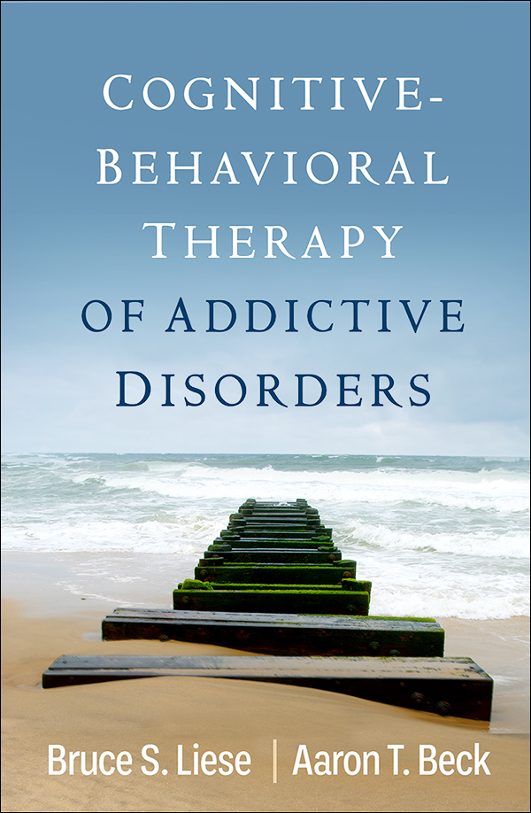
In 2022…

Slide 15
Today: Changes and Advances
Cognitive-Behavioral Therapists are strongly encouraged to:
Be flexible and prepared to hear profoundly complex problems
In addition to focusing on addiction, pay close attention to coexisting mental health problems, personality, context, culture and much more
Conduct (and share) careful, thorough case conceptualizations (CC) that include early life and cultural experiences; base treatment on CC
Conceptualize and address interpersonal processes
Carefully attend to the therapeutic relationship
Emphasize the centrality of motivation and emotion
Please do not copy or distribute without permission
from Bruce S. Liese, PhD (bliese@kumc.edu)

Slide 16
What is CBT?
CBT is not a single approach to therapy;
CBT is comprised of many brands with more similarities than differences
Cognitive Therapy (CT)
Acceptance and Commitment Therapy (ACT)
Rational Emotive Behavior Therapy (REBT)
Behavioral Activation (BA)
Contingency Management (CM)
Dialectical Behavior Therapy (DBT)
Cognitive Processing Therapy (CPT)
Mindfulness-Based Cognitive Therapy (MBCT)
Exposure and Response Prevention (ERP)
Please do not copy or distribute without permission
from Bruce S. Liese, PhD (bliese@kumc.edu)

Slide 17
CT
ACT
REBT
The house that CBT built
BA
CM
DBT
MBCT
ERP
© 2024 Bruce S. Liese

Slide 18
Theoretical model influences clinical focus
  ACT Psychological flexibility, acceptance, commitment
  DBT Emotion regulation, distress tolerance, surviving crises, mindfulness
  BA Identifying values and establishing corresponding behaviors
  REBT Maladaptive thoughts, cognitive distortions
  CT Schemas, basic beliefs, conditional beliefs, ATs
  ERP Exposure and response prevention
  MBCT Mindfulness, awareness, being present
  CM Rewards contingent on advances towards goals
Please do not copy or distribute without permission
from Bruce S. Liese, PhD (bliese@kumc.edu)

Slide 19
Problems are complex – Change is difficult
Patients seek treatment to:
Make cognitive, affective, behavior changes
Feel less sad, worried, angry; happier, content, fulfilled, connected
Improve coping skills
Get out of legal trouble
Repair broken relationships (e.g., get their kids back)
Better understand their personal world
Stop feeling so alone
End the pain they associate with living
Please do not copy or distribute without permission
from Bruce S. Liese, PhD (bliese@kumc.edu)

Slide 20
CBT Content and Process
Content: What is to being discussed for the purpose of facilitating change
Process: How change is facilitated in session (e.g., interpersonal and intrapersonal dynamics)
Please do not copy or distribute without permission
from Bruce S. Liese, PhD (bliese@kumc.edu)

Slide 21
Presenting problems and symptoms provide content
    Addictive behaviors
    Depression
    Anxiety
    Anger, aggression
    Loneliness
    Eating disorders
    Family problems
    Marital problems
Please do not copy or distribute without permission
from Bruce S. Liese, PhD (bliese@kumc.edu)

Slide 22
CBT process: The five essential components
Structure
Collaboration/alliance
Case conceptualization
Psychoeducation
Standardized techniques
Liese & Beck (2022). Cognitive-Behavioral Therapy
of Addictive Disorders. NY: Guilford Press.
Please do not copy or distribute without permission
from Bruce S. Liese, PhD (bliese@kumc.edu)

Slide 23
CBT case conceptualization
Collection and integration of clinically relevant information as an iterative process
Identification of problems and change targets
Ongoing, ever-evolving hypothesis formulation and testing
Influenced by therapist’s “home” theory, as well as professional and personal life experiences
Vital to therapy; everything else depends on it
Requires substantial effort
Liese & Beck (2022). Cognitive-Behavioral Therapy
of Addictive Disorders. NY: Guilford Press.
Please do not copy or distribute without permission
from Bruce S. Liese, PhD (bliese@kumc.edu)

Slide 24
CBT case conceptualization
Primary problems: Addiction, depression, anxiety, anger, aggression, loneliness, addictive behaviors, marital or family problems, etc.
Social/environmental/cultural context: Current living situation; close relationships; sociocultural factors; economic circumstances; legal or safety concerns; SDoH; community norms and expectations
Distal antecedents: Neurobiological, genetic, cultural, family, community, environmental influences
Liese & Beck (2022). Cognitive-Behavioral Therapy
of Addictive Disorders. NY: Guilford Press.
Please do not copy or distribute without permission
from Bruce S. Liese, PhD (bliese@kumc.edu)

Slide 25
CBT case conceptualization
Proximal antecedents: Current internal and external cues, triggers, circumstances, situations, physical states
Cognitive processes: Relevant schemas, beliefs, thoughts; cognitive distortions; values, principles
Affective processes: Predominant emotions, feelings, moods, physiologic sensations
Behavioral patterns: Adaptive versus maladaptive behaviors; coping versus compensatory strategies
Liese & Beck (2022). Cognitive-Behavioral Therapy
of Addictive Disorders. NY: Guilford Press.
Please do not copy or distribute without permission
from Bruce S. Liese, PhD (bliese@kumc.edu)

Slide 26
CBT case conceptualization
Readiness to change and associated goals: Precontemplation, contemplation, preparation, action maintenance
Integration of the data: Salient processes and patterns; causal relationships between context, thoughts, feelings, behaviors
Implications for treatment: strategies and techniques, based on data and hypotheses
Liese & Beck (2022). Cognitive-Behavioral Therapy
of Addictive Disorders. NY: Guilford Press.
Please do not copy or distribute without permission
from Bruce S. Liese, PhD (bliese@kumc.edu)

Slide 27
CBT model for understanding addictive behaviors
Internal and external triggers, cues, stimuli, circumstances
Thoughts and beliefs activated
Urges and craving (Impulses to engage in addictive behavior)
Path to
Recovery
Lapse or relapse
that triggers the abstinence violation effect
(AVE)
Permission to engage in behavior
Opportunity to abstain
Liese & Beck (2022). Cognitive-Behavioral Therapy of Addictive Disorders. NY: Guilford Press.

Slide 28
CBT model for understanding gambling disorder
Home alone, lonely, bored, restless; recent big casino losses
“I don’t have anything to do”
“This sucks.”
“I need to recoup losses.”
Urges and craving – strong impulse to visit casino
Path to
Recovery
Playing for an hour turns into many hours; more money lost
“I’m feeling lucky.”
“I’ll limit my play to $100.”
“I’ll leave while I’m ahead.”
Opportunity to abstain
Liese & Beck (2022). Cognitive-Behavioral Therapy of Addictive Disorders. NY: Guilford Press.

Slide 29
Early life experiences/Distal antecedents
Neurobiological, psychosocial, environmental (risk factors)
Development of vulnerability
Cognitive: Thoughts, beliefs, schemas
Behavioral: compensatory, habitual behaviors
Affective: depression, anxiety, anger, etc.
Development of addictive behaviors
Exposure, experimentation, and continued engagement in addictive behaviors
Continued development and reinforcement of problematic patterns (e.g, addictive, avoidant, withdrawn behaviors)
Liese & Beck (2022). Cognitive-Behavioral Therapy for Addictive Disorders. NY: Guilford Press.
Please do not copy or distribute without permission
from Bruce S. Liese, PhD (bliese@kumc.edu)

Slide 30
Early life experiences
Distal antecedents (risk factors):
Neurobiological, psychosocial, environmental
Development of vulnerability
Cognitive: thoughts, beliefs, schemas
Behavioral: compensatory habitual behaviors
Affective: depression, anxiety, anger, etc.
CBT developmental case conceptualization diagram
Exposure, experimentation, and continued engagement in maladaptive behaviors
Continued development and reinforcement of problematic patterns (e.g, addictive behaviors)
Internal and external triggers, cues, stimuli, circumstances
Thoughts and beliefs are activated
Urges and Craving (Impulse to engage in addictive behavior)
Lapse or relapse
that triggers potential AVE
Permission to engage in behavior
Opportunity to abstain
Please do not copy or distribute without permission
from Bruce S. Liese, PhD (bliese@kumc.edu)

Slide 31
Individual CBT structure
Agenda
Mood
Bridge (including review of homework)
Prioritize and discuss items
Guided discovery/motivational interviewing/functional analysis
Facilitate skill development
Provide and receive feedback
Homework
Liese & Beck (2022). Cognitive-Behavioral Therapy
of Addictive Disorders. NY: Guilford Press.
Please do not copy or distribute without permission
from Bruce S. Liese, PhD (bliese@kumc.edu)

Slide 32
Group CBT structure
90-minute sessions (more time if necessary)
5-8 members with addictions, comorbid conditions, and associated life problems
Open, rolling enrollment
Compatible with other approaches (e.g., mutual help groups, individual therapy)
Member goals variable (e.g., abstinence, harm reduction, improved relationships, employment, etc.), dependent on problems and readiness to change
Liese & Beck (2022). Cognitive-Behavioral Therapy
of Addictive Disorders. NY: Guilford Press.
Please do not copy or distribute without permission
from Bruce S. Liese, PhD (bliese@kumc.edu)

Slide 33
Group psychotherapy therapeutic factors (processes)
Instillation of hope
Universality
Imparting information
Altruism
Corrective recapitulation of family of origin issues
Developing social skills
Imitative behavior
Interpersonal learning
Group cohesiveness
Catharsis
Existential factors
Yalom, I. D. & Leszcz, M. (2020). Theory and practice
of group psychotherapy (6th ed.). NY: Basic Books
Please do not copy or distribute without permission
from Bruce S. Liese, PhD (bliese@kumc.edu)

Slide 34
Group CBT rules
Strict confidentiality
No clique formation or outside meetings
No advice
Personalize (vs. philosophize): “I” statements rather than “You” or “People…”
No threatening or disruptive behaviors
Liese & Beck (2022). Cognitive-Behavioral Therapy
of Addictive Disorders. NY: Guilford Press.
Please do not copy or distribute without permission
from Bruce S. Liese, PhD (bliese@kumc.edu)

Slide 35
Specific CBT techniques
Functional analysis
Motivational interviewing
Stimulus management
Delay and distract
Advantages-disadvantages analysis
Hierarchy of values
Activity monitoring and scheduling
Behavioral activation
Automatic thought records
Acceptance and commitment
Relaxation training
Mindfulness and meditation training
Contingency management
Role playing
Liese & Beck (2022). Cognitive-Behavioral Therapy
of Addictive Disorders. NY: Guilford Press.
Please do not copy or distribute without permission
from Bruce S. Liese, PhD (bliese@kumc.edu)

Slide 36
Functional (chain) analysis
Trigger, cue, situation, context
Trigger, cue, situation, context
Clinical outcome patterns
AT
C
AT
C
AT
C
AT
Trigger, cue, situation, context
Please do not copy or distribute without permission
from Bruce S. Liese, PhD (bliese@kumc.edu)

Slide 37
Automatic Thought Record (ATR)
Date and Time | Situations | Emotions (0-100) | Automatic thoughts or related beliefs (0-100%) | Alternative thoughts, beliefs, or responses (0-100%) | New Emotions (0-100)
Liese & Beck (2022). Cognitive-Behavioral Therapy
of Addictive Disorders. NY: Guilford Press.

Slide 38
Advantages-Disadvantages Analysis
 | Engage in problematic behavior | Stop problematic behavior
Advantages
Disadvantages
Relief from tension, pain, doubt, fear, discomfort
I have a sense of control
I can avoid problems that may solve themselves
I feel better about myself
I reduce or eliminate related problems
Improve my health and self confidence
My problems don’t resolve or they worsen
I continue to feel bad about myself
I’m still dependent on problematic patterns
I feel depression, anxiety, doubt, lost, overwhelmed
I must face my failures
I don’t yet have other coping skills or strategies
Liese & Beck (2022). Cognitive-Behavioral Therapy of Addictive Disorders. NY: Guilford Press.

Slide 39
CBT homework
All psychotherapy requires homework
Assignments to be determined collaboratively
In group therapy, other members are likely to provide ideas for homework
May be related to painful emotions or problematic behaviors but often involves general coping skills (cognitive, behavioral, relational)
Review of homework is essential
Conceptualizing noncompletion of homework is also essential
Liese & Beck (2022). Cognitive-Behavioral Therapy
of Addictive Disorders. NY: Guilford Press.
Please do not copy or distribute without permission
from Bruce S. Liese, PhD (bliese@kumc.edu)

Slide 40
Cognitive science constructs relevant to CBT
Attention
Executive functions
Cognitive effort (ease vs. strain)
Dual processes (e.g., system 1 and System 2 thinking)
Heuristics and biases
Intuition and expertise
Please do not copy or distribute without permission
from Bruce S. Liese, PhD (bliese@kumc.edu)

Slide 41
Executive functions
Mental processes necessary for planning, regulating, organizing, self-managing, and making personal changes
They are effortful
At least three core functions:
  Inhibitory control
  Cognitive flexibility
  Working memory
Diamond, A. (2012). Executive functions.
Annual Review of Psychology, 64, 135-168.
Please do not copy or distribute without permission
from Bruce S. Liese, PhD (bliese@kumc.edu)

Slide 42
Inhibitory control (self-control)
Maintains necessary attention, behavior, thoughts, emotions, to accomplish desired goals
Suppresses cognitive interference (inhibits extraneous mental images; selectively attends to important matters)
Overrides strong impulses; makes pattern change possible
Suspension of preconceived thoughts, beliefs is necessary for collaboration, change
Diamond, A. (2012). Executive functions.
Annual Review of Psychology, 64, 135-168.
Please do not copy or distribute without permission
from Bruce S. Liese, PhD (bliese@kumc.edu)

Slide 43
Cognitive flexibility
“Changing perspectives or approaches to problems, flexibly adjusting to new demands, rules, or priorities”
Shifting attention from one task to another, as needed
Empathy (perspective-taking) involves inhibiting one’s own perspective and loading another’s into working memory (overlaps with imagination and creativity)
Diamond, A. (2012). Executive functions.
Annual Review of Psychology, 64, 135-168.
Please do not copy or distribute without permission
from Bruce S. Liese, PhD (bliese@kumc.edu)

Slide 44
Working memory
Holds multiple thoughts, ideas in memory and organizes them so they can be acted upon in a goal-directed manner
Appraises and reappraises ideas, to make decisions and plans
Not the same as short-term memory; uses dorsolateral PFC
Requires inhibitory control and cognitive flexibility
Diamond, A. (2012). Executive functions.
Annual Review of Psychology, 64, 135-168.
Please do not copy or distribute without permission
from Bruce S. Liese, PhD (bliese@kumc.edu)

Slide 45
Cognitive effort
Executive functions require cognitive effort
Cognitive effort varies depending on load placed on it
Simple functions place little load on individuals: ease
Complex functions place heavy loads on individuals: strain
Cognitive strain is experienced as work, effort, demanding
People tend to minimize cognitive effort; we make snap judgments and rely on intuition
Kahneman, D. (2011). Thinking Fast and Slow.
New York: Farrar, Straus and Giroux.
Please do not copy or distribute without permission
from Bruce S. Liese, PhD (bliese@kumc.edu)

Slide 46
System 1 thinking
Automatic, fast, effortless, involuntary, intuitive (scans)
Generates impressions, feelings, judgments
Biased to believe and confirm, suppress doubt
Focuses on existing evidence; ignores absent evidence
Responds more strongly to losses than gains (aversion)
Seeks simple answers (i.e., heuristics) to complex questions and substitutes easy for difficult ones
When System 1 thoughts are reinforced, they become core beliefs
Kahneman, D. (2011). Thinking Fast and Slow.
New York: Farrar, Straus and Giroux.
Please do not copy or distribute without permission
from Bruce S. Liese, PhD (bliese@kumc.edu)

Slide 47
System 2 thinking
Effortful, deliberate, intentional, reflective, slow
Activated when cognitive load too much for System 1
Searches memory
Associated with attention, concentration, agency, choice
Works by asking and answering questions
Not the same as intelligence; more related to rationality
Many people assume that their System 2 is in charge
Kahneman, D. (2011). Thinking Fast and Slow.
New York: Farrar, Straus and Giroux.
Please do not copy or distribute without permission
from Bruce S. Liese, PhD (bliese@kumc.edu)

Slide 48
Heuristics
System 1 short cuts that ease cognitive load
Typically helpful, but not always
Numerous categories, including:
Availability – first thoughts, most easily accessed
Representativeness – assigns membership to categories
Framing – How stories are told influences perspective
Affect – Emotional reasoning; good feelings associated with cognitive ease; bad feelings associated with cognitive strain
Anchoring – The information first presented may have disproportionate influence on impressions
Kahneman, D. (2011). Thinking Fast and Slow.
New York: Farrar, Straus and Giroux.
Please do not copy or distribute without permission
from Bruce S. Liese, PhD (bliese@kumc.edu)

Slide 49
Cognitive bias
When heuristics are employed, cognitive biases are inevitable and they can take multiple forms
Heuristic categories provide insight into cognitive biases:
Availability – What you see is all there is (WYSIATI)
Representativeness – Categories may be chosen erroneously
Framing – Underemphasizing or overemphasizing essential facts
Affect – Just because it feels right/wrong doesn’t mean it is
Anchoring – The first facts or ideas may be least important
Kahneman, D. (2011). Thinking Fast and Slow.
New York: Farrar, Straus and Giroux.
Please do not copy or distribute without permission
from Bruce S. Liese, PhD (bliese@kumc.edu)

Slide 50
Bias in mental health providers
Mental health professionals in private practice (n=129)
60% women; 12 psychiatrists, 34 psychologists, 28 professional counselors, 37 clinical social workers, 18 marriage and family therapists
On average, viewed skills to be at the 80th percentile
Modal rating 75th percentile; none below 50th percentile
On average, believed 77% of their patients improved; 3.66% deteriorated; 21% thought 90% of their patients improved
Walfish, S. (2012). An investigation of self-assessment bias in
mental health providers. Psychological Reports, 110(2), 639-644.
Please do not copy or distribute without permission
from Bruce S. Liese, PhD (bliese@kumc.edu)

Slide 51
Overconfidence
Overconfidence occurs in System 1
“When we don’t know what we don’t know.”
Likely related to loss aversion; we “fabricate and revise history,” and our egos conserve what we like about ourselves (Greenwald, 1980; p.604)
The confidence:competence ratio is important
Too much confidence results in arrogance (Grant, 2021)
Too little may result in insecurity, avoidance, passivity
It’s important to know what you don’t know
Please do not copy or distribute without permission
from Bruce S. Liese, PhD (bliese@kumc.edu)

Slide 52
The Dunning-Kruger effect
When people are blind to their own ignorance
Meta-ignorance: Ignorance of ignorance; unknown unknowns
Dunning argues:
  Ignorance is prevalent in everyday life
  Ignorance is often invisible to those who suffer from it
The first rule of the Dunning-Kruger Club is you don’t know you’re a member of the Dunning-Kruger Club (Grant, 2021; p. 40)
Dunning, D. (2011). The Dunning-Kruger effect: On being ignorant of one’s own ignorance. Advances in Experimental Social Psychology, 44, 247-296.
Please do not copy or distribute without permission
from Bruce S. Liese, PhD (bliese@kumc.edu)

Slide 53
Processes to consider when CBT isn’t working
Losing focus in session (not following agenda; fear of re-directing)
Overreliance on preferred techniques (based on home theories)
Missing vital opportunities to focus on process (Ah-hah moments)
Failing to do a thorough functional analysis or case conceptualizatin
Leaving the patient behind
Over-focusing on triggers (context), thoughts, feelings, or behaviors
Overreliance on the alliance
Failure to attend to cognitive science processes
Please do not copy or distribute without permission
from Bruce S. Liese, PhD (bliese@kumc.edu)

Slide 54
Summary and conclusions
Addictions – and the people who suffer from them – are far more complex and diverse than many clinicians realize
CBT is far more complex and diverse than many clinicians realize
We (clinicians) tend to overestimate our expertise – and underestimate the work it takes for patients to change
Rigorous thinking – in System 2 – is essential to effective therapy
Clinician uncertainty is an asset, rather than a liability
Hypotheses generation and testing are essential to good therapy
We benefit from understanding our own heuristics and biases
Please do not copy or distribute without permission
from Bruce S. Liese, PhD (bliese@kumc.edu)

Slide 55
Summary and conclusions
  Be cognitively flexible, curious, intentional, deliberate
  Fully understand the complex and nonlinear nature of change
  Continually formulate and revise clinical hypotheses
  Closely attend to context and functions of patient choices
  Identify barriers to change – especially when working with diverse, marginalized, and disadvantaged individuals
  Don’t exaggerate skills or expertise; avoid attachment to a brand
  Remember: all brands of CBT provide wisdom and valuable technique; learn and draw from them all
Please do not copy or distribute without permission
from Bruce S. Liese, PhD (bliese@kumc.edu)

