Slide 1
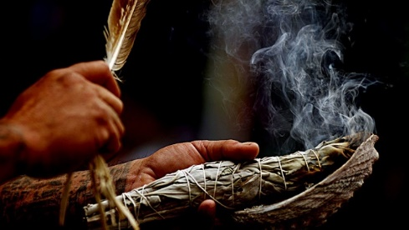
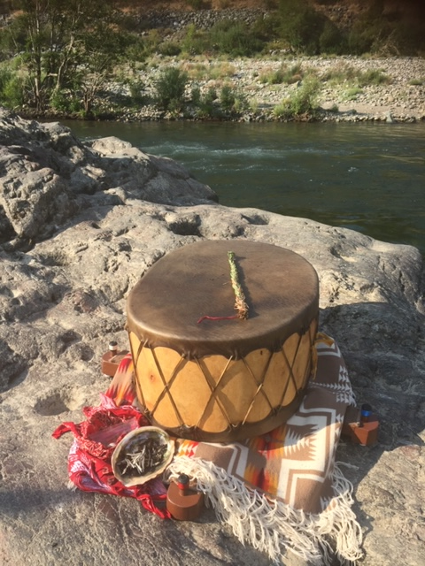
Healing the Spirit of Addiction
Addressing Historical Trauma and Indigenous Cultural Perspectives of Addiction Treatment
Tonya Elliott Ph.D. LMFT
University of Louisiana Monroe

Slide 2
Land Acknowledgment for Sandia Pueblo
Before we begin, I would like to acknowledge that we are gathered today on the ancestral lands of the people of Tuf Shur Tia, meaning "Green Reed Place," known today as Sandia Pueblo. The Sandia people are the stewards of this land and have cultivated a deep connection to its mountains, rivers, animal and plant relatives and to the people here. ​
I acknowledge the historical and ongoing impacts of colonization, systemic oppression, and intergenerational trauma. I also recognize the profound wisdom and resilience embedded in Indigenous healing traditions, which continue to offer strength and restoration for our families of all traditions and communities. I recognize the enduring strength, resilience, and wisdom of the Sandia people. I honor their ongoing contributions to the cultural and spiritual fabric of this region.
With gratitude and respect, I offer this acknowledgment as an expression of solidarity, commitment, and responsibility toward fostering healing, equity, and cultural reclamation.
May our time here be guided by the wisdom of our ancestors.
Wado-Giving Thanks in Cherokee

Slide 3

Agenda
Introductions-Osiyo Hello/Welcome
Situating Gambling Addiction in Native Culture
Defining Historical Trauma
Understanding our responsibility to cultural competency and trauma informed practices as mental health counselors
Answering the questions:
Why do dominant culture theories fall short for helping Native people heal from addiction?
What brings resiliency and wellness to Native people?
Ceremony Assisted Treatment-Experiential Learning
Questions/Discussion

Slide 4
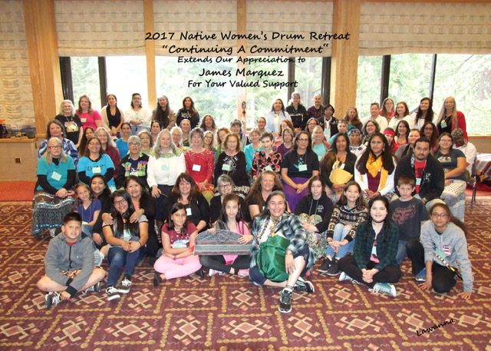



My cultural mentors and our community:
Dr. April Lea Go Forth (Cherokee-Lakota)
Dr. Shirley Rowland (Eastern Cherokee)
Barbara Warren (Western Cherokee)
Maggie Steele (Chiricahua-Apache

Slide 5
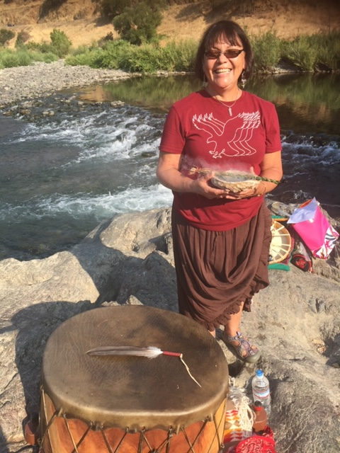
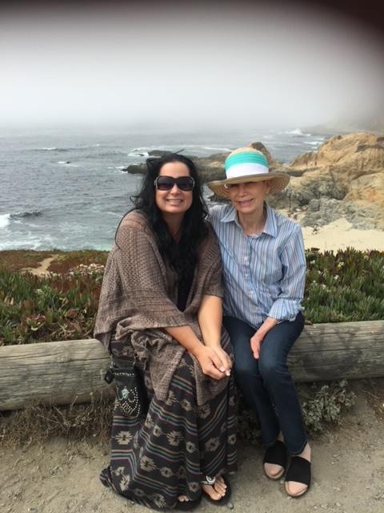
Sonia & Barbara
Sonia Keller-Lapoint ‘Birdwoman’: Seneca Onondaga Beaver Clan
Barbara Warren: Cherokee Nation

Slide 6
Problem Gambling
Different terms used to define gambling addiction.
“problem”, “pathological”, “disordered”, “compulsive”, “excessive”, and “at risk” (Griffiths, 2014).
The essential features of “pathological gambling” are seen as (a) a continuous or periodic loss of control over gambling; (b) a progression, in gambling frequency and amounts wagered, in the preoccupation with gambling and in obtaining monies with which to gamble; and (c) a continuation of gambling involvement despite adverse consequences (Rosenthal & Lesieur, 2007).

Slide 7
Conceptualizing the problem
When training therapists we understand that conceptualization must come before treatment planning.
We collect data: Clinical Assessment
We conceptualize from within a theoretical orientation.
When we interpret the results of a research study we use a theoretical framework.
These are most often based in dominant culture Euro-American based theories.
Individual vs. collective perspectives

Slide 8
The BIG DIVIDE
Philosophical Underpinnings of Counseling Theories
Modern (medical model) | Post-Modern (cultural relational model)
Truth is absolute | Truth is contextual
One truth to be known | Many truths and perspectives to be known
There is one path to the top of the mountain. | There are many paths to the top of the mountain.
Individual Collective

Slide 9
ACA Multicultural and Social Justice Counseling Competencies
4 Developmental Domains-
Attitudes/ Beliefs, Knowledge, Skills and Awareness
Counselor self-awareness
Client world-view
Counseling relationship
Counseling and advocacy interventions
ACA MSJCC
https://www.counseling.org/docs/default-source/competencies/multicultural-and-social-justice-counseling-competencies.pdf?sfvrsn=20

Slide 10
Cultural Relational Conceptualization
Addiction is viewed as a symptom of developmental, relational and spiritual failures
For Native American people, developmental, relational and spiritual failures are understood collectively and have roots in current and historical trauma.
This creates an importance for following a relational model of treatment as well as relational models of data interpretation.
(Duran, 2019), (Mooney, Roberts, Bayston, & Bowden, 2019).

Slide 11
Fundamental Differences in Stage Model
Collective vs Individual Identity
GONA - Erikson’s Psychosocial Stages:
Belonging- Trust vs. Mistrust
Autonomy vs Doubt and Shame
Mastery- Initiative vs. Guilt
Industry vs Inferiority
Interdependence- Identity vs Role Confusion
Intimacy vs Isolation
Generosity- Generativity vs Stagnation
Integrity vs Despair

Slide 12
Problems with Dominant Culture Theories
1.) We are trying to understand a collective phenomenon from within an individualistic perspective
2.) Perpetuates oppression- both internalized and externalized
3.) Pathologizes trauma-creates more shame triggers and can actually, cause harm.
4.) Medical model approaches typically do not address the spiritual trauma.
Symptoms of historical trauma cannot be effectively treated by current psychotherapies that do not include some form of cultural adaptation
(Brave Heart, Chase, Elkins, Altschul, 2011; Gone, 2013; Griner, & Smith, 2006; Johnson, 2006).

Slide 13
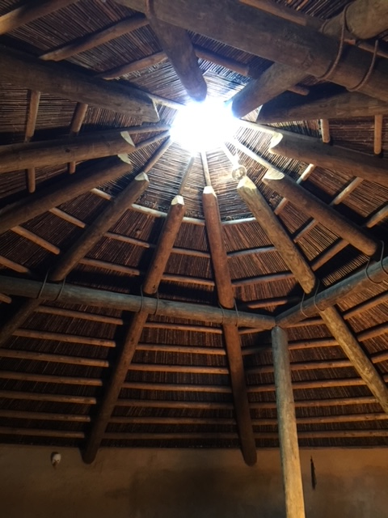
Historical Trauma
Cumulative emotional and psychological wounding across generations which emanates from massive group trauma (Brave Heart, Chase, Elkins, Altschul, 2011)
Includes multigenerational genocide, and ethnic cleansing of Indigenous peoples of the Americas, which has resulted in unresolved grief, complicated bereavement, PTSD and depression in Native people (Brokenleg, 2012).
Complicated by continuous daily reminders such as reservation living, loss of language, loss of culture, loss of traditional family systems, loss of traditional healing practices (spiritual trauma) etc. (Whitbeck, Adams, Hoyt, & Chen, 2004) (Johnson, 2006) (Bernal & Scharró-del-Río, 2001).
Wellbriety Video Clip
https://youtu.be/vZwF9NnQbWM?feature=shared

Slide 14
Understanding Genocide
Genocide is defined as specific acts committed with the intent to destroy, in whole or in part, a national, ethnic, racial, or religious group (United Nations, 1948).
Established under the Convention on the Prevention and Punishment of the Crime of Genocide (UN, 1948).
Acts Constituting Genocide
Killing members of the group.
Causing serious bodily or mental harm to members of the group.
Deliberately inflicting conditions of life calculated to bring about the group's destruction.
Imposing measures intended to prevent births within the group.
Forcibly transferring children of the group to another group.
United Nations. (1948). Convention on the Prevention and Punishment of the Crime of Genocide.

Slide 15
Psychology of Genocide
Social Categorization and In-Group Bias-They are all criminals
Propaganda and Dehumanizing Language-Savages, Pagan, Devils, Animals,
Moral Disengagement-Collective dehumanization enables moral disengagement- implement policies that systematically dehumanize certain groups, such as segregation or discriminatory laws. These practices reinforce societal norms that marginalize and oppress, perpetuating cycles of dehumanization.
Institutional Policies and Practices- implement policies that systematically dehumanize certain groups, such as segregation or discriminatory laws. These practices reinforce societal norms that marginalize and oppress, perpetuating cycles of dehumanization.
Cultural Narratives and Stereotypes- Deep-seated cultural narratives and stereotypes depict specific groups as barbaric or uncivilized. These portrayals, entrenched in media, literature, and folklore, shape collective perceptions and justify exclusionary or violent actions.

Slide 16
Collective Dehumanization
Collective dehumanization, where entire groups are perceived as less than human, is a multifaceted phenomenon influenced by various psychological and social mechanisms.
Understanding these mechanisms is crucial for addressing and mitigating the effects of historical trauma and preventing future atrocities. ​

Slide 17
Cultural Destruction
Systemic racism can lead to the erosion of cultural identities through:
-Forced assimilation,
-Suppression of languages
-Destruction of cultural sites and practices.
Cultural genocide aims to eliminate the existence of a group as a distinct entity, a practice observed in various colonial contexts.

Slide 18
Historical Trauma Response
Typical emotional responses to historical trauma include:
Feelings of persistent grief and loss
Complicated and unresolved bereavement
Dysregulated emotions
Sadness
Anger
Hopelessness.
Difficulty with attachment to caregivers
Historical trauma response explains the profound mental health disparities and difficulty in access to and follow through in mental health treatment for Native people
(Grayshield et al., 2015; Guenzel & Struwe, 2019; Nelson-Barber & Johnson, 2016; Reagan, 2012; Brave Heart-Yellow Horse and colleagues (2016a); Whitbeck et al 2004).

Slide 19
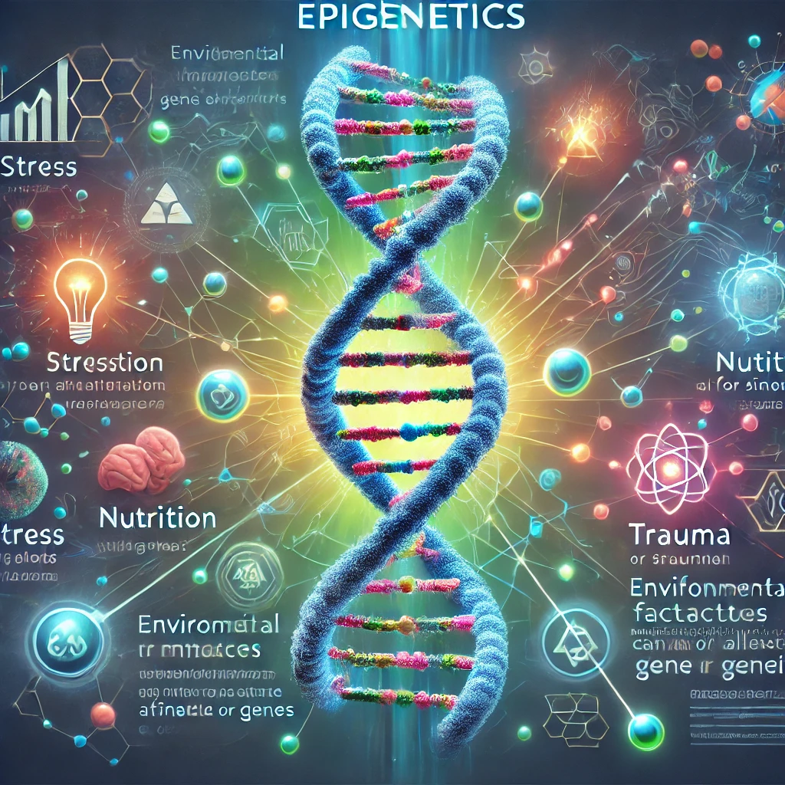
Epigenetics
Epigenetics is the study of how your behaviors and environment can cause changes that affect the way your genes work.
Unlike genetic changes, epigenetic changes are reversible and do not change your DNA sequence, but they can change how your body reads a DNA sequence(POWs who survived starvation-descendants more prone to diabetes).
Explains how events in someone’s lifetime can change the way their DNA is expressed, and how that change can be passed on to the next generation.
Tiny chemical tags are added to or removed from our DNA in response to changes in the environment in which we are living. These tags turn genes on or off, offering a way of adapting to changing conditions without inflicting a more permanent shift in our genomes.
These tags can be passed down genetically (Mice and cherry blossoms)
Can the legacy of trauma be passed down the generations?
https://www.bbc.com/future/article/20190326-what-is-epigenetics
Epigenetic Mechanisms of Integrative Medicine
https://www.ncbi.nlm.nih.gov/pmc/articles/PMC5339524/

Slide 20
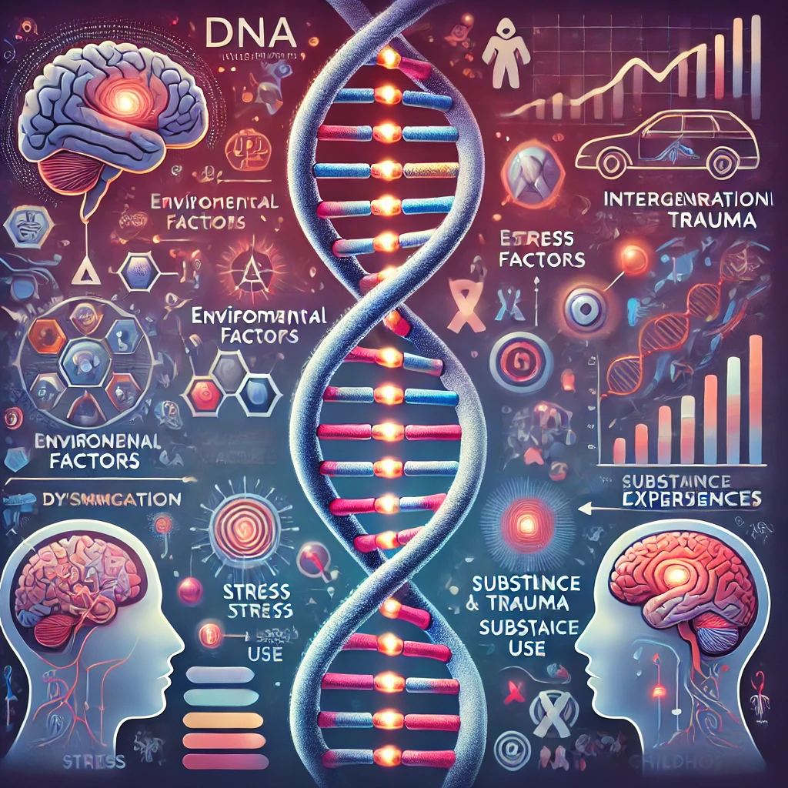
Epigenetics and Addiction Vulnerability
Environmental factors—such as stress, trauma, substance use, and early childhood experiences—can trigger epigenetic modifications, affecting how genes related to stress response, emotional regulation, and addiction vulnerability are expressed. (Zhang & Meaney, 2010).

Slide 21
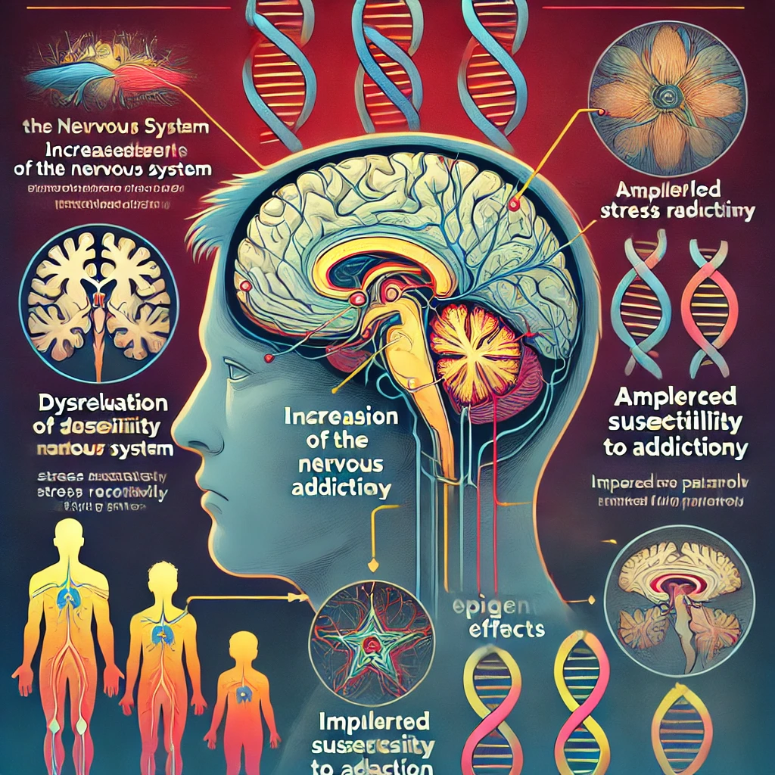
Epigenetics:
A Trauma Informed Perspective
For people with a history of trauma, these epigenetic changes can lead to:
Dysregulation of the nervous system,
Increasing susceptibility to addiction by amplifying stress reactivity
Impairing impulse control
Altering reward pathways.
Trauma, particularly Adverse Childhood Experiences (ACEs), has been linked to long-term epigenetic effects that contribute to addiction risk across generations(Yehuda & Bierer, 2009).

Slide 22
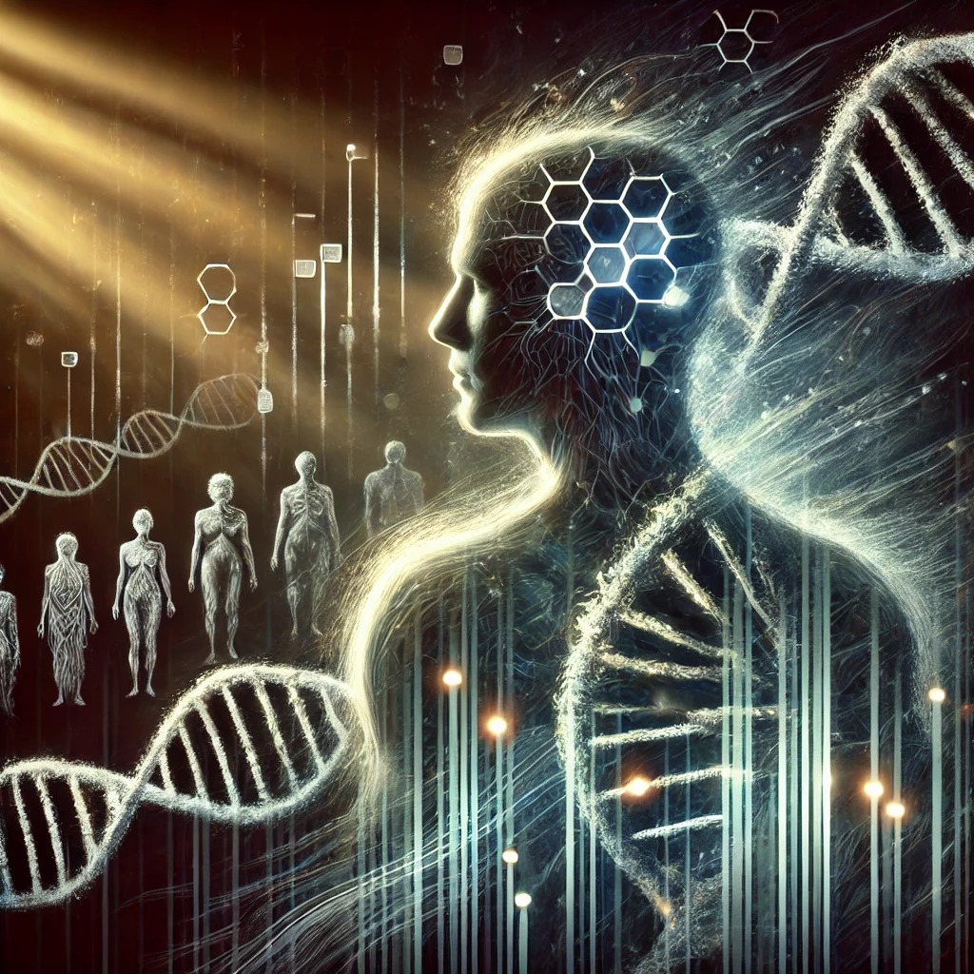
This Means…
People with historical trauma may have certain chemical tags turned on that make them more susceptible to mental health disorders such as depression, anxiety, PTSD and Addictive Disorders.
When those tags are turned on it changes our ability to access cognitive resources as blood flow and energy are being redirected to parts of the body that are perceiving the threat.

Slide 23
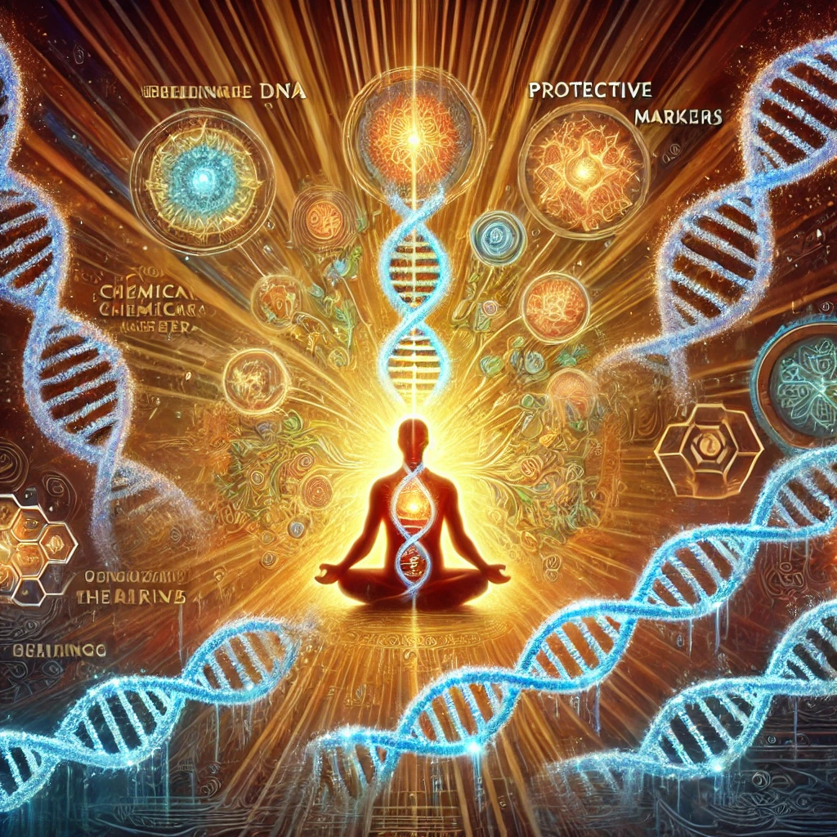
This also means…
Historical trauma is reversible.
Resiliency can be created through continuous meaningful experiences that turn protective chemical tags on.
It explains what we already know as Native people….when we heal….we heal 7 generations back and 7 generations forward.
Science is finally catching up with what our ancestors knew and what we have passed down in oral traditions for thousands of years.
The power to heal is inside of us.

Slide 24
How do we reverse Epigenetic Markers?
Clinical Implications for Trauma-Informed Addiction Treatment
Normalize and Destigmatize – Addiction is not just a behavioral issue; it has biological, psychological, social and spiritual roots.
Regulate the Nervous System – Since trauma impacts gene expression in stress-response systems, interventions like somatic therapy, EMDR, mindfulness, and polyvagal-informed approaches can help stabilize dysregulated physiology
Promote Neuroplasticity and Healing – Epigenetic markers are modifiable. Safe, supportive relationships, nutritional interventions, breathwork, and mind-body practices can help reverse stress-induced epigenetic changes
Address Intergenerational Trauma – Many clients struggling with addiction may carry ancestral and historical trauma encoded in their biology. Integrating cultural healing, ceremony, and Indigenous wisdom can be a powerful tool for repair
(Duran, 2019; Gibson, 2008; Gone, 2013;Yliniemi, Malott, Riegert, & Branco, 2024).

Slide 25
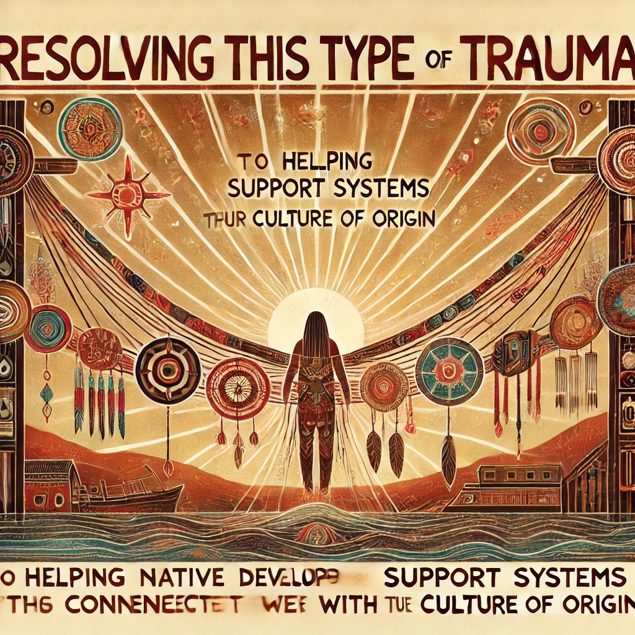
Healing Historical Trauma
Resolving this type of trauma requires helping Native people to develop support systems/bridges that connect Native peoples with their culture of origin.
(Brave Heart, Chase, Elkins, Altschul, 2011)(Chong, & Lopez, 2005)(Griner, & Smith, 2006).

Slide 26
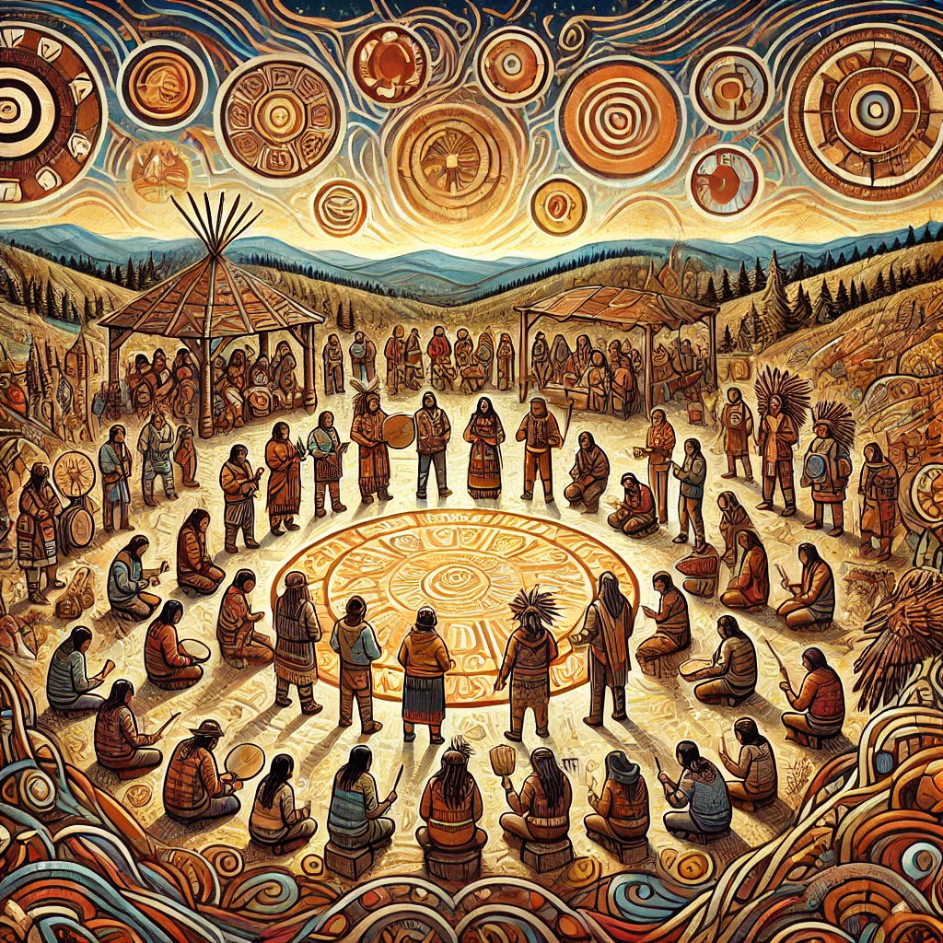
Restoring Collective Identity
Reconnecting Native people to their cultural roots, including values, traditions, language, songs, spirituality, and community, helps to restore cultural identity and mental wellness.
(Brave Heart-Yellow Horse et al., 2016a; Gone, 2014, 2019a; Marsh, Coholic, Cote-Meek, &amp; Najavits, 2015a; Nelson-Barber &amp; Johnson, 2016; Robbins et al., 2016).

Slide 27
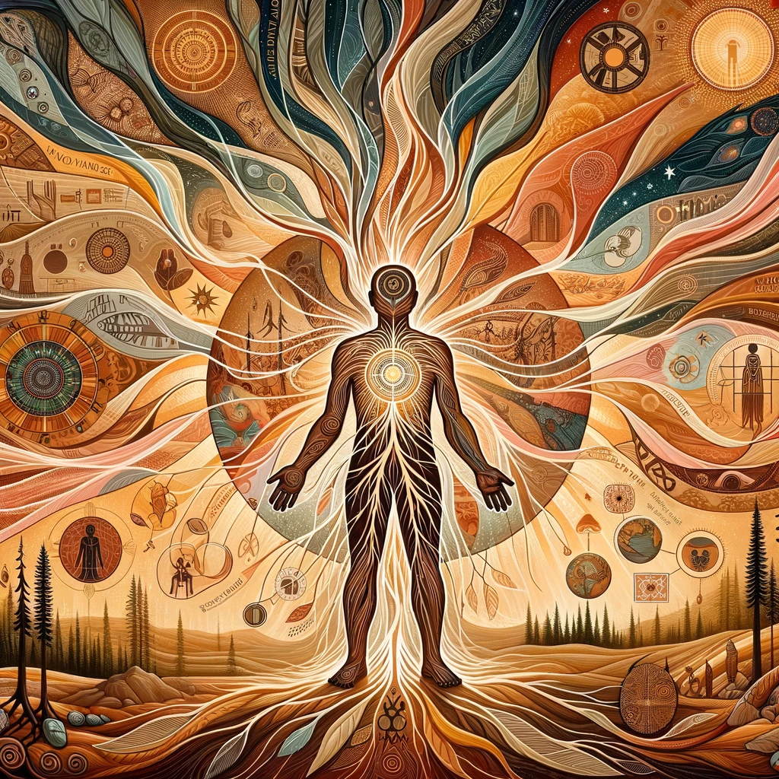
Quote from Dr. Ruby Gibson
Trauma happens when we lose our voice, choice & power
Healing happens when we reclaim our voice, choice and power
(Gibson, personal communication, 2021)

Slide 28

Researched Methods of Culturally Competent and Trauma Informed Healing for Native people
Healing the Soul Wound- Practices recognizing old ceremonies, creating new ceremonies, naming ceremonies, dream work (Duran, 2019).
Somatic Archaeology -Excavating the trauma stories as well as the healing path from our DNA (Gibson, 2008)
Drum Assisted Recovery Treatment for Native Americans- using drumming protocol and practices for building belonging, connection and personal/collective mastery(Dickerson, Venner, Duran, Annon, Hale, & Funmaker, 2014).
Ceremony Assisted Treatment –Ethically sourced Indigenous healing ceremonies offer spiritually oriented interventions that maintain client wellness or mitigate client existential, biopsychosocial, or spiritual distress. ( Julie Smith-Yliniemi, Krista M. Malott, JoAnne Riegert, & Susan F. Branco, 2024).

Slide 29

What do these methods have in common?
All recognize that healing begins with a ceremonial recognition of the spirit of the concern aka the Spirit of Addiction/ the Spirit of Trauma
Facing and allowing the presence of the Spirit of Addiction long enough to correct the relationship to one of respect.
Emphasize accessing The Spirit of Healing -a part of One’s Self that is already spiritually aligned and capable of self-healing
Learning to trust that part of Self and inviting it to be in charge again
Views on diagnosis as naming ceremonies

Slide 30
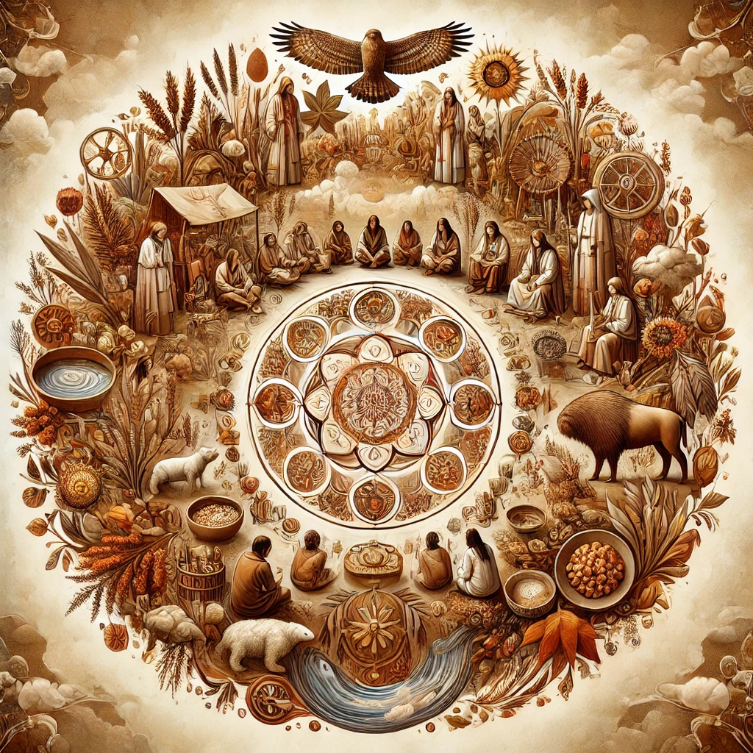
What do these methods have in common?
Ceremony.
Life is viewed as a ceremony.
Relationship is viewed as a ceremony.
We are in relationship with everything (land, water, food, animals each other).
Even bad habits and diseases can be viewed as ceremony (albeit unconscious ones).
Healing is ceremony.
We require a new ceremony to undo an old ceremony

Slide 31
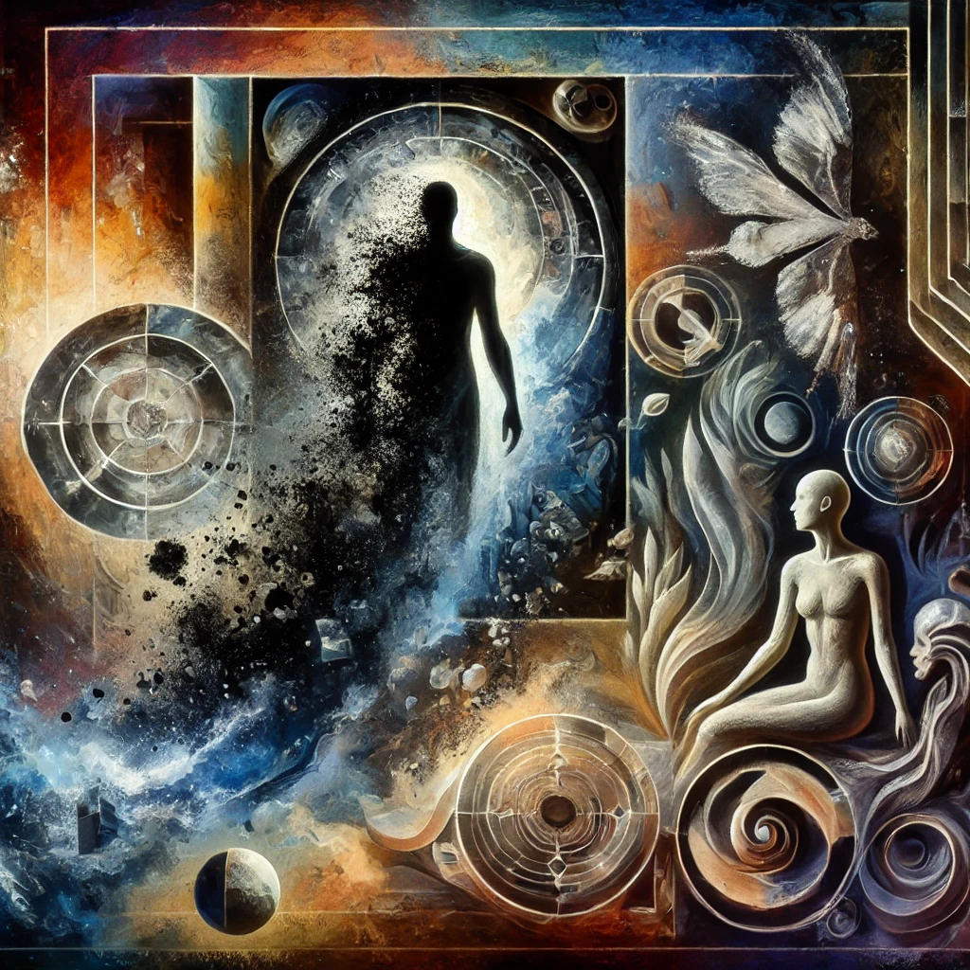
Dr. Duran’s Soul Healing Work
When the Soul is wounded it goes back into the “black world” (Duran, 2019). The unconscious. Psychological regression…creates a “huge spiritual gap” in the person who has been wounded.
Natural law dictates that soul or spirit seeks itself-that person begins to “seek spirit” albeit from an ego (wound) based perspective.
Spiritual Emptiness= vulnerability to addiction in Native people.
Duran, E. (2019). Healing the soul wound

Slide 32
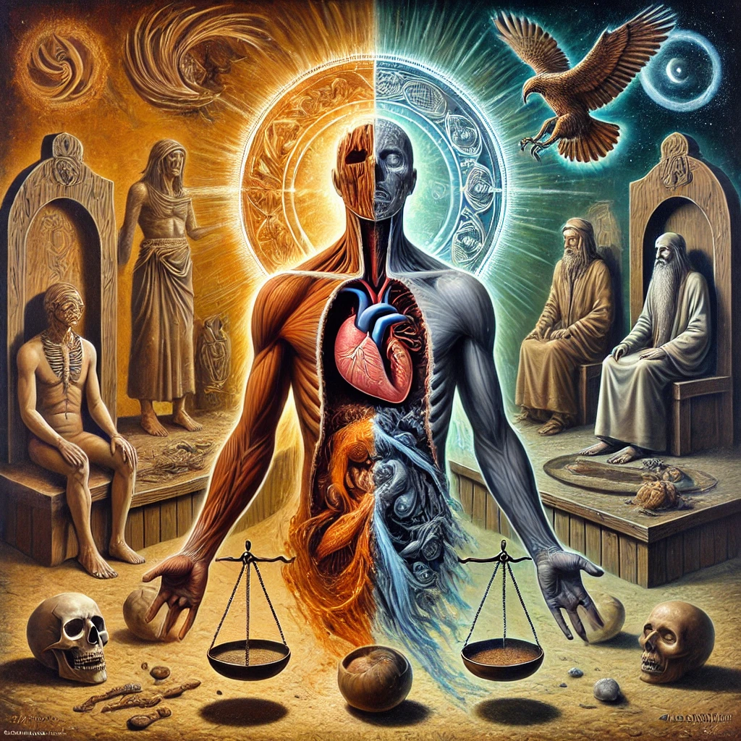
Healing Soul Wounding
Historical trauma leaves a gaping void in the soul/psyche of the person
In some traditions, there is an exchange between the spirit of addiction and the persons soul-balance of give and take
This requires a ceremony to undo this exchange.
Duran, E. (2019). Healing the soul wound

Slide 33
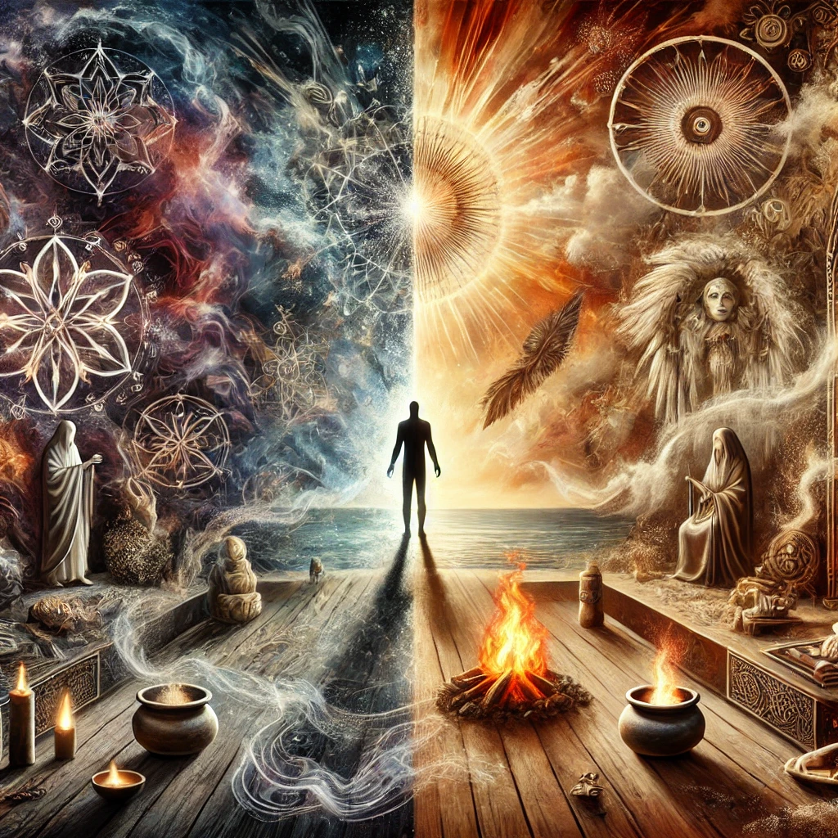
Healing the Soul Wound
Psycho-therapist= Soul healer Counseling/Psychotherapy is a Ceremony
Addiction is a Spiritual Matter.
All mental health symptoms are a result of spiritual imbalance.
All imbalance is created through ceremony.
All healing (restoration of balance) happens through creating a new ceremony (making an offering to the spirit of….(name the addiction).
(Duran, 2019)

Slide 34
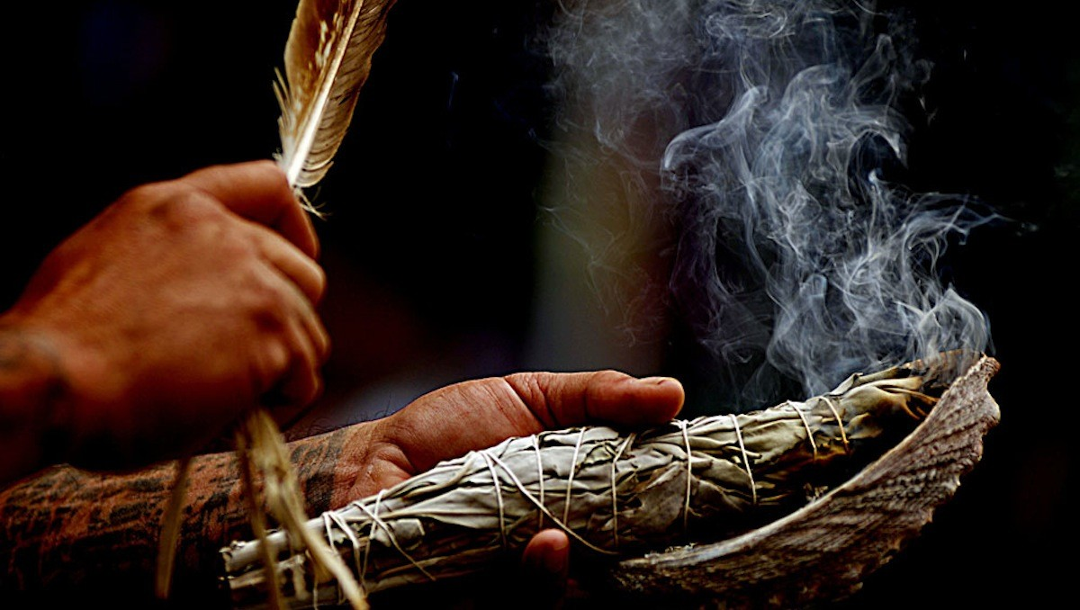
Dr. Gibsons Somatic Archaeology Work
Accessing “Seventh generation memory” (Gibson, 2008).
Cherokee people understand this as ancestral memory
  It is reflected in our creation stories which remind us that our ancestors are from the Star Nations.
We must slow down.
Slowing down our sense of time and movement helps one to better attend to the needs and impulses of the body.
  Not only is the trauma stored there but also the healing remedy.
  Healing Happens in the NOW!

Slide 35

Somatic Storykeeping
The body is the “custodian of stories”
Somatic storytelling is a “sacred job”.
Looking at patterns over the timeline and prepare the psyche for excavation of those stories.
Similar to Buddhist and Hindu philosophies of Karma and Dharma, Native American spiritual perspectives of spiritual rebirth and how and why and when healing happens are part of our Earth walk.
By facing whatever there is to face karmically in the stories, energy is then freed up to energize one’s divine path, or Dharma.
Gibson, (2008) My Body My Earth.

Slide 36
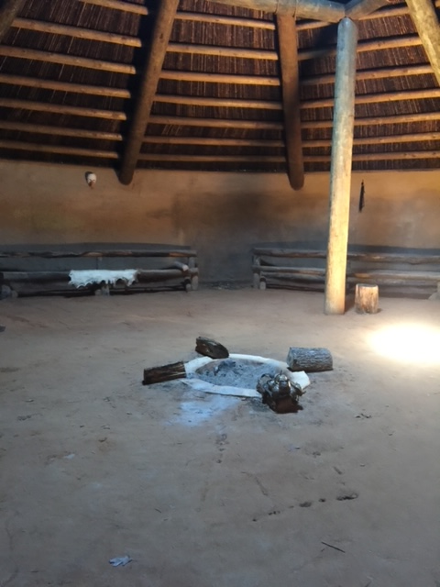
Do not to be afraid of your story
We begin with the breath- helps access these innate healing energies.
One main goal-to be present
Breathe-Connect with our bodies
Ground-Connect with the earth’s body
Settle deeper into the body
Invite the ancestors/spirit team
Gibson, (2008) My Body My Earth.

Slide 37

5 steps of Somatic Archeology
I Notice-observing the body inside and out
I Sense-intuitively sensing an entry point
I Feel-becoming present with the feeling experience physically and emotionally
I Interpret- understanding and changing the narrative
I Reconcile- Who am I now?
Experiential Activity-
Gibson, (2008) My Body My Earth.

Slide 38
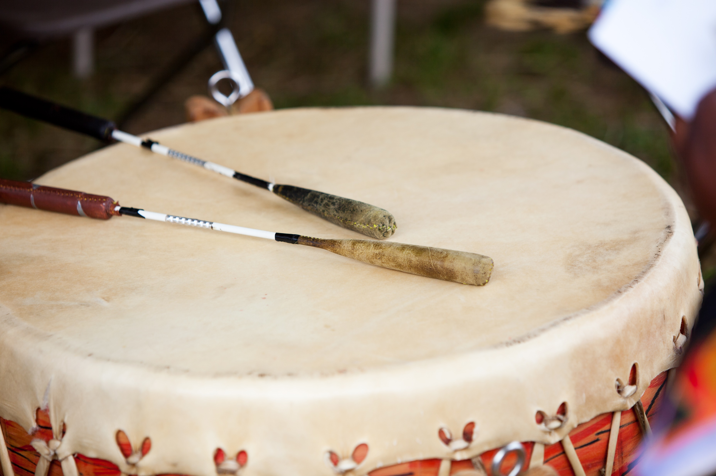
Drum Assisted Recovery
Belonging-Initiation to the drum and lifetime commitment.
Mastery-Mastering tribal language and drumming techniques as well as learning the medicine.
Interdependence-Being in relationships with each other and the drum.
Generosity-Being of service and teaching the next generation.
(Moorehead, Gone & December, 2015).

Slide 39
Healing the Spirit of Addiction
Simple but powerful process.
Offering medicine (tobacco or cornmeal)-The access medicine-Story of how humans got tobacco
Begins with a new ceremony-offer the tobacco, cornmeal, song
Continues with excavating the trauma from the body and soul-
Completes with a new naming ceremony and asking the question who am I now with this new name and purpose?
( Duran, 2019, Gibson,2008)

Slide 40
Experiential Activity
Think of something you have been wanting to heal in yourself.
Maybe something you’ve been avoiding or procrastinating.
Maybe something you felt like you had no control over.
Imagine making an offering to the spirit of that something. Use a metaphor if that is helpful (In Narrative and Solution Focused theory we call this externalizing the problem).
Ask to heal the relationship. Be careful not to try and get rid of it. Allow it to be there. Recognize what it has taught you. Offer respect.
Then make a second offering to the spirit of healing.
Ask the spirit of healing to help mediate the relationship with the spirit of ( name the concern-addiction)…..

Slide 41

Questions/Reflections
What are your take-aways from today?

Slide 42
My contact info.
Dr. Tonya Elliott PhD LMFT
Dr.elliott@soulgardenwellness.com
telliott@ulm.edu
530-307-0101
Bringingmedicine.org

Slide 43
References and Resources
Bemme, D. (2019). Finding “What Works”: Theory of Change, Contingent Universals, and Virtuous Failure in Global Mental Health. Culture, Medicine & Psychiatry, 43(4), 574–595. https://doi-org.ulm.idm.oclc.org/10.1007/s11013-019-09637-6
Brave Heart, M.,Yellow Horse, Chase, J., Elkins, J., & Altschul, D. B. (2011). Historical trauma among indigenous peoples of the Americas: Concepts, research, and clinical considerations. Journal of Psychoactive Drugs, 43(4), 282-290. doi:10.1080/02791072.2011.628913
Brokenleg, M. (2012). Transforming cultural trauma into resilience. Reclaiming Children and Youth, 21(3), 9-13. Retrieved from http://search.proquest.com.library.capella.edu/docview/1326253617?accountid=27965 Example 3, p.1999.
Gibson, R. 2008. My Body My Earth iUniverse Books. Bloomington, Indiana
Dickerson, D. L., Venner, K. L., Duran, B., Annon, J. J., Hale, B., & Funmaker, G. (2014). Drum-assisted recovery therapy for Native Americans (DARTNA): Results from a pretest and focus groups. American Indian and Alaska native mental health research (Online), 21(1), 35–58. doi:10.5820/aian.2101.2014.35
Duran, E. (2019). Healing the soul wound: Trauma-informed counseling for Indigenous communities. New York, NY: Teachers College Press.
Elliott, T. E. (2020). Otsigeya: Understanding historical trauma and Native American Women’s experiences of cultural restoration (Order No. 27999093). Available from ProQuest Dissertations & Theses Global. (2421517147). https://www.proquest.com/dissertations-theses/otsigeya-understanding-historical-trauma-native/docview/2421517147/se-2

Slide 44
References Cont.
Kong, G., Smith, P. H., Pilver, C., Hoff, R., & Potenza, M. N. (2016). Problem-gambling severity and psychiatric disorders among American-Indian/Alaska native adults. Journal of Psychiatric Research, 74, 55–62. https://doi-org.ulm.idm.oclc.org/10.1016/j.jpsychires.2015.12.004
Momper SL, & Jackson AP. (2007). Maternal gambling, parenting, and child behavioral functioning in Native American families. Social Work Research, 31(4), 199–209. https://doi-org.ulm.idm.oclc.org/10.1093/swr/31.4.199
Manderino, D. D. (2014). A constructivist approach to promoting spiritual competencies in counselor trainees (Order No. 3632876). Available from ProQuest Dissertations & Theses Global. (1608969826). Retrieved from http://search.proquest.com.library.capella.edu/docview/1608969826?accountid=27965
Patterson-Silver Wolf Adelv Unegv Waya, D. A., Welte, J. W., Barnes, G. M., Tidwell, M.-C. O., & Spicer, P. (2015). Sociocultural Influences on Gambling and Alcohol Use Among Native Americans in the United States. Journal of Gambling Studies, 31(4), 1387–1404. https://doi.org/10.1007/s10899-014-9512-
Pyłypczuk, A., Makara- Studzińska, M., & Urbańska, A. (2011). Gambling- causes, diagnosis, criteria, spreading. Current Problems of Psychiatry, 12(3), 333–340.

Slide 45
References Cont.
Shaw, B. M., Bayne, H., & Lorelle, S. (2012). A constructivist perspective for integrating spirituality into counselor training. Counselor Education and Supervision, 51(4), 270-280. Retrieved from http://search.proquest.com.library.capella.edu/docview/1269157441?accountid=27965
Julie Smith-Yliniemi, Krista M. Malott, JoAnne Riegert, & Susan F. Branco. (2024). Utilizing Collective Wisdom: Ceremony-Assisted Treatment for Native and Non-Native Clients. Professional Counselor, 13(4), 448–461.
Soto, C., West, A. E., Ramos, G. G., & Unger, J. B. (2022). Substance and Behavioral Addictions among American Indian and Alaska Native Populations. International Journal of Environmental Research and Public Health, 19(5). https://doi.org/10.3390/ijerph19052974
Whitbeck, L. B., Adams, G. W., Hoyt, D. R., & Chen, X. (2004). Conceptualizing and measuring historical trauma among American Indian people. American Journal of Community Psychology, 33(3), 119–130. doi:10.1023/B:AJCP.0000027000.77357.31

