Slide 1

Gambling Addiction: Trends in Treatment,
Public Health, and Gambling
Welcome to

Slide 2
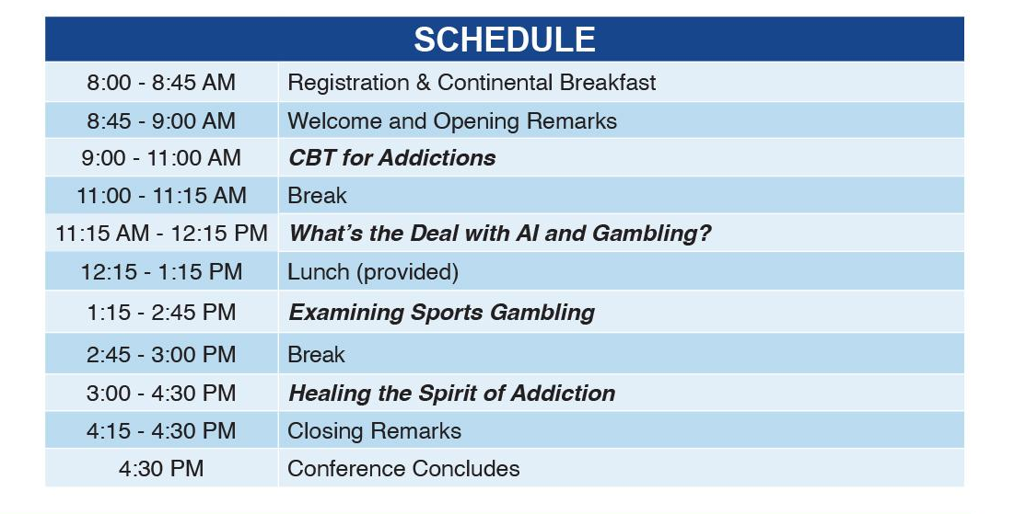

Slide 3
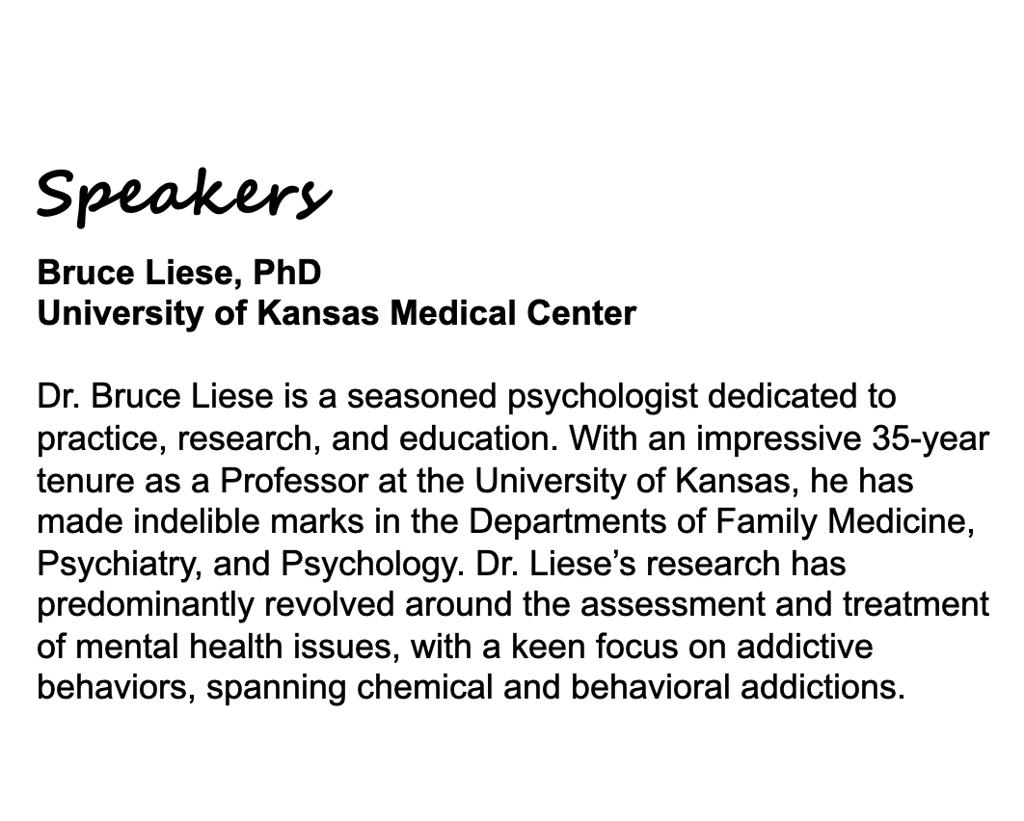
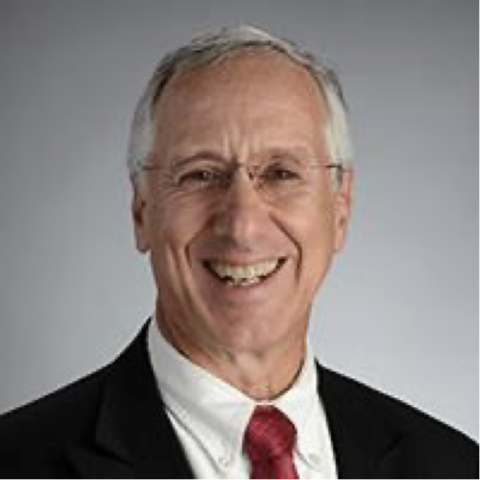

Slide 4
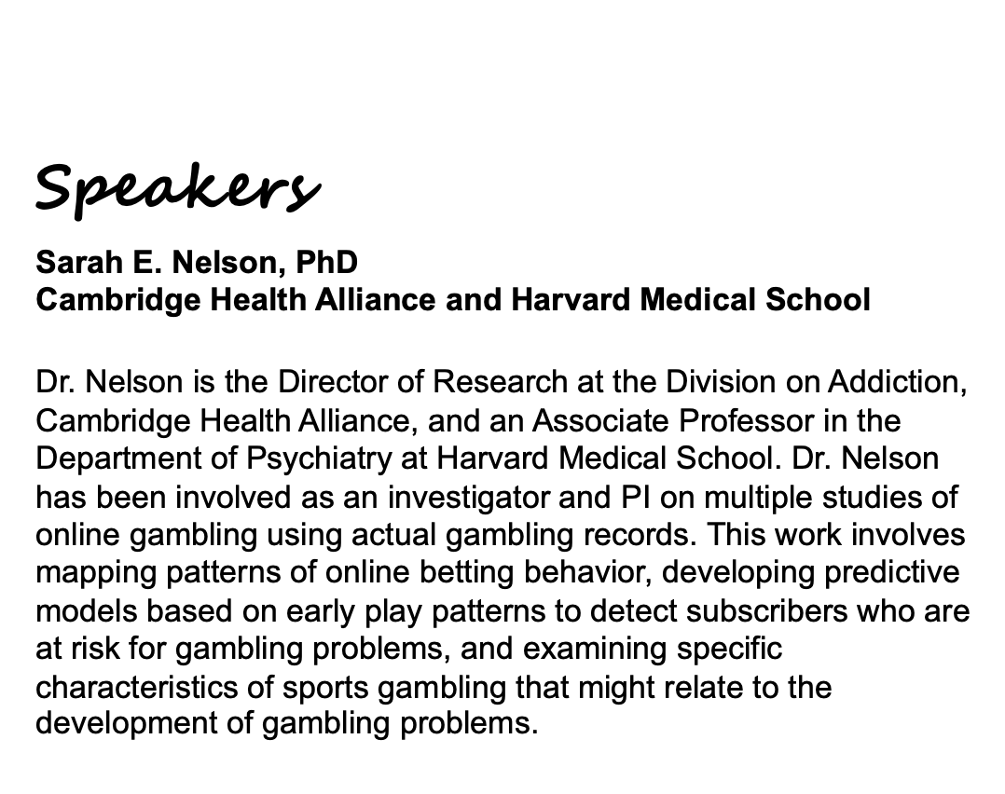
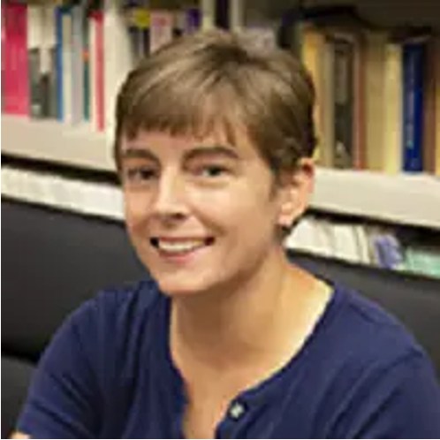

Slide 5
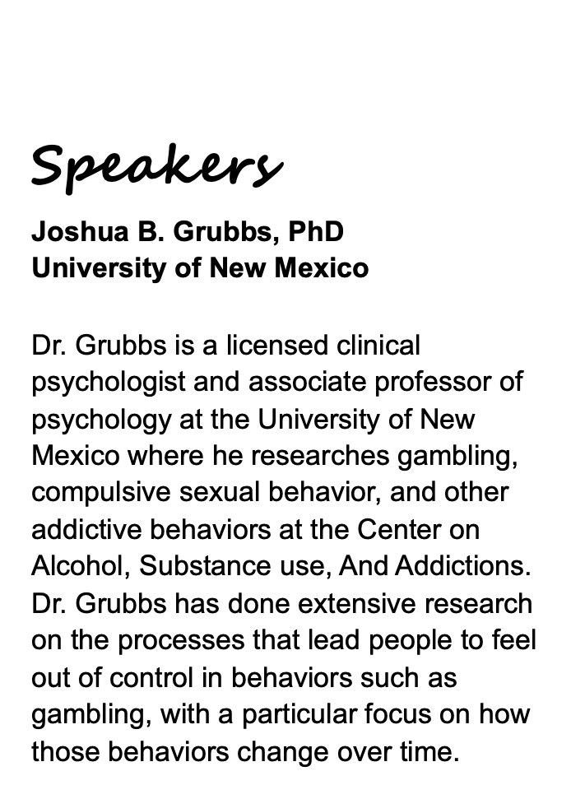
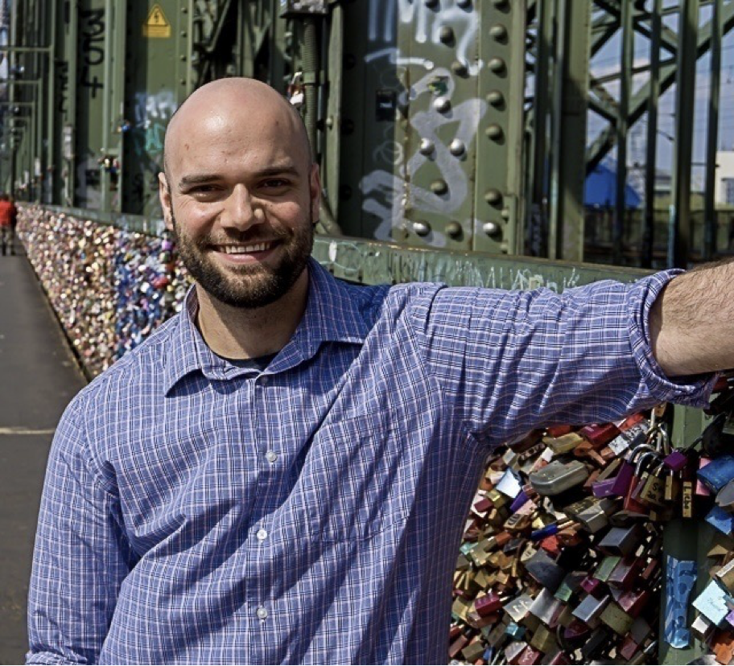

Slide 6

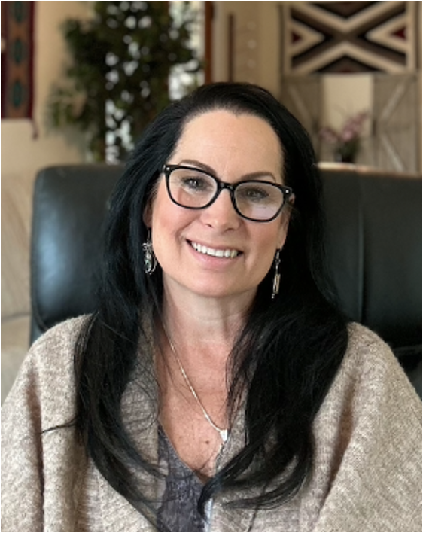

Slide 7
Access
Speaker Presentations
https://www.icrg.org/events
and click on this event

Slide 8
Continuing Ed Hours
Please fill out the emailed survey you will receive after the conference. This will expedite your CE Hours Certificate.
The process takes two to three weeks.
Attendees will earn five CE hours approved by NBCC, NAADAC, and NASW-Florida. The ICRG is approved by the American Psychological Association to sponsor continuing education for psychologists. The ICRG maintains responsibility for this program and its content.

